Slide 1
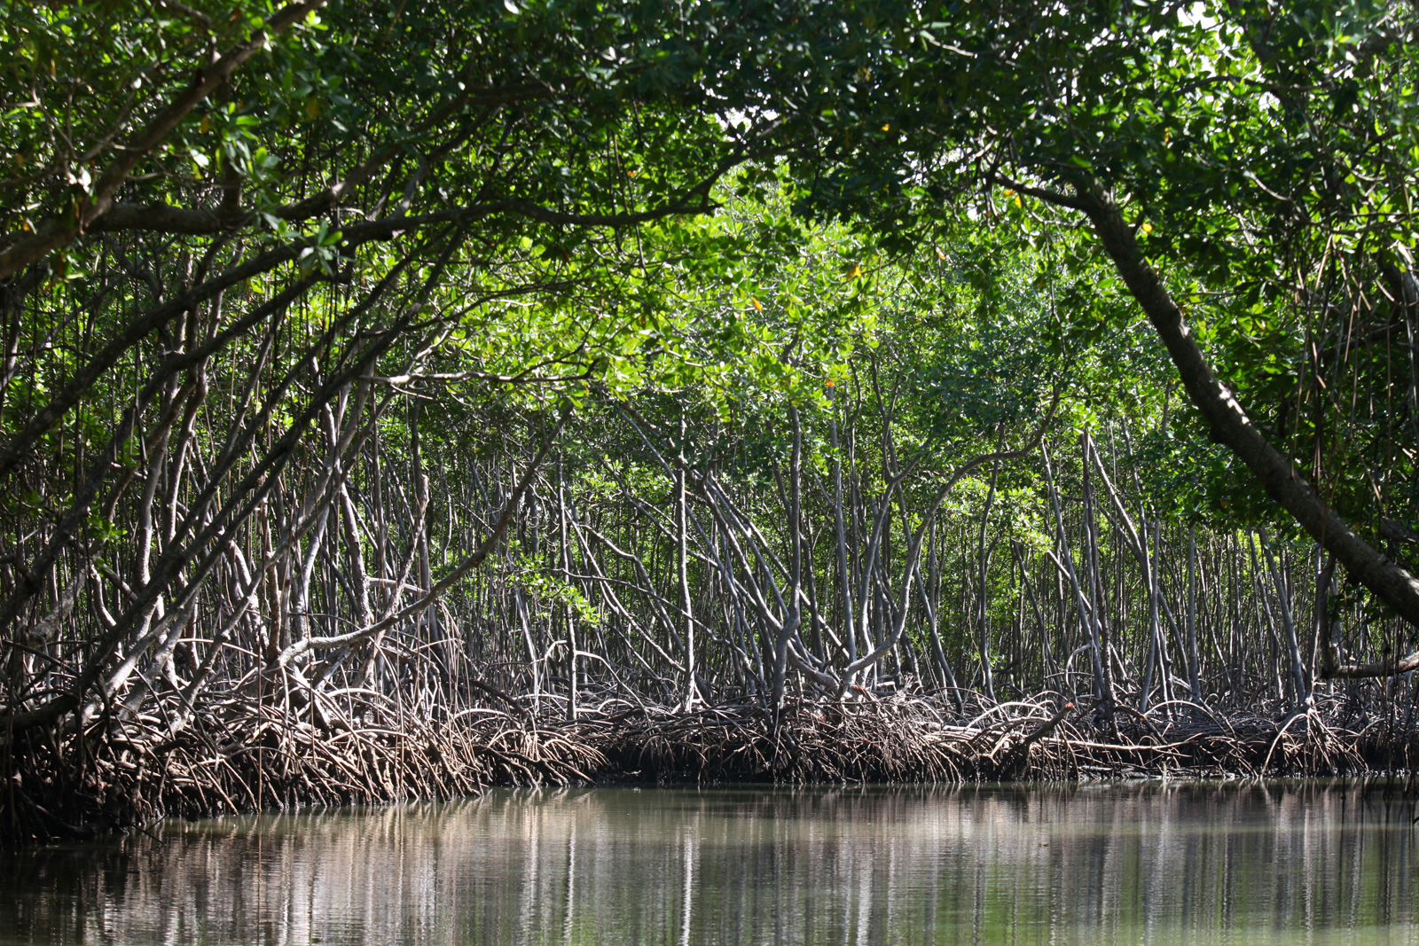
2: ENGAGEMENT
Conservation Stewards Program
Notes:
Session title

Slide 2
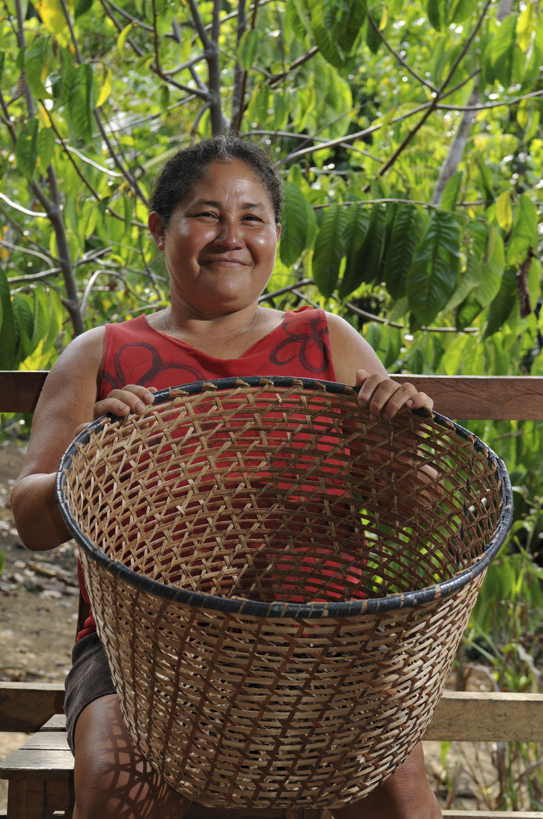
CONSERVATION AGREEMENT
MODEL
a negotiated exchange of benefits in return for changes in resource use, depending on verified performance
Notes:
Repeat basic definition of the CA model, to reinforce big picture concept

Slide 3
PROJECT CYCLE TOWARD SUSTAINABILITY
STEP 1
STEP 4
Feasibility Analysis
Monitoring
Renegotiation
Implementation
STEP 2
Conservation Agreement
Engagement
STEP 5
STEP 3
Design & Negotiation
Secure Financing & Management
Notes:
Reminder of steps in application of the CA model, show that this session is about the second step. Purpose: ensure that community (and other key stakeholders) understand the approach, as well as motivations for the project, and seek community consent/agreement to proceed to next steps

Slide 4
RIGHTS-BASED APPROACH
(RBA) PRINCIPLES
Respect human rights
Promote human rights and wellbeing
Protect the vulnerable
Encourage good governance
Work in partnership
Notes:
Key principles of RBA (at least CI’s version, but something like this will be common to most organizations that embrace RBA). Given that CAs are all about working with communities, these principles are especially important.

Slide 5
RBA POLICIES
No illegal logging
No illegal hunting
Agriculture follows land-use plan
No burning or nets around nests
Community forest patrols
Notes:
CI has developed policy documents addressing several important topics with respect to rights of specific groups, and other specific issues, relevant for RBA. Working with the SPP team, CSP has incorporated these principles and best practices into the model.

Slide 6
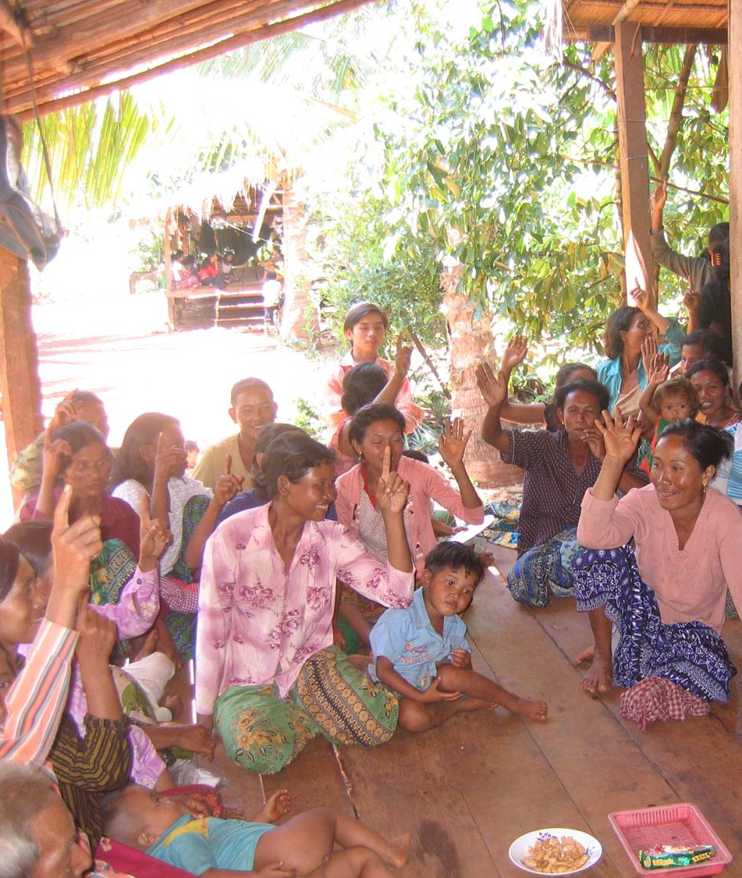
ENGAGEMENT
Free
Prior
Informed
Consent
FPIC
Notes:
FPIC – this slide is essential for the CA approach. Free, Prior and Informed Consent – FPIC – is central to the model as it is about voluntary participation on the part of communities, based on a complete understanding of what the deal is … the agreement cannot go forward unless you have determined and documented that everyone in the community understands it, and a critical number of people agree on it. Critical number does not need to mean everyone, but a simple majority (just over 50%) is probably not adequate either. Often the implementer must work with the community to identify the acceptable minimum number of community members in support of the CA.

Slide 7
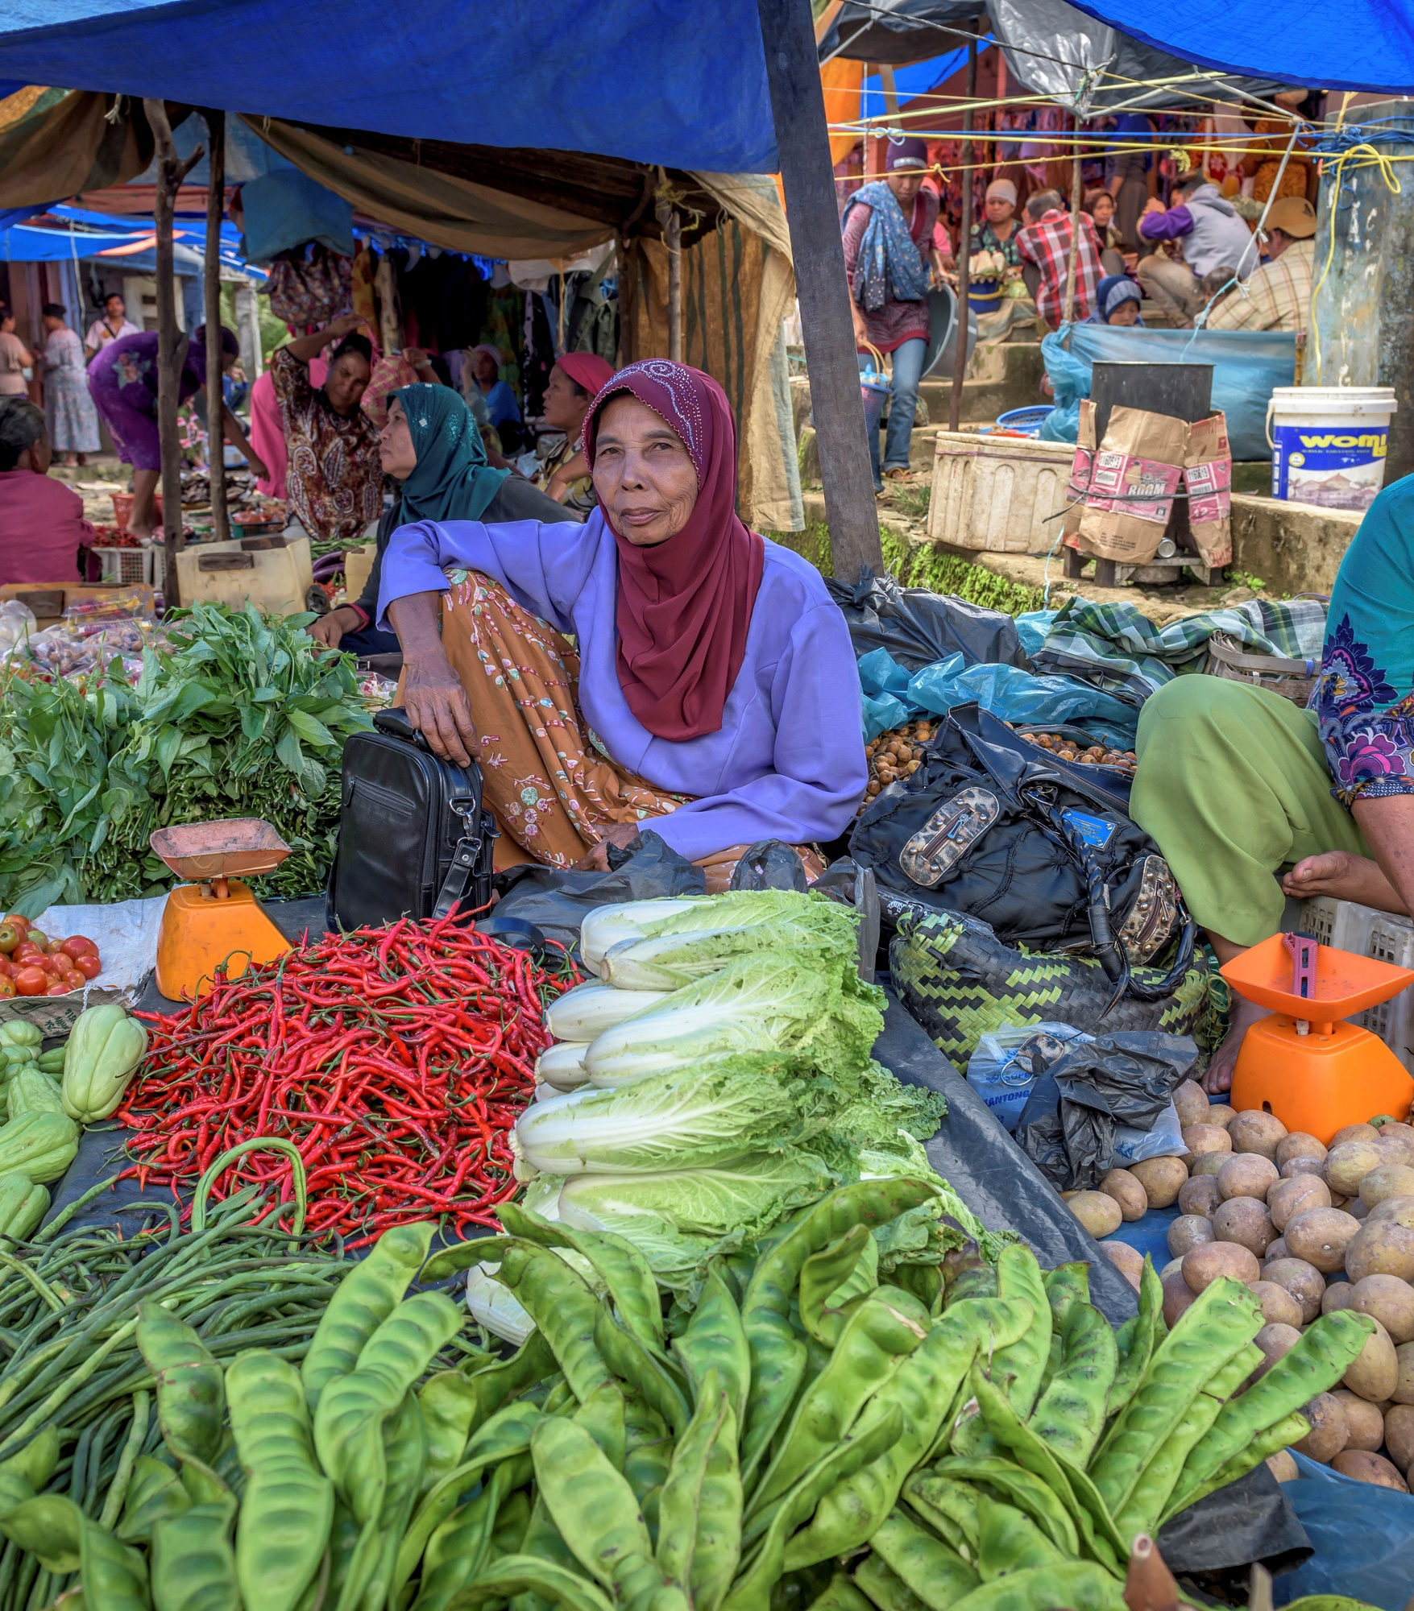
GENDER
Men and women use resources differently
They have different access to information and decision-making
Considering gender helps ensure equitable benefits
Who uses the resources?
How is information shared?
Who makes decisions?
Notes:
Engagement (and later design and every other step and activity in the CA) must take into account gender differences. Since men and women have different roles in resource use, in community governance, in managing household finances, and more, the different needs, priorities, perspectives, and ways of participating in a CA need to be examined and incorporated. In some projects, this means deliberately empowering women by assigning specific roles, or by insisting on ways for them to participate in consultations and decision-making. It can be challenging to strike the right balance between advancing women’s status and respect local norms and traditions; see the case studies provided in Supplementary Materials and CI’s guidance on gender within RBA for reflections on overcoming this challenge.
Because of social and cultural norms, men's and women's access to information and decision-making structures may be different
Within the Conservation Agreement model we want to make sure that everyone impacted by the agreement is involved in decision-making and ensure that benefits are equitable and that nobody is harmed.
Therefore we need to understand how men and women use the resources that the CA seeks to protect, and make sure that decision-making is equitable.
And while many of you may already have some focus on gender within your CAs, we want to be more systematic and explicit about it
That's why we've worked with CSP to integrate gender into the new CA model
We're also working with several CI programs to assess how gender has been incorporated and how to improve implementation (see handout)

Slide 8
STAKEHOLDER PROCESS
Understand the different groups relevant to project
Verify initial stakeholder information collected for feasibility analysis
Ensure all parties are appropriately involved
Define steps to create or strengthen relationships or address conflicts
Update analysis throughout negotiation and design
Notes:
Two key points to emphasize with respect to stakeholder process are that the community cannot be viewed or treated as a single, homogenous entity but is composed of multiple groups with different perspectives, needs and priorities (men/women, young/old, farmers/hunters/traders, etc.), and community resource management does not take place in a vacuum – many other relevant parties need to be considered in the CA strategy (private landowners, many government agencies, other NGOs working in the area, companies operating nearby, etc.). Some relationships will be critical, requiring specific plans and strategies to maintain or strengthen the relationship. Each actor and each relationship is complex, and the implementer will continually learn more about them, requiring frequent updating of stakeholder analyses. See Stakeholder Mapping handout.

Slide 9
ENGAGEMENT PROCESS
Select team
Prepare engagement plan
Exchange ideas
Verify understanding of model
Joint decision to continue
Notes:
The basic steps of the engagement process are fairly intuitive. A few points: keeping the engagement team stable makes it easier to develop a positive relationship with stakeholders; engagement requires planning and preparation, you can’t just show up at a meeting and say “ok, what shall we talk about?”. You need an agenda, meeting objective, handouts, talking points, initial thoughts on follow-up steps, etc. (see Engagement handout). The critical thing to achieve during the engagement process is that everyone shares an understanding of how the project is going to evolve; you have to make sure that people don’t mean different things when they say “CA”!

Slide 10
ENGAGEMENT PROCESS
OUTPUTS:
Engagement plan
Documented FPIC
Joint plan for next steps
Notes:
Outputs: The desired outcome is that, based on shared understanding, everyone decides together whether or not to go ahead to the next steps – this is one key way in which the CA approach embodies FPIC.

Slide 11
STAKE-
HOLDER
ANALYSIS
men/women
old/young
leaders
hunters/farmers
national/local ministries
agencies
law enforcement
COMMUNITY
GOVERNMENT
environmental development
health
logging
NTFP purchasers
academia
religious
ORGANIZATIONS
COMPANIES
OTHERS
Notes:
As mentioned before, stakeholder analysis is essential to making sure that you are engaging all the actors that need to be evolved, and engaging them in the right ways with respect to how they relate to the project and each other. Here are some categories of stakeholders that may be relevant to your CA project. (The reason this slide is here, rather than after Slide 8, is that it sets up for the stakeholder mapping exercise)

Slide 12
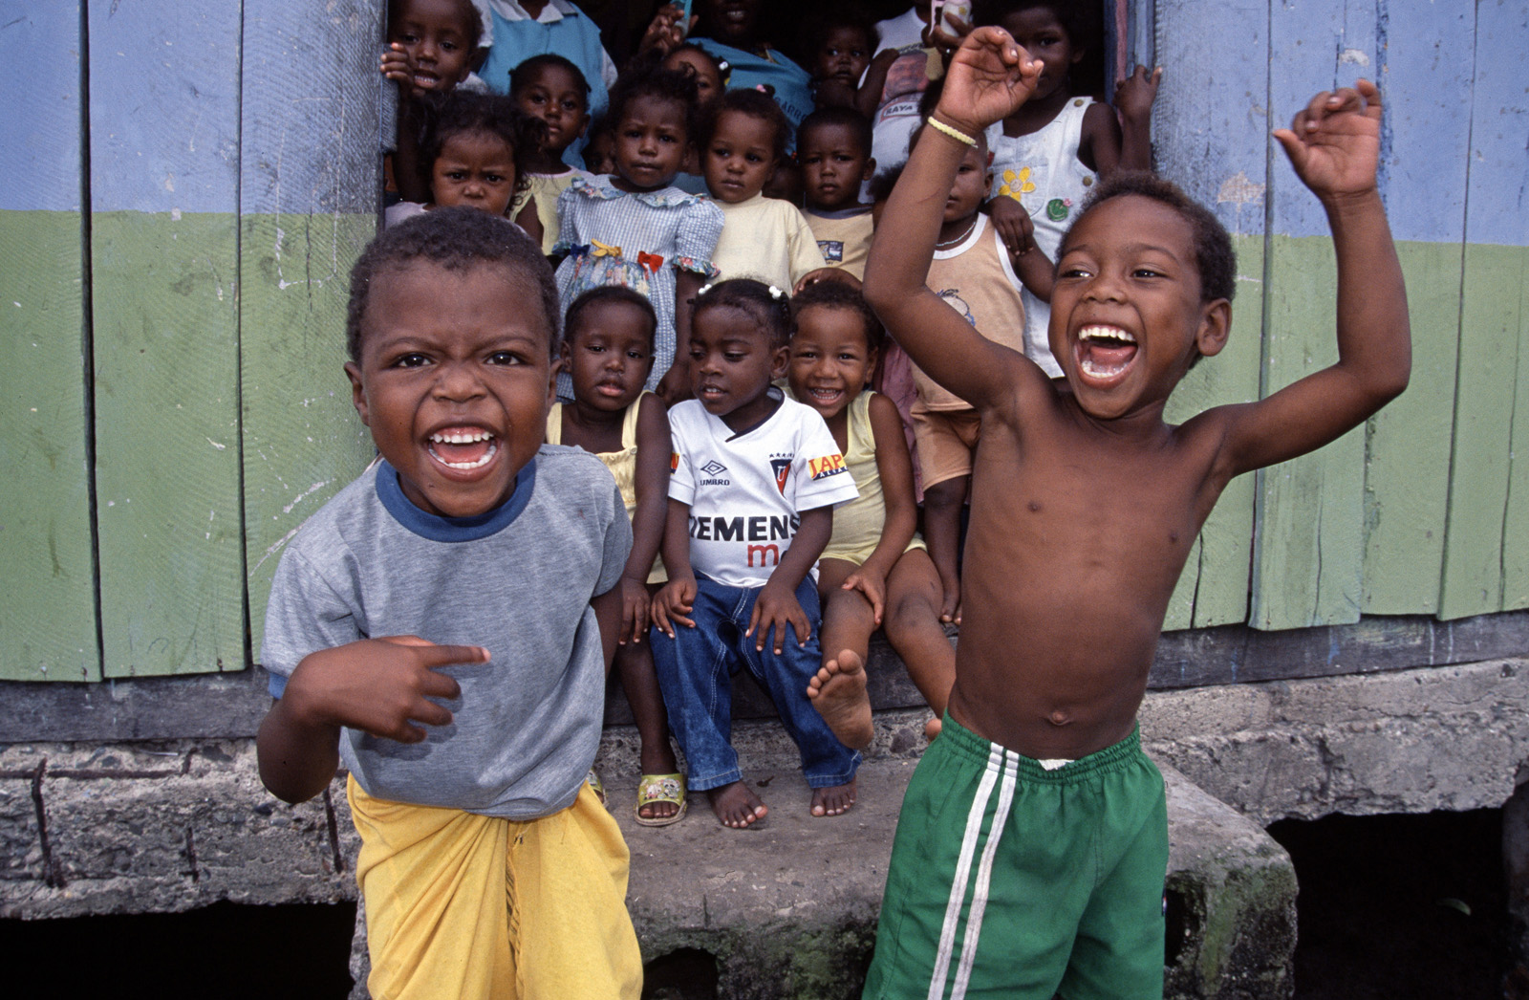
THANK YOU!
Notes:
Closing slide, opens Q&A session.

