Slide 1
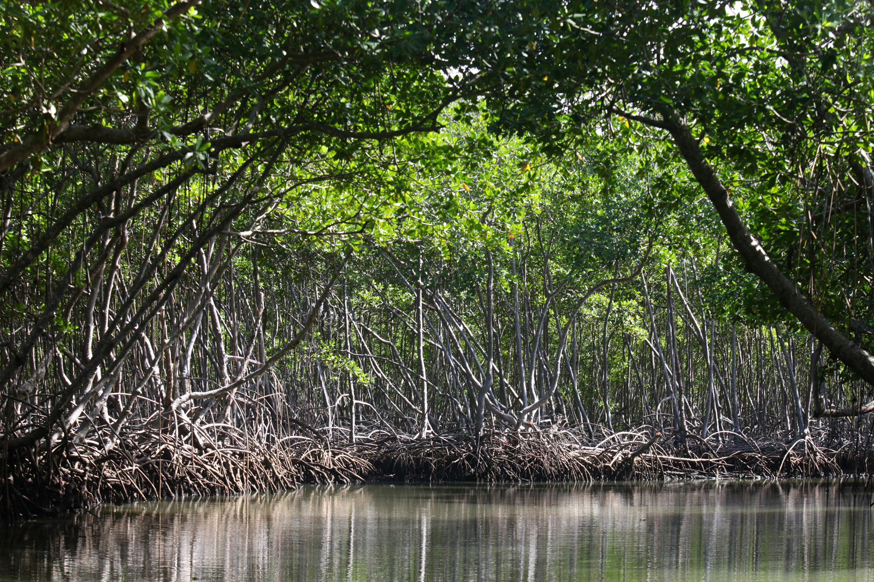
1: FEASIBILITY ANALYSIS
Conservation Stewards Program
Notes:
Session title

Slide 2
PROJECT CYCLE TOWARD SUSTAINABILITY
STEP 1
STEP 4
Feasibility Analysis
Monitoring
Renegotiation
Implementation
STEP 2
Conservation Agreement
Engagement
STEP 5
STEP 3
Design & Negotiation
Secure Financing & Management
Notes:
Reminder of steps in application of the CA model, show that this session is about the first step

Slide 3
4 KEYS
TO CONSERVATION AGREEMENTS
Conservation
Actions
Benefit
Package
Monitoring
Penalties
Notes:
Reiterate the 4 key parts of a CA, the most important take away message from the previous session; when looking at a potential site, the first thought exercise is to come up with initial idea of what these components might be – at least for actions and benefit package – to help frame feasibility analysis

Slide 4
INITIAL IDEA FOR CA
WHAT will we conserve?
WHY is it in danger?
WHAT needs to be done?
WHO can do these actions?
TARGETS
THREATS AND DRIVERS
ACTIONS
STEWARDS
Forest/ biodiversity
Slash and burn for rice production
Reduce slash and burn
Community
Support from government?
Support from other partners?
3,000 hectares
Alternatives?
30 hectares/yr
Notes:
Thinking in terms of targets, threats/drivers, actions, and stewards helps frame first ideas for the CA; these first ideas help frame the feasibility analysis.

Slide 5
FEASIBILITY ANALYSIS
Purpose is to answer the following questions for the site under consideration:
Will a CA work?
Is a CA the best tool?
Is a CA a good investment?
Notes:
The purpose is to build the arguments to answer three essential questions, noting that CAs are not always the right tool, or the most cost-effective tool, for a particular situation.

Slide 6
FEASIBILITY CONSIDERATIONS
Biological importance
Resource rights
Expected costs
Threats
Stakeholders/ conflicts
Financing options
Capacity of stewards and implementers
Political/legal context
Exit strategy
Notes:
9 categories of questions/information to look at when doing the feasibility analysis, ranging from basic physical features of the site to first rough ideas about long-term financial and management sustainability needed for exit strategy for the implementer

Slide 7
FEASIBILITY CONSIDERATIONS
Unavoidable large-scale development
Absent or conflicting property rights
POSSIBLE
DEAL-
BREAKERS
Low donor interest
Extremely high costs
Crowded development context
Notes:
Deal-breakers: there are a number of things that could make a CA impossible at a given site. If costs are extremely high, strategies based on policy/enforcement/regulations may be more appropriate; if the government has committed to huge infrastructure projects such as hydrodams or super highways, it might not make sense to invest in a CA; if there are many other NGOs providing many benefits for free, CA benefit packages might not be an effective incentive; some property rights situations are too unclear or conflicting, so you don’t know who to compensate for behavior change in a way that leads to conservation; some sites are simply too difficult to raise funding for based on the CA model; in addition, if the value of biodiversity or ecosystem services at the site is low, investing in a CA is probably not a good idea …

Slide 8
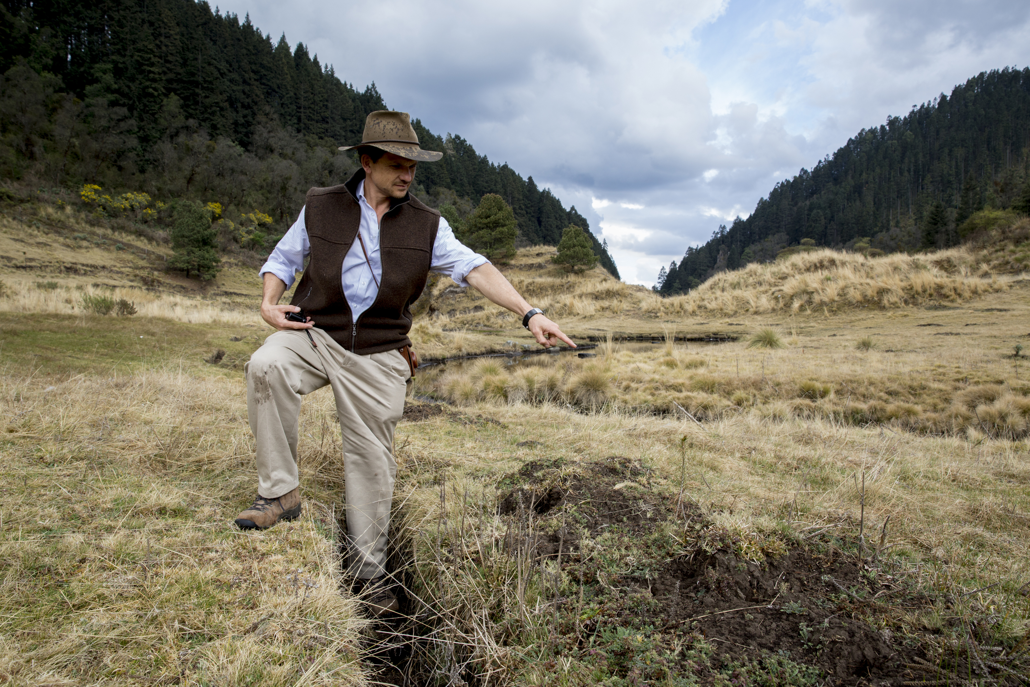
FEASIBILITY CONSIDERATIONS
Critical Challenge
Obtain information while managing expectations
Notes:
Critical challenge: managing expectations. You need to gather information about the community (and other stakeholders) to determine whether an incentive-based deal can be structured to achieve conservation outcomes, identify potential livelihood investments, etc.; however, since you have not yet determined that you will actually do a CA in this place, you have to be very careful not to fuel expectations. Relying on published documentation and local partners can help, but sometimes you can’t avoid doing primary information collection. You need a careful communication strategy that is fair and honest.

Slide 9
BENEFIT PACKAGE
OPPORTUNITY COST OF CONSERVATION
+
=
COST OF PERFORMING CONSERVATION ACTIONS
Notes:
As we indicated in the first session, benefit package has to offset the burden/cost of conservation. This is the sum of the cost of conservation actions (patrolling, monitoring, reforesting, etc.) and opportunity cost of foregone resource use – income lost by not logging, or not converting an area to agriculture, or not hunting/fishing.

Slide 10
CONSERVATION AGREEMENT MODEL
Threats to biodiversity
CONSERVATION AGREEMENT
Opportunity
cost
Conservation
Actions
Benefits
What must the community give up to deliver the conservation outcomes?
Notes:
Technically, the opportunity cost is what the community has to give up in order to achieve the conservation outcomes; thinking about it that way helps figure out how substantial the benefit package must be to secure community interest in conservation

Slide 11
OPPORTUNITY COST OF CONSERVATION
LOSSES ACCOMPANYING THAT ALTERNATIVE
(E.G. BIODIVERSITY, CARBON, WATER, CULTURE, ETC.)
=
-
REVENUE FROM NEXT BEST ALTERNATIVE
(E.G. NET INCOME FROM LOGGING)
Notes:
Technically, the opportunity cost of conservation related to foregone resource use is the income lost by not doing something (like logging or hunting), MINUS the enhanced conservation values from not doing it (like better watershed services resulting from not logging).

Slide 12
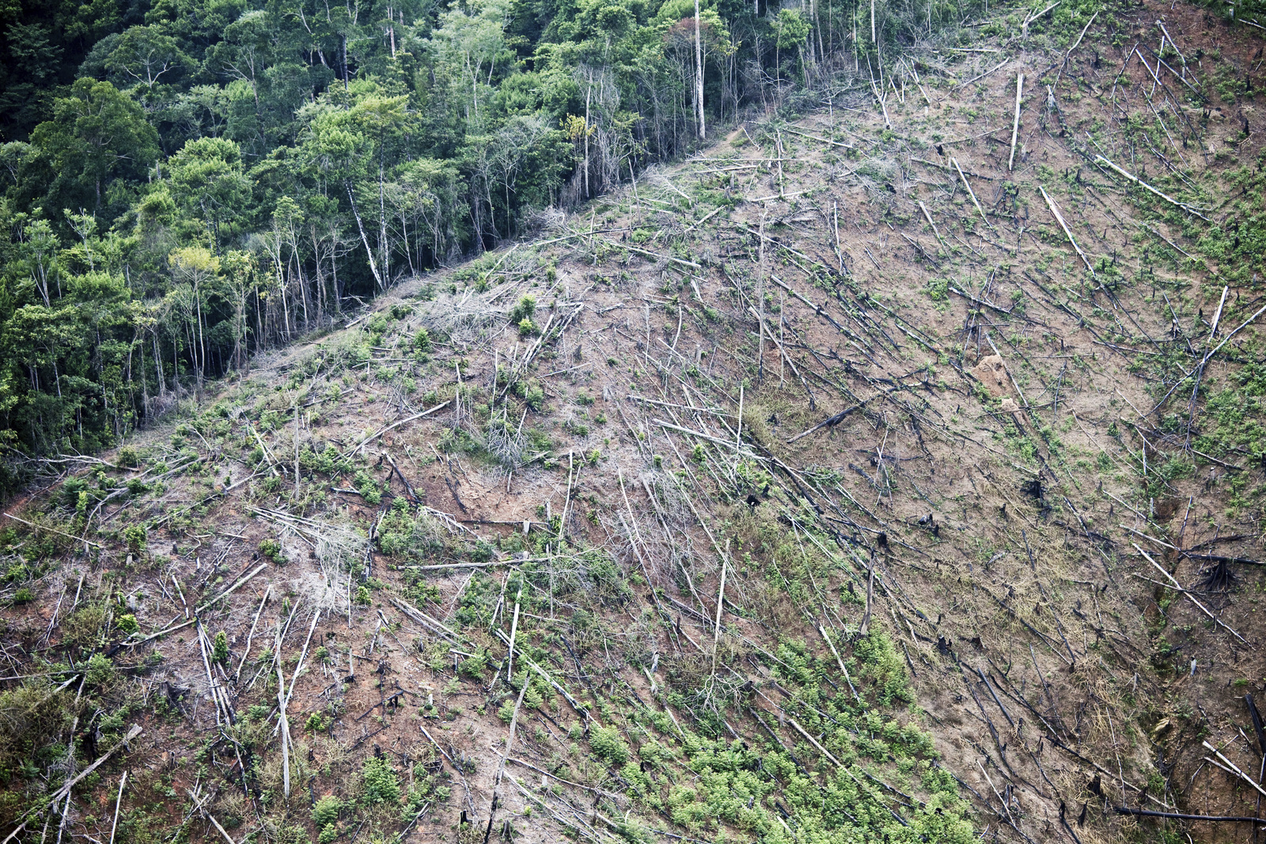
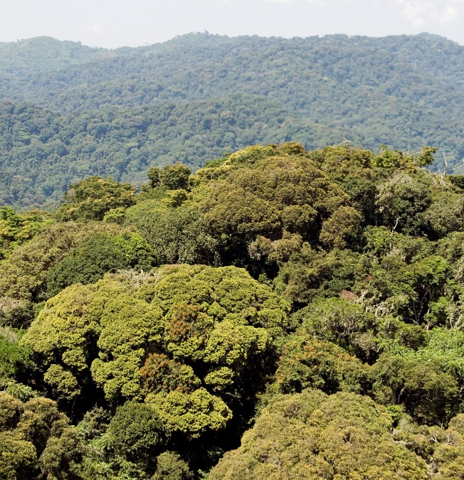
EXAMPLE: GUYANA
DEFORESTATION
$50,000/year in
timber royalties
CONSERVATION
$0/year
OPPORTUNITY COST
Notes:
For example, in Guyana not logging in the Upper Essequibo Conservation Concession meant foregoing $50,000 in logging revenues
2002, CI deal with government. Idea of agreements with people from here.

Slide 13
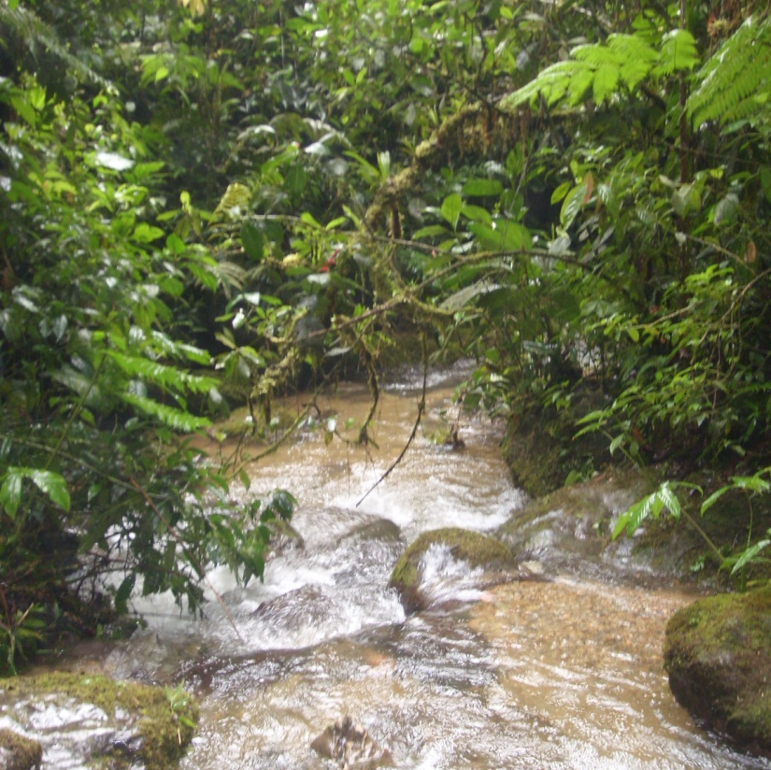
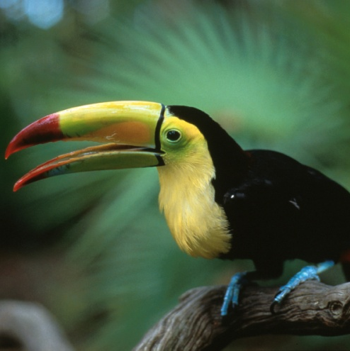
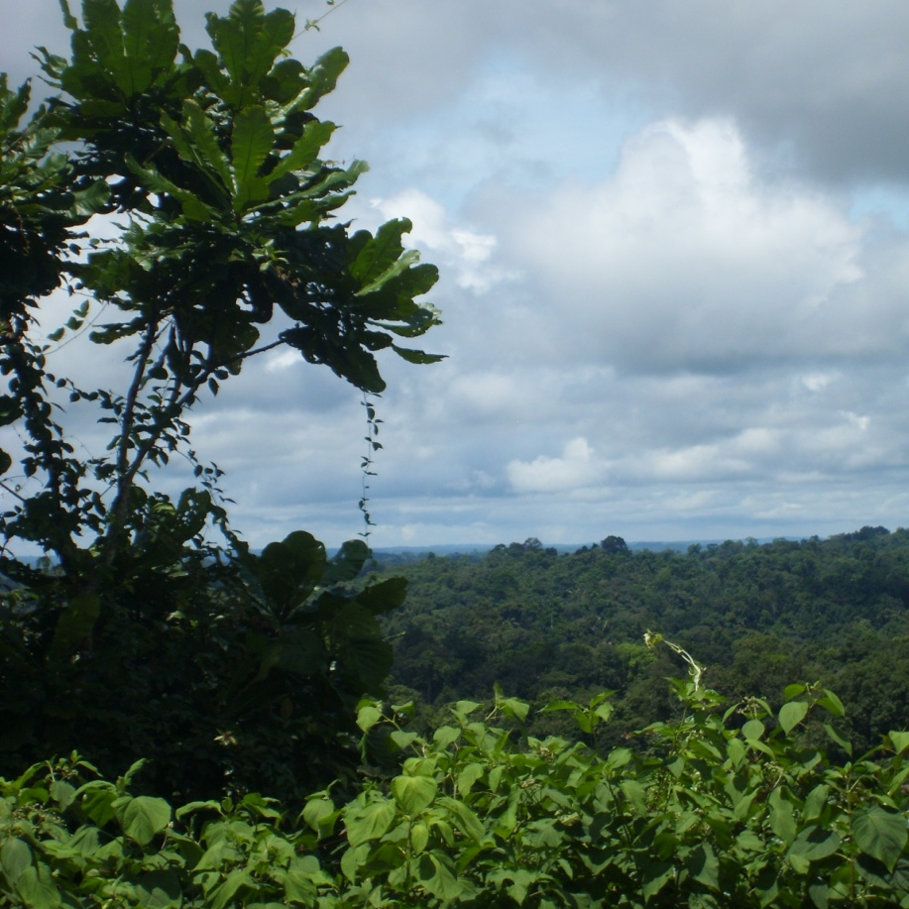
ONLY TIMBER?
Water Quality
Biodiversity
Carbon
Notes:
Not logging in Guyana meant improved water quality, protecting habitat for biodiversity, and avoiding carbon emissions; technically, these values should be subtracted from the $50,000 of lost logging revenues, so the true opportunity cost is less than $50,000

Slide 14
CHALLENGES
Some values are relatively easy to measure
(timber, carbon…)
Other values can be estimated indirectly
(tourism…)
Other values cannot be quantified
(spiritual value of a sacred forest…)
Notes:
There are several difficulties in figuring out technically accurate opportunity cost. Overcoming these difficulties could take a lot of time and a lot of money for expert consultants.

Slide 15
BEING PRACTICAL
Conservation
Concession
(81,000 ha)
Annual Royalties
= $50,000
OPPORTUNITY COST of protecting this is $50,000 per year
Notes:
So, in many cases the opportunity cost analysis is best served by looking at the simple-to-quantify elements, rather than doing complex/expensive analyses that probably won’t be very convincing to communities (or other stakeholders such as government) anyway. The savings in time and expense are worth the loss of accuracy, noting also that the ultimate benefit package is the result of negotiations. In negotiations, you can point out the additional benefits of conservation that were omitted in the opportunity cost assessment.
CI paid for a 30-year logging concession and then didn’t log but managed for conservation.
If we can do this with governments, why can’t we do the same with communities?

Slide 16
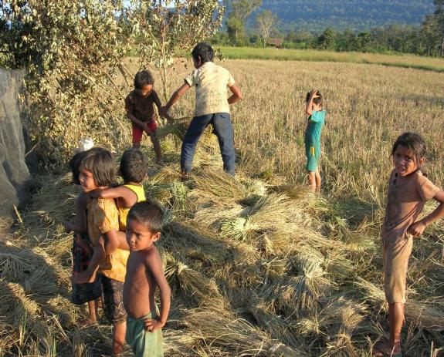
Opportunity cost CAMBODIA
MAIN THREAT deforestation for rice production
40 hectares slash-and-burn per year
1 ton of rice per hectare
Subsistence agriculture
BEST ALTERNATIVE? Buying rice at nearest market
OC = $300/ton x 40 tons = $12,000
Notes:
Value of foregone rice production from areas protected from shifting cultivation

Slide 17
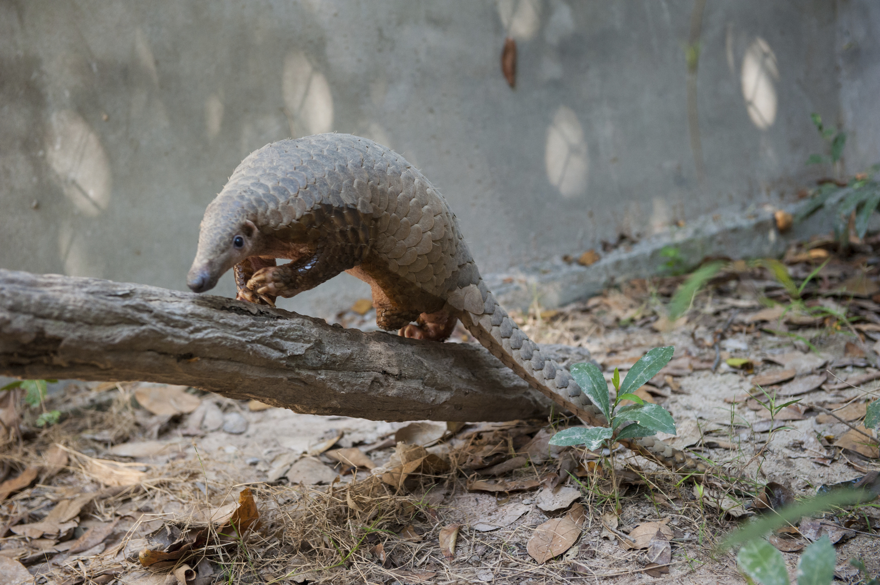
Cost of conservation CAMBODIA
ILLEGAL HUNTING
Address by community patrolling
Quantify time invested in patrolling
OC = 8 people
x 5 days per person/month
x $5 per day
x 9 months per year
= $1,800 per year
Notes:
Slide simply about the cost of the conservation action

Slide 18
FEASIBILITY ANALYSIS
OUTPUT
Decision: continue to next step or not?
Possibly produce report
Notes:
Key result of this step is a decision on whether or not to move to the next step

Slide 19
FEASIBILITY ASSESSMENT
FEASIBILITY FACTOR | WHY OR WHY NOT FAVORABLE?
Biological priority & threats
Capacity of stewards & implementers
Resource rights
Stakeholder & conflict analysis
Legal & policy context
Project costs
Financing opportunities
Long-term sustainability
Notes:
A useful thing for the report is a table that clearly spells out favorable/unfavorable factors, organized by the considerations described earlier; Field Guide has more specific questions; some of these are on the handout.

Slide 20
FEASIBILITY ANALYSIS
If Feasibility Analysis is positive, next step:
initial THEORY OF CHANGE
Notes:
If the analysis does justify moving to the next step, it is time to develop an initial Theory of Change, to describe the logic of the intervention, or the logic of how the proposed rough idea for the CA will lead to the desired conservation outcome

Slide 21
THEORY OF CHANGE
How will the CA result in behavior change
needed to achieve outcomes?
Action
Driver
Threat
Target and Outcome
Notes:
More specifically, the ToC has to present the rationale for what kind of behavior change the CA will produce, how it will do so, and how that behavior change will deliver the conservation outcomes. This logic/rationale is structured as the relationships between Actions and Drivers, Drivers and Threats, and Threats and Outcomes.

Slide 22
THEORY OF CHANGE
Targets and outcomes – what are we trying to conserve or restore (e.g. species, habitat) and what is the status we hope to achieve (area restored, change in population numbers/status)?
Threats – what is threatening the status of our conservation targets (e.g. unsustainable hunting, overgrazing, forest clearing)?
Drivers – what in the broader system is behind the threats (e.g. economic drivers, absence of enforcement, climate change)?
Actions – what can be done to manage the drivers and reduce the threats (in the hopes of reaching our conservation outcomes)?
Notes:
In developing the Theory of Change we begin by describing what it that we care about and want to conserve as well as the status we intend to achieve. We then evaluate threats and drivers and finally areas where we may be able to elicit a change to achieve our desired outcomes.

Slide 23
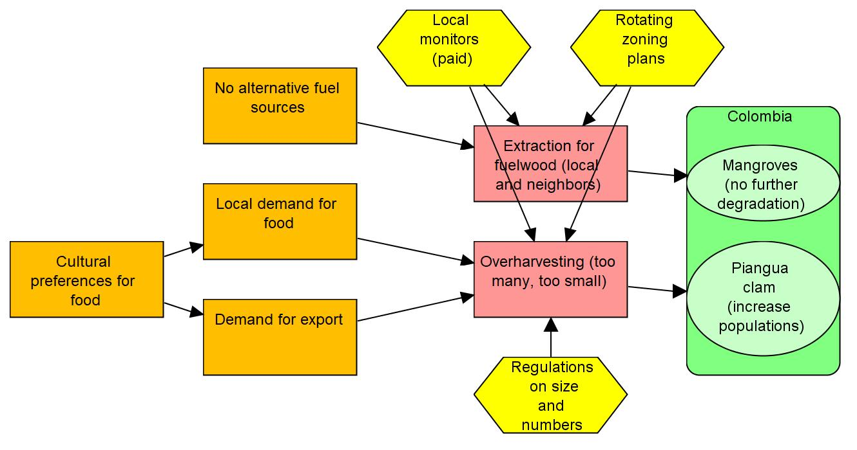
THEORY OF CHANGE
Iscuande, Colombia - Exported from Miradi
Notes:
This diagram represents one way to begin the ToC using a software called Miradi. The image shows a generic representation of conservation targets, threats and drivers at a specific site. Outcomes are simply measurable desired changes in status for conservation targets. The yellow icons indicate points in the model (addressing drivers and threats) where we can elicit a behavior change through our CA.

Slide 24
FINAL THOUGHTS
Incentive-based conservation requires competing with market values: opportunity cost
Things change (including opportunity cost!), so need to periodically revisit/update feasibility assessment
Periodic updating of feasibility assessment is a chance to assess validity of Theory of Change
Notes:
Opportunity cost is important, because it addresses a fundamental driver of decision-making which is the relative costs and benefits of particular resource use decisions. The whole point of the CA model is to shift those costs and benefits to make conservation more attractive.
The feasibility assessment is a snapshot in time (often with some historical perspective). But things change over time, sometimes rapidly and dramatically, such as new plans for a mine or a road, or a new national REDD+ program – therefore it is important to revisit key factors (threats, funding opportunities, and others) regularly to keep your information on feasibility considerations up to date.
When things change, your Theory of Change may become obsolete and require adaptation. This is another important reason to keep up to date on key feasibility considerations.

Slide 25
THANK YOU!
Notes:
Closing slide, opens Q&A session.

