Slide 1
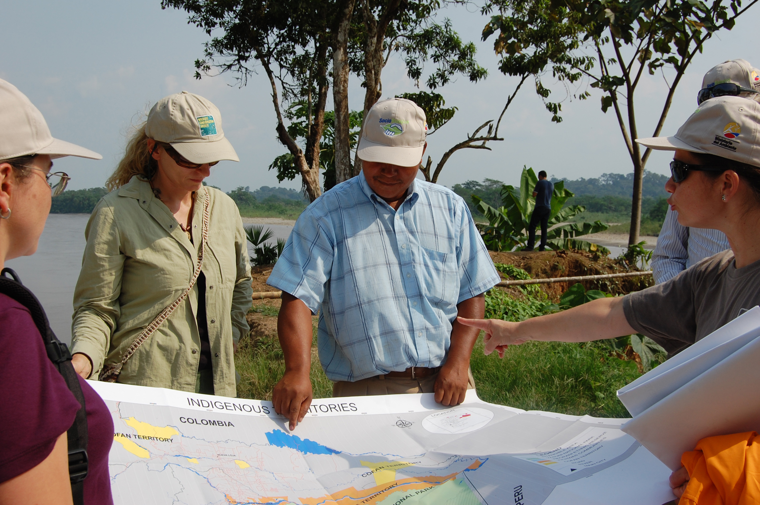
4: IMPLEMENTATION
Conservation Stewards Program
Notes:
Session title

Slide 2
PROJECT CYCLE TOWARD SUSTAINABILITY
STEP 1
STEP 4
Feasibility Analysis
Monitoring
Renegotiation
Implementation
STEP 2
Conservation Agreement
Engagement
STEP 5
STEP 3
Design & Negotiation
Secure Financing & Management
Notes:
Reminder of steps in application of the CA model, show that this session is about the implementation component of the 4th step.

Slide 3
IMPLEMENTATION
Stakeholder engagement (FPIC, gender)
Capacity building
Technical support (patrolling plans)
Delivery of benefits
Notes:
This session is relatively short, as most people are familiar with what implementation looks like in the field, and implementation of CAs are so different for each site depending on conservation objectives and the specific elements that emerged from negotiations. Stakeholder engagement is ongoing, paying attention to RBA including FPIC and gender – RBA is not a step, but a set of principles that apply to every part of the relationship with communities and project process. Many CAs involve capacity building, for activities such as community patrolling and monitoring, and for broader resource management and governance. The implementer usually provides technical support, especially during early periods before capacity building has progressed, for specific activities like patrolling and also facilitates governance processes. The key implementer responsibility is to ensure delivery of benefits, as this will be their main commitment in the CA itself.

Slide 4
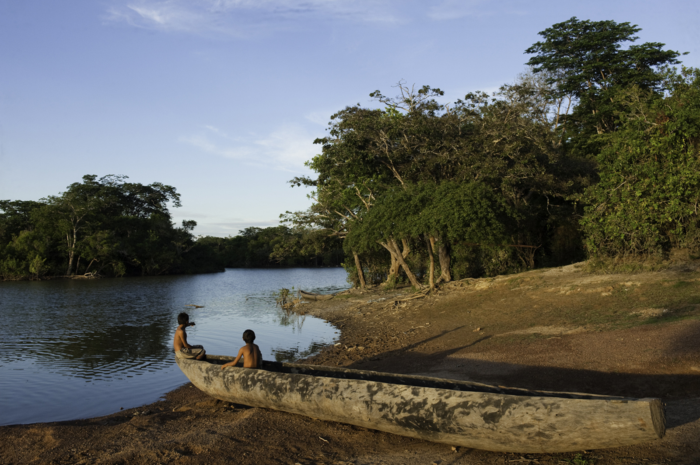
PLANNING IS KEY
“
Every battle is won before it is ever fought.
- Sun Tzu
Notes:
The relationship with the community is crucial, so to maintain their respect and confidence the implementer must perform reliably and professionally – this requires careful planning and continuous communication. Planning relates to meetings and ongoing engagement, to technical execution of activities, to delivery of benefits, to monitoring and reporting … every aspect of the project.

Slide 5
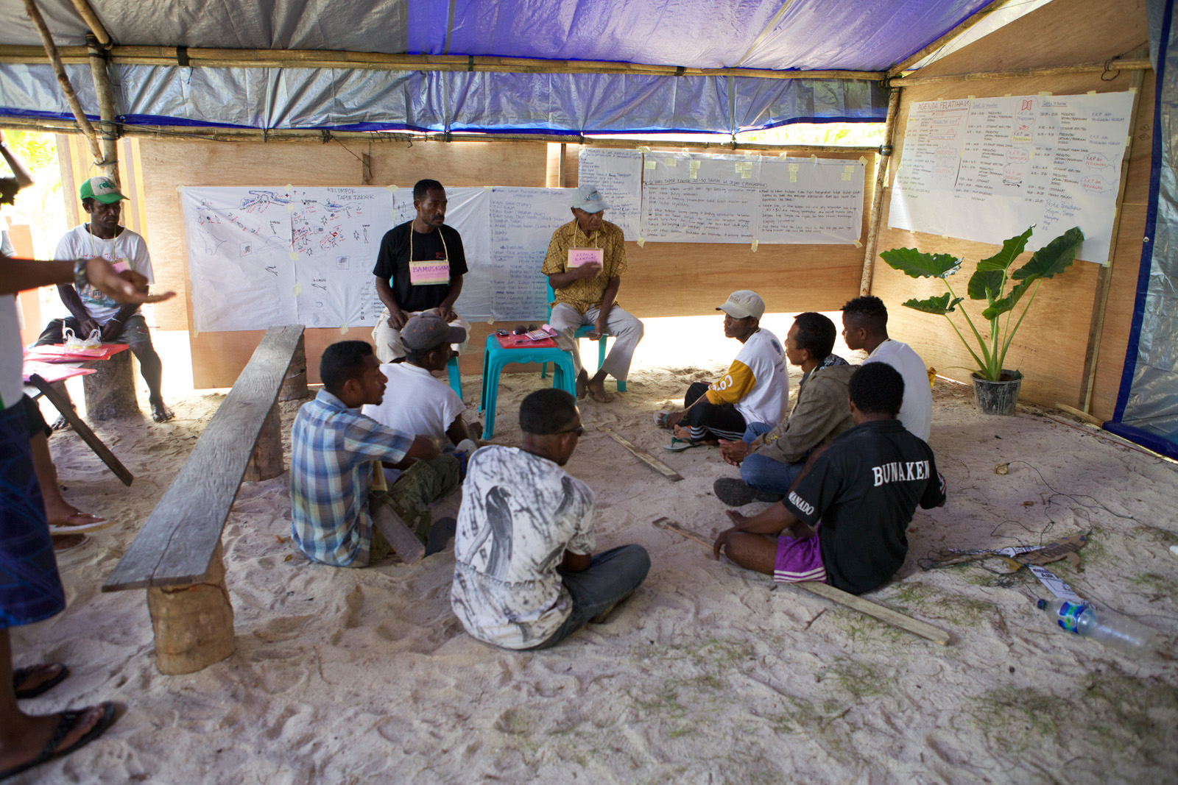
ADAPTING IS KEY
“
No battle plan ever survives contact with the enemy
– Helmut von Moltke the Elder
Notes:
No matter how well you plan, reality will present surprises. Therefore while it is essential to have thorough plans in place, you have to be ready to adapt to change and adjust plans – to new threats, to economic changes that affect livelihoods, to changes in leadership in the community, to interruptions in funding, to … any of a million things that can change (not always, but unfortunately often, in negative ways). When plans change, it is critical to communicate with the community to explain and agree on changes.

Slide 6
BAD IMPLEMENTER HABITS
Compliance goes unchecked
Penalties are not enforced
Benefits are delayed
Failure to inform communities
Notes:
This slide has some bad practices that must be avoided if you want an effective CA. Perhaps a big picture observation is that we have to avoid some of the characteristics sometimes associated with NGO culture! While action is more motivating for implementers than monitoring, incentive-based approaches cannot work without reliable monitoring. Implementers working in the field may prioritize maintaining good relationships over discipline in adhering to CA terms, but penalties have to be applied or the incentives will be weakened. Often people working hard in NGOs have many demands and pressures and are handling several different initiatives, but the CA is a negotiated deal and you cannot let things slip due to the distraction of other projects and activities; a community will not respect the implementer or the CA if they feel they are not taken seriously.

Slide 7
GOOD IMPLEMENTER HABITS
Transparency in decision-making
Adhere to clear schedule and timelines
Frequent communication with stakeholders
Check that community representatives regularly share information with others
Do not overpromise
Notes:
The items in this slide add up to two overarching themes – the implementer must be professional, even business-like, in living up to the terms of the deal in the CA, and they must treat the community, as a whole but also as individuals, with respect and consideration.

Slide 8
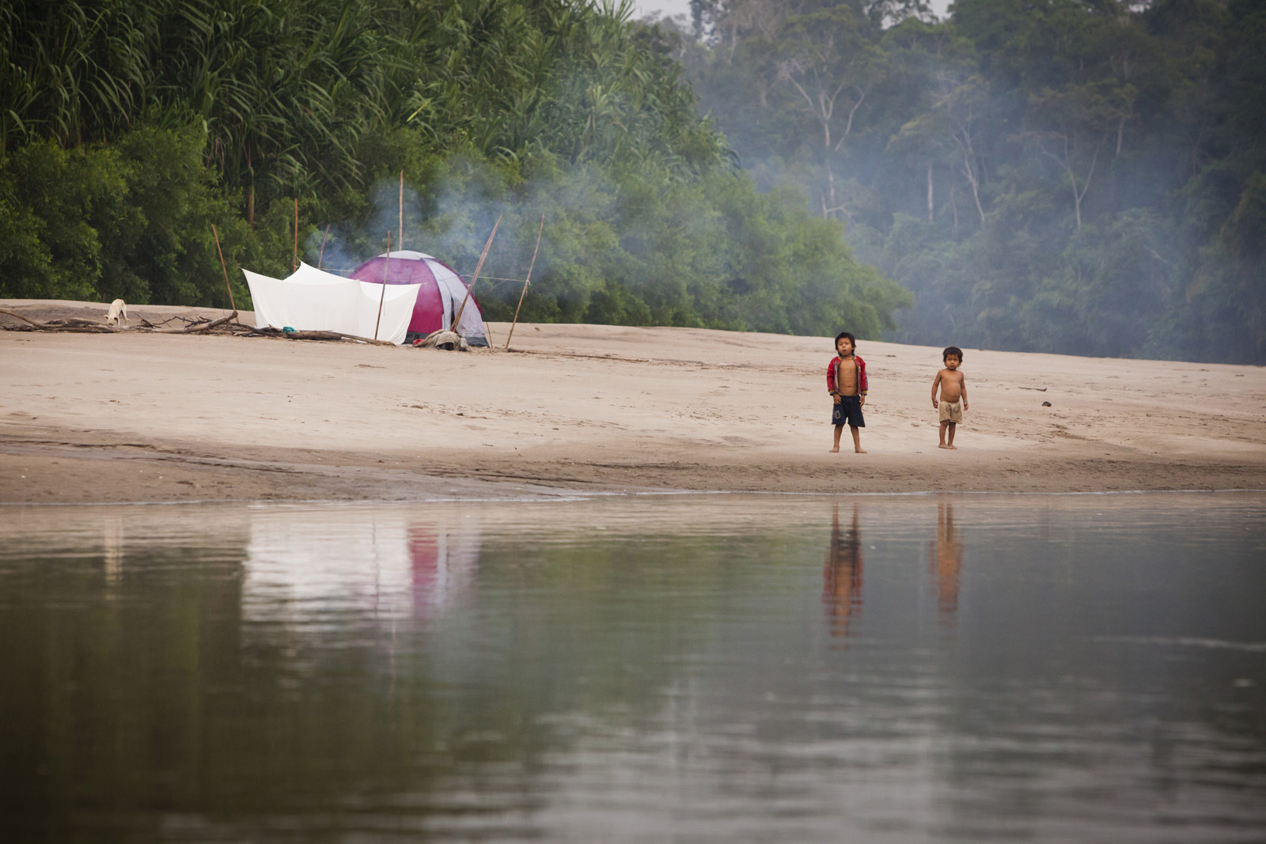
THANK YOU!
Notes:
Closing slide, opens Q&A session.

