Slide 1
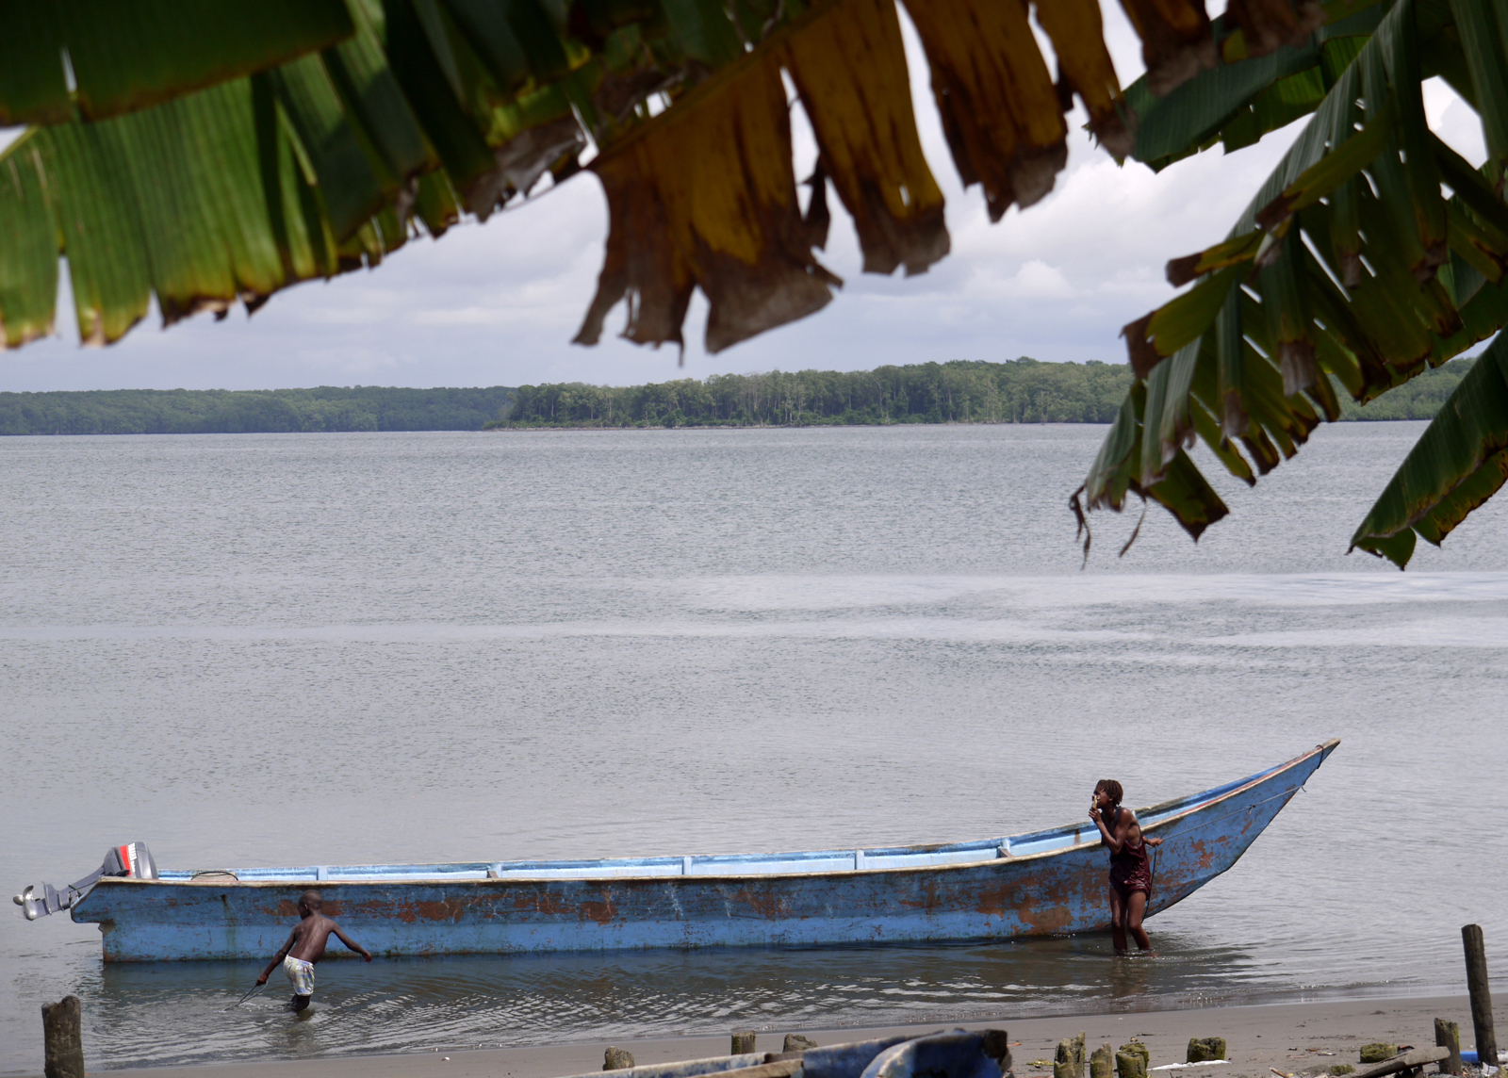
3: DESIGN & NEGOTIATION
Conservation Stewards Program
Notes:
Session title

Slide 2
PROJECT CYCLE TOWARD SUSTAINABILITY
STEP 1
STEP 4
Feasibility Analysis
Monitoring
Renegotiation
Implementation
STEP 2
Conservation Agreement
Engagement
STEP 5
STEP 3
Design & Negotiation
Secure Financing & Management
Notes:
Reminder of steps in application of the CA model, show that this session is about the third step

Slide 3
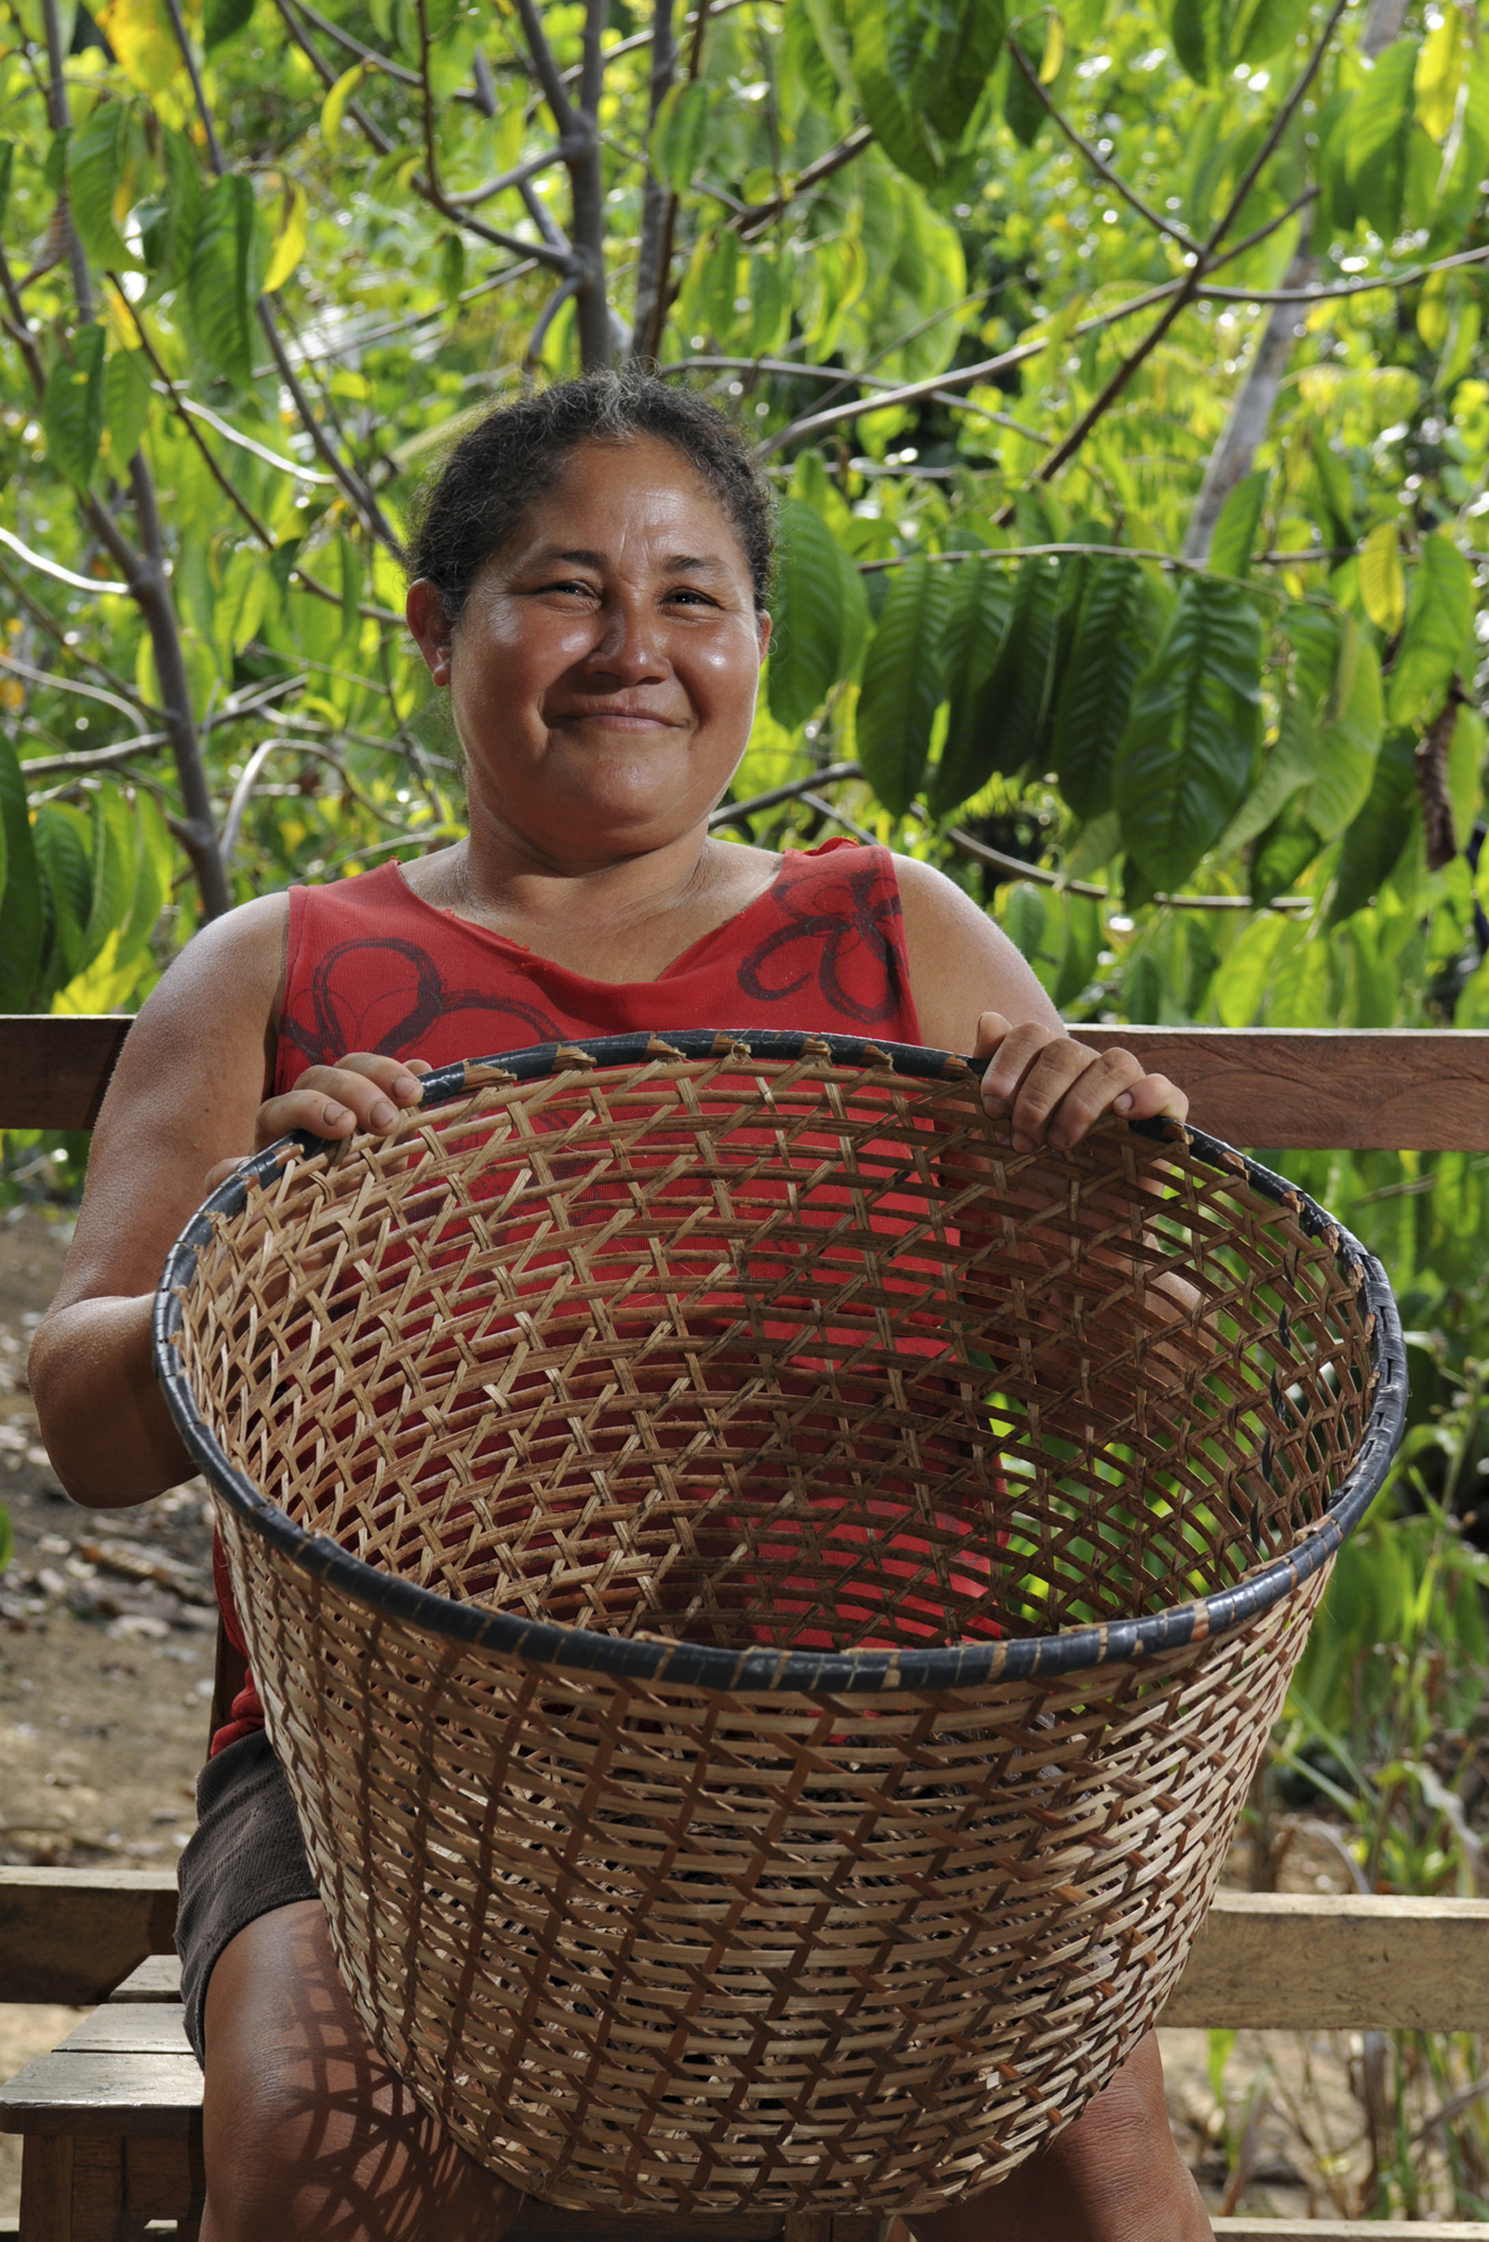
CONSERVATION AGREEMENTS
a negotiated exchange of benefits in return for changes in resource use, depending on verified performance
Notes:
Repeat basic definition of the CA model, to reinforce that negotiation is key

Slide 4
4 KEYS
TO CONSERVATION AGREEMENTS
Conservation
Actions
Benefit
Package
Monitoring
Penalties
Notes:
Negotiation, discussion, consultation – lots and lots of communication and exchange! – is relevant to all aspects of the project, but these 4 keys are the central items to be negotiated, the core features of the CA.

Slide 5
NEGOTIATION PROCESS
Agree on schedule
Prepare negotiating position
Define deal-breakers
FPIC – ensure broad representation
Agreement needs to be fair, but cost effective
Notes:
As with engagement, negotiation requires thorough preparation. When defining the schedule, it is critical to allow sufficient time for internal discussions within community; they cannot feel rushed or pressured, as this would violate our FPIC principles. For your negotiating position, you need to define the minimum conservation actions needed to make the CA worthwhile, and have a sense of the opportunity cost of those actions to frame discussions about the benefit package. Also, remember that the CA will evolve over time, so you don’t necessarily have to get (or give) everything in the first round of the CA. It is also important to identify deal breakers, and make clear to the community (and other stakeholders) that you will walk away from a bad deal. You want to be fair, but also need to use your hard-raised conservation funds wisely; if the community demands too much, there are other communities at other sites that will offer a better deal; pointing this out during negotiations can sometimes be effective.

Slide 6
DEFINING CONSERVATION ACTIONS
Verifiable and measurable
Aligned with capacity
ACTIONS MUST BE:
Relative to clear baseline
Realistic in terms of costs
Notes:
The commitments of the community have to be realistic, things they can do (potentially with technical support and capacity building), but at minimum they have to contribute meaningfully (and in a measurable way) to conservation goals. An implication is that in a CA, the incentive often is for doing an action, regardless of whether that action produces the desired outcome; this is fair because that is what the community can more directly control. However, it is also fair to make clear that if, after some period time, the CA is not producing conservation results despite good performance on actions, the CA will need to be changed or terminated to justify continued conservation investment.

Slide 7
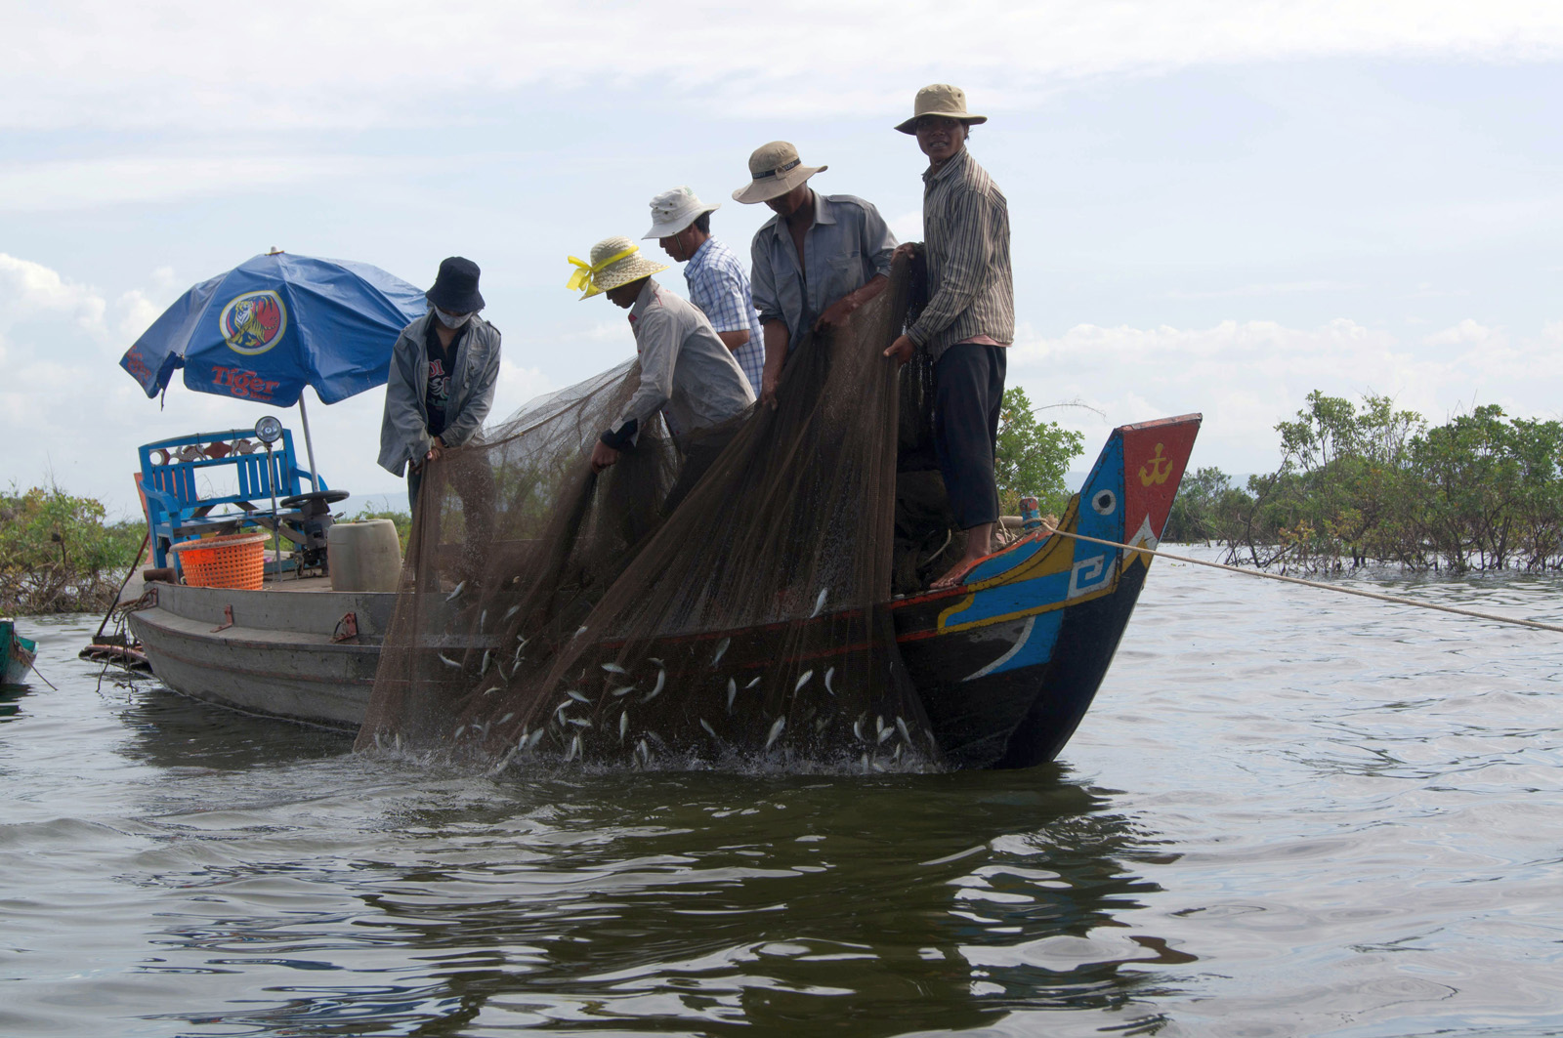
EXAMPLE AGREEMENT: CAMBODIA
COMMITMENTS
No illegal logging
No illegal hunting
Agriculture follows land-use plan
No burning or nets around nests
Community forest patrols
Notes:
A useful observation here is that for many CAs, it will be helpful to have a land use plan of some kind. Clearly defined land uses and management practices, explicitly mapped, offers a transparent foundation for conservation commitments. However, it also means that you will need to ensure community-wide awareness of the plan, and, usually, that there is some physical demarcation in the field identifying what may and may not be done where.

Slide 8
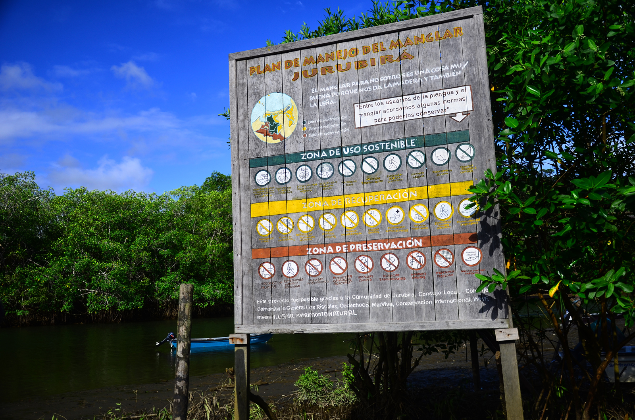
EXAMPLE AGREEMENT: COLOMBIA
COMMITMENTS
In protected lakes and creeks:
No fishing of Pirarucú or Arowana
No fishing during spawning season
Fishing only with allowed methods
Define catch quotas for other species
Continuous patrolling
Participation in monitoring
No deforestation along lakes and waterways
Notes:
The Colombia CA offers a great example of restrictions on how people can use resources, in this case through restrictions on fishing practices. This means that compliance monitoring has to specifically pay attention to fishing practices, and that the implementer has to invest in awareness raising throughout the community on permitted/prohibited practices, harvest timing, fishing zones, etc.

Slide 9
DEFINING AGREEMENT BENEFITS
Clear delivery timeline
Opportunity cost
IMPORTANT CONSIDERATIONS
No environmental harm
Equitable benefit distribution
Realistic commitments
Notes:
Obviously, in many places this will be the most interesting part of the negotiating process for the community. Therefore it is important to start with the commitments first, to make clear why you are doing the project to begin with, to emphasize that benefits are in return for conservation actions, and to emphasize the point that the size/number/nature of benefits is linked to the extent/nature of conservation actions.

Slide 10
DEFINING
AGREEMENT
BENEFITS
CRITICAL
Can you adjust the benefit based on conservation performance?
→ PENALTIES
Notes:
CRITICAL: Since the point is for benefits to serve as an incentive that is linked to conservation performance, it is essential that (a large part) of the benefit package consists of things that can be increased/decreased (or turned off or on) depending on compliance with conservation commitments.

Slide 11
DEFINING AGREEMENT BENEFITS
Jobs
(patrols, monitoring, reforestation)
Equipment
(boots, GPS, canoe, tractor)
Facilities
(school, water pump, meeting house)
Services
(teacher, health worker)
Capacity building (governance, management)
Technical assistance (sustainable agriculture)
Market access (purchasing agreements)
Enterprise support (certification)
Cash
(Village Development Fund, scholarships)
Notes:
What can go into a benefit package? There are many, many different possibilities; CSP’s portfolio has tons of different examples ranging from simple (handing out small farm tools or school books) to complex (arranging legal recognition of land rights or working with the navy and police to enforce marine fishery zones). Some benefits are linked to resource management/protection, directly contributing to conservation objectives. Others are totally separate from conservation objectives. Some are benefits for individuals, while others are for the community as a whole. The negotiating process needs to consider these differences to identify what will make a fair, affordable, and effective incentive package.

Slide 12
EXAMPLE AGREEMENT: CAMBODIA
COMMITMENTS
BENEFITS
No illegal logging
No illegal hunting
Agriculture follows land-use plan
No burning or nets around nests
Community forest patrols
Water buffalos
Plowing technology
Teacher salary supplements
Agricultural extension services
Patrolling wages
Notes:
Some benefits require elaborate systems. Patrolling wages require ways to verify that people did the patrols, reported accurately, etc. In Cambodia, the water buffalo benefit required designing a process to identify who received the animals and in what order, what happened if those people later violated the CA, what happened to offspring of animals … all this after implementer and community representatives went to regional markets together to select the animals to purchase.

Slide 13
EXAMPLE AGREEMENT: COLOMBIA
COMMITMENTS
BENEFITS
In protected lakes and creeks:
No fishing of Pirarucú or Arowana
No fishing during spawning season
Fishing only with allowed methods
Define catch quotas for other species
Continuous patrolling
Participation in monitoring
No deforestation along lakes and waterways
Direct
$8/day for patrolling and monitoring
Food and equipment for patrolling missions
$55/month for natural resource committee
Indirect
Strengthened leadership and governance
Strengthened territorial rights
Recovery of Pirarucú and Arowana populations
Notes:
Again, many CAs result in indirect benefits in addition to what is agreed on in the formal benefit package. This is not linked to opportunity cost, but can be significant and attractive to communities. Therefore it can be useful to point out such benefits during the negotiation process.

Slide 14
DEFINING PENALTIES
Define penalties and triggers together with community
Penalties escalate for number and/or seriousness of infractions
Ensure possibility of returning to compliance
Penalties for implementers
Notes:
Incentives only work if there is a consequence of non-compliance. Defining penalties has to be part of the negotiation process to ensure that the penalty framework is seen as just and transparent by the community. Also, it is important to have penalties that are scaled to the number/frequency of violations, allowing the opportunity to correct behavior, return to compliance, and restore the full benefit package. It is also important that there are consequences for the implementer if they fail to uphold their end of the deal, as in the case of long delays in benefit delivery.

Slide 15
DEFINING PENALTIES: COLOMBIA
MINOR
SERIOUS
VERY SERIOUS
using project equipment for non-project travel
ignoring patrolling duties
taking Pirarucú or Arowana
1st offense → warning
1st offense → 20% wage cut
1 YEAR SUSPENSION
2nd offense → 10% wage cut
2nd offense → 6 month
suspension
3rd offense → 6 month suspension
Notes:
The Colombia CAs have a well-defined penalty framework relating to individual patrollers, the community as a whole, and the implementer. It also combines internal penalties (things the community does with respect to its own members) and external penalties (things the implementer does with respect to the community). This slide shows internal penalties. Many CAs include internal community penalties as part of the overall framework, often building on traditional/customary ways of enforcing community norms and rules.

Slide 16
DEFINING PENALTIES: COLOMBIA
If communities do not apply internal penalties
If CI-Colombia benefit delivery is delayed
1st breach
10% cut in annual benefit package
1st breach
$90 payment to community fund
2nd breach
20% cut in annual benefit package
2nd breach
$180 payment to community fund
3rd breach
CA is terminated
3rd breach
$270 payment to community fund
Notes:
This slide shows external penalties in the Colombia CA.

Slide 17
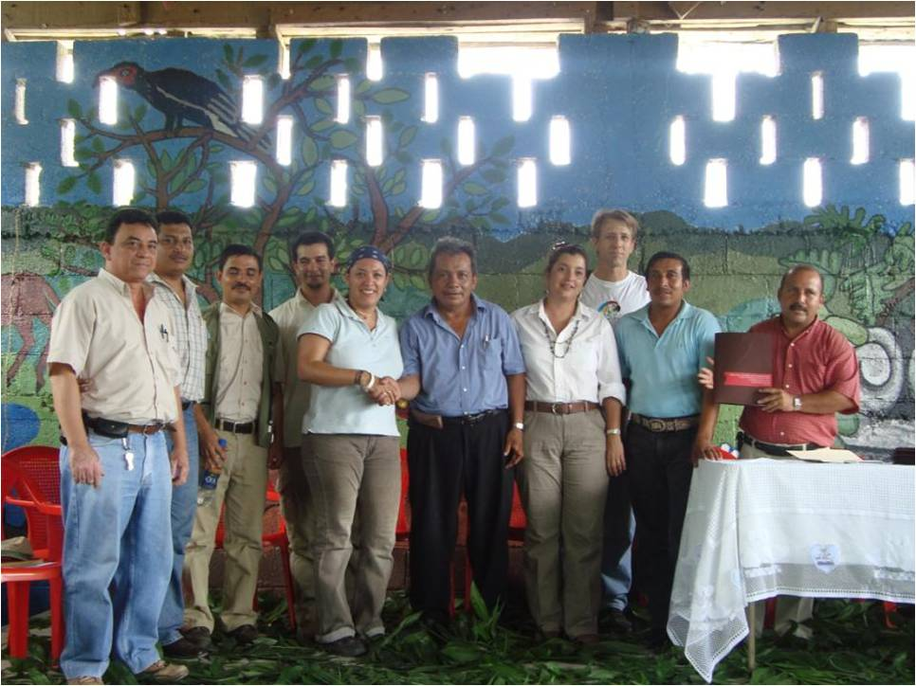
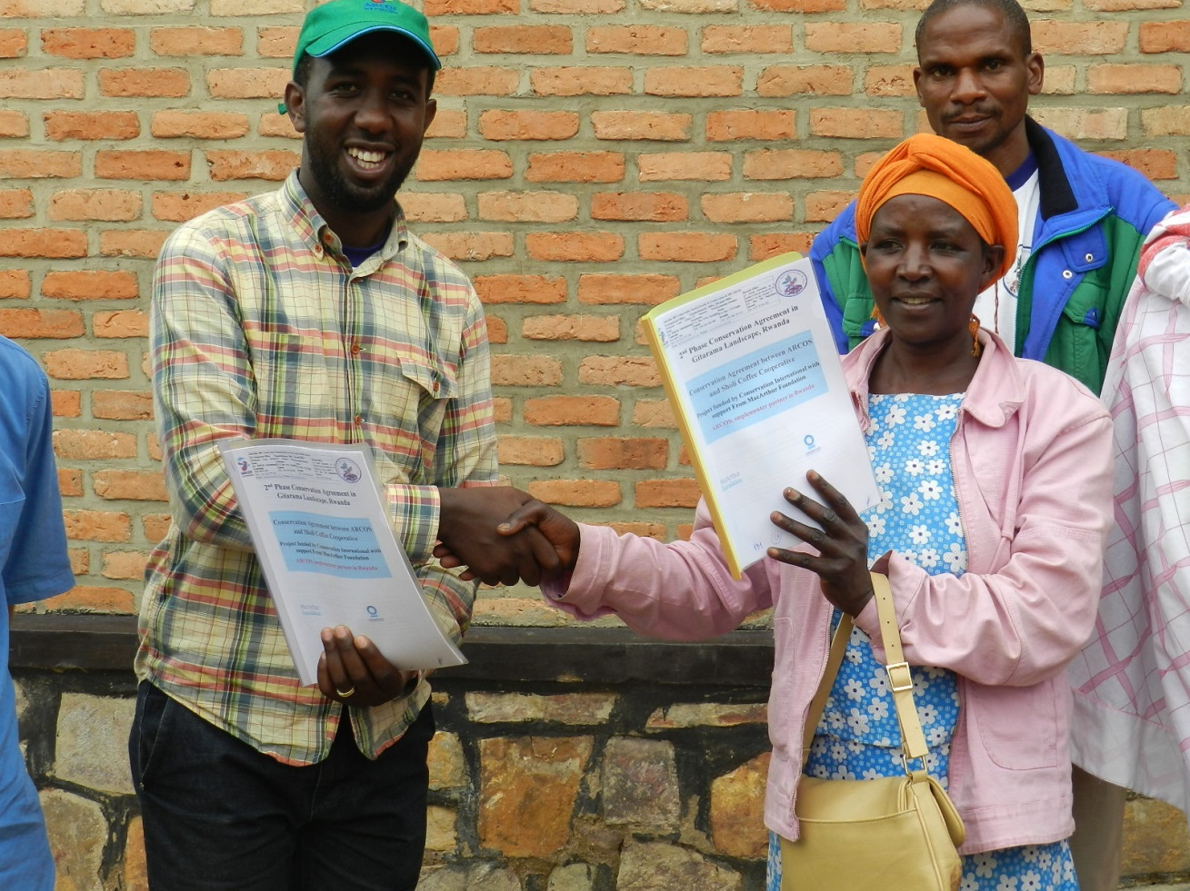
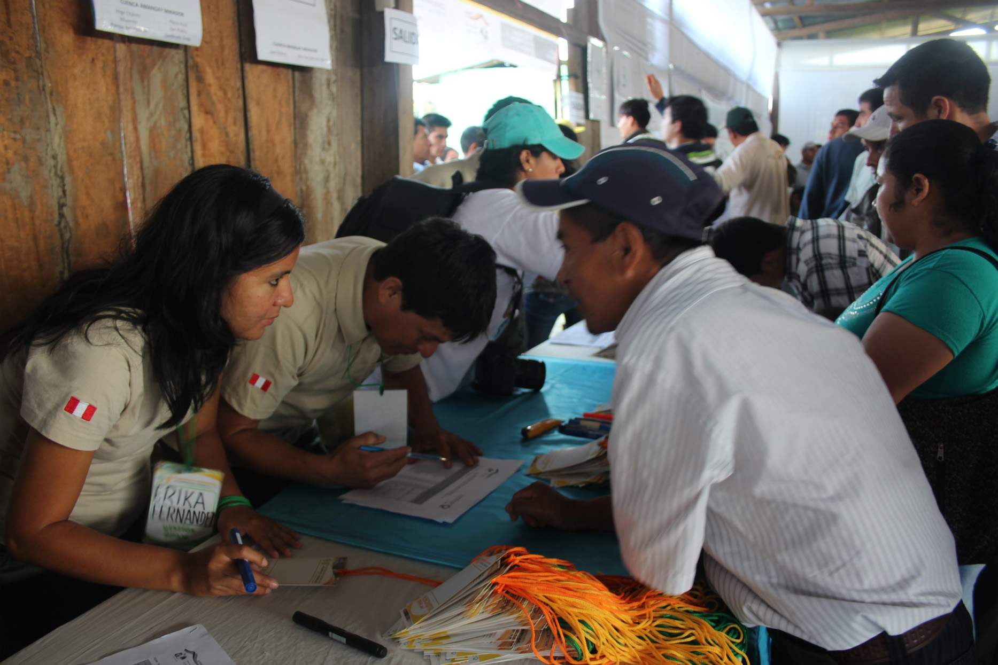
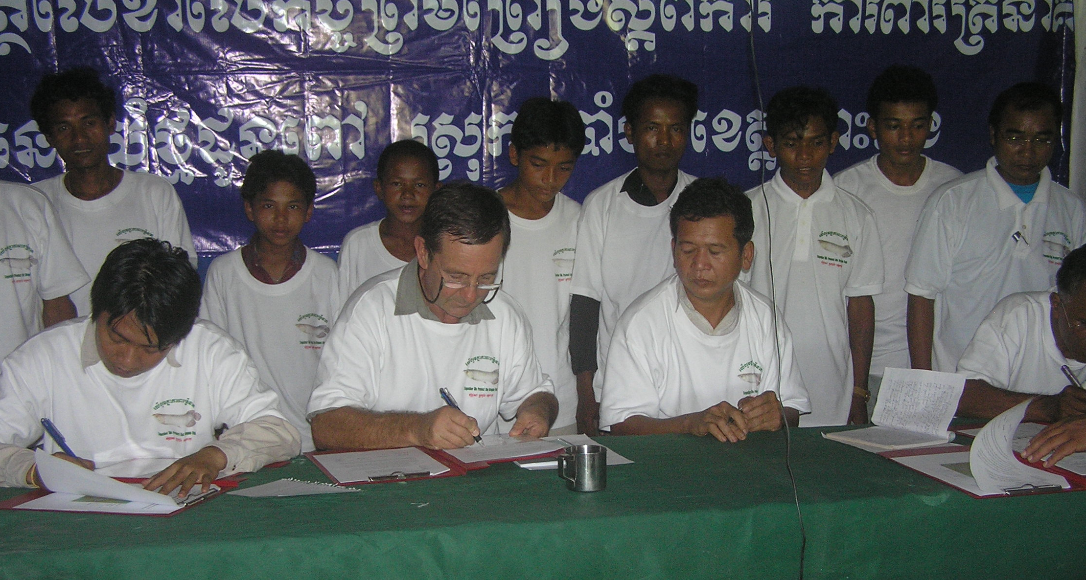
Notes:
Successful negotiating processes conclude with the signing of a CA. Often, this will happen in a ceremony with accompanying festivities, to signal CA importance and serve as a dissemination/awareness event. Including government officials (mayor, district head, provincial governor … what is appropriate depends on the place) in the signing ceremony, potentially as witness signatories on the actual CA document, can reinforce the importance of the CA in people’s eyes. A key question is who will sign the CA for the community – the community leader, members of a natural resource committee, representatives from each household … what is appropriate/feasible will depend on the site.

Slide 18
THANK YOU!
Notes:
Closing slide, opens Q&A session.

