Slide 1
INTRODUCTION TO CONSERVATION AGREEMENTS
Notes:
Session title

Slide 2
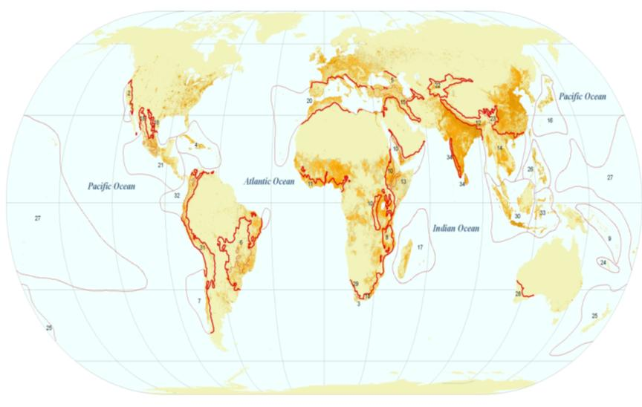
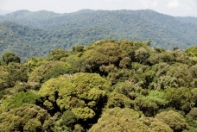
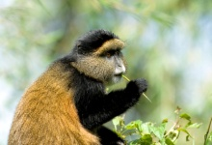
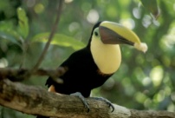
BIODIVERSITY, ECOSYSTEM SERVICES AND PEOPLE
Notes:
Overlap between hotspots and population density: key point here is that biodiversity and ecosystem services are in the hands of local people, so we need an effective approach to working with local people.

Slide 3
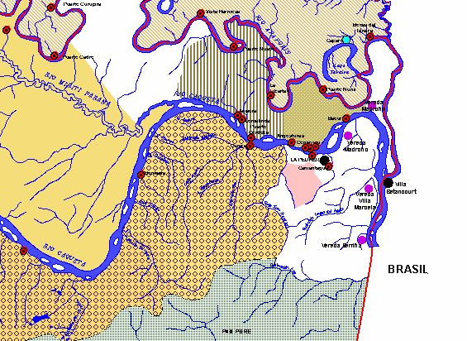
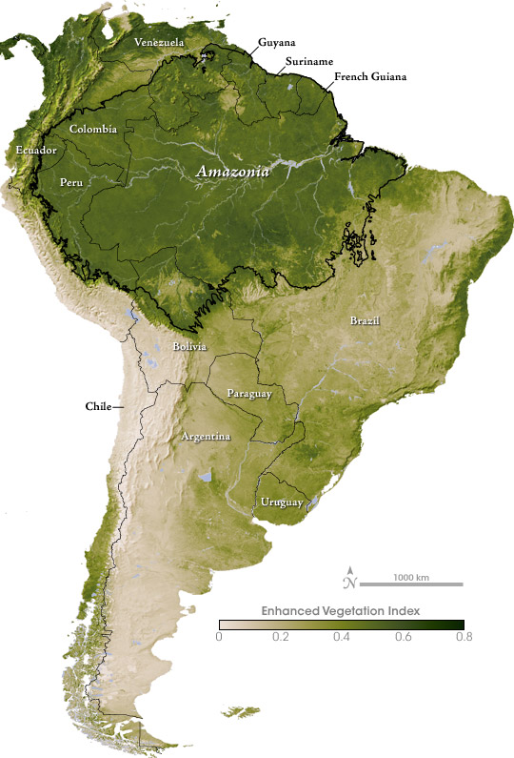
Colombian Amazon
Example
Notes:
One such place is the lower Caquetá / Apaporis basin in southeastern Colombia, near the border with Brazil, where CI-Colombia is implementing CAs with local settlers and indigenous communities

Slide 4
Threats to Biodiversity
COLOMBIAN AMAZON
Notes:
Title

Slide 5
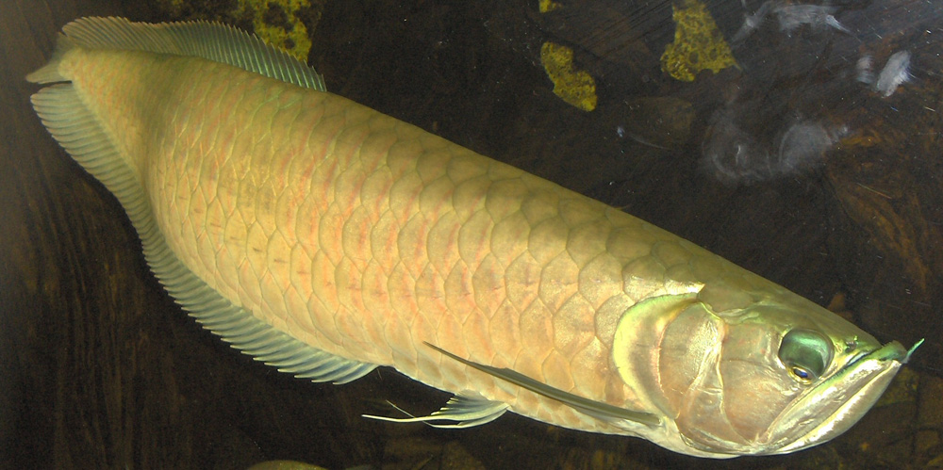
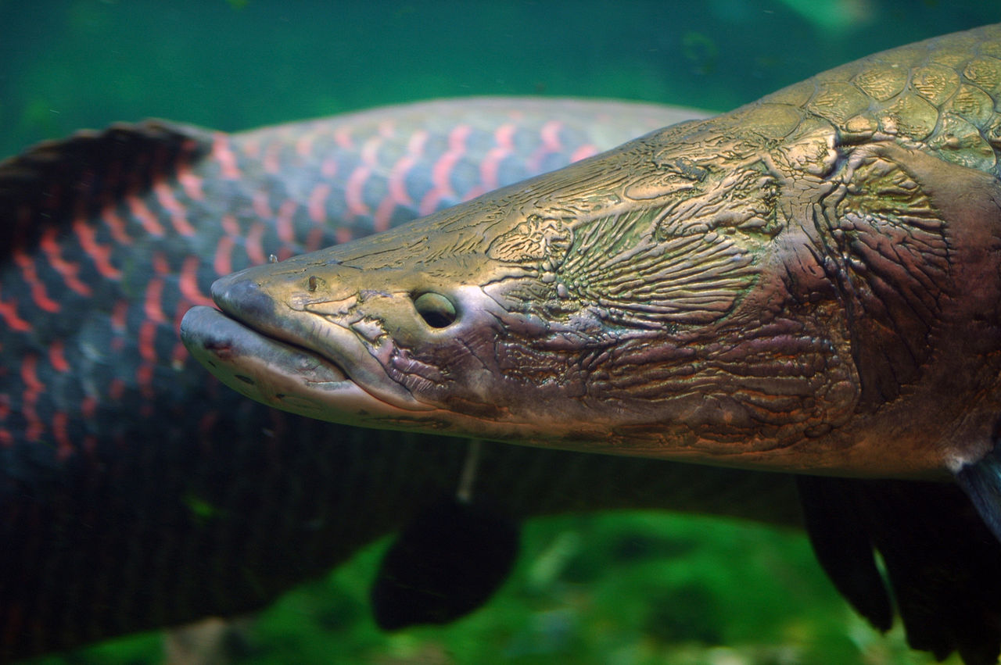
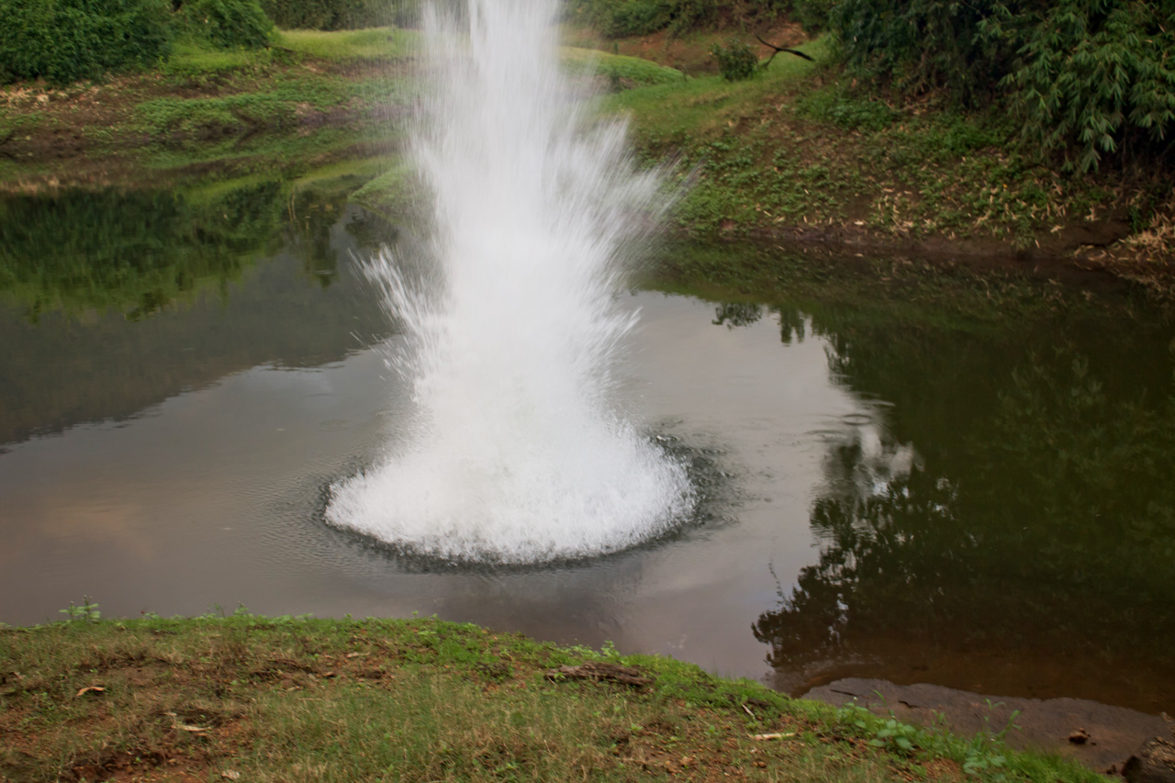
Notes:
Illustrate threats in Colombian Amazon: the main threat to biodiversity CI-Colombia seeks to address using CAs is overharvesting of key fish species, Pirarucú and Arowana

Slide 6
Local Priorities
COLOMBIAN AMAZON
Notes:
Title

Slide 7
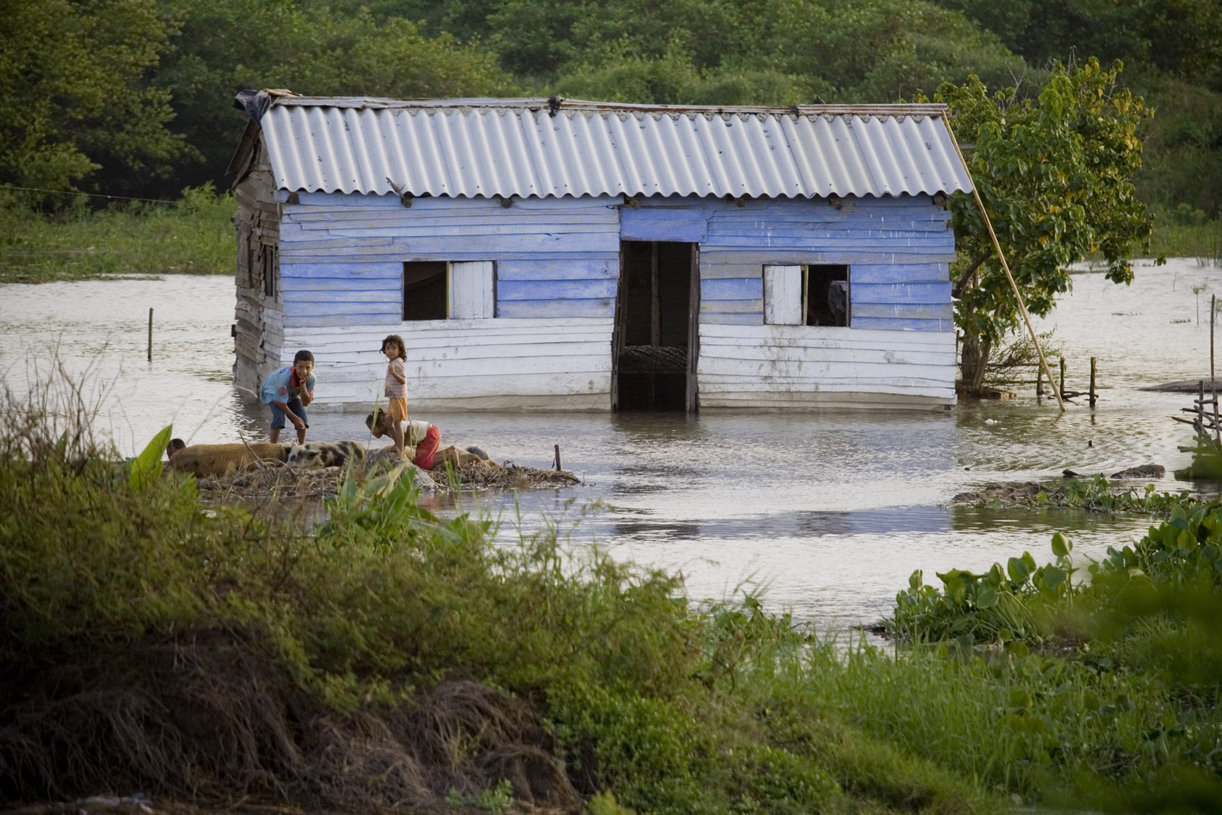
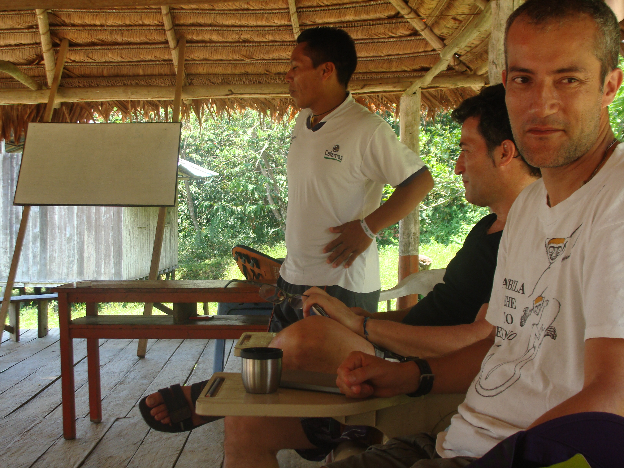
Notes:
Illustrate priorities in Colombian Amazon: main priorities of the communities are livelihoods and rights & capacity to manage their lands and resources

Slide 8
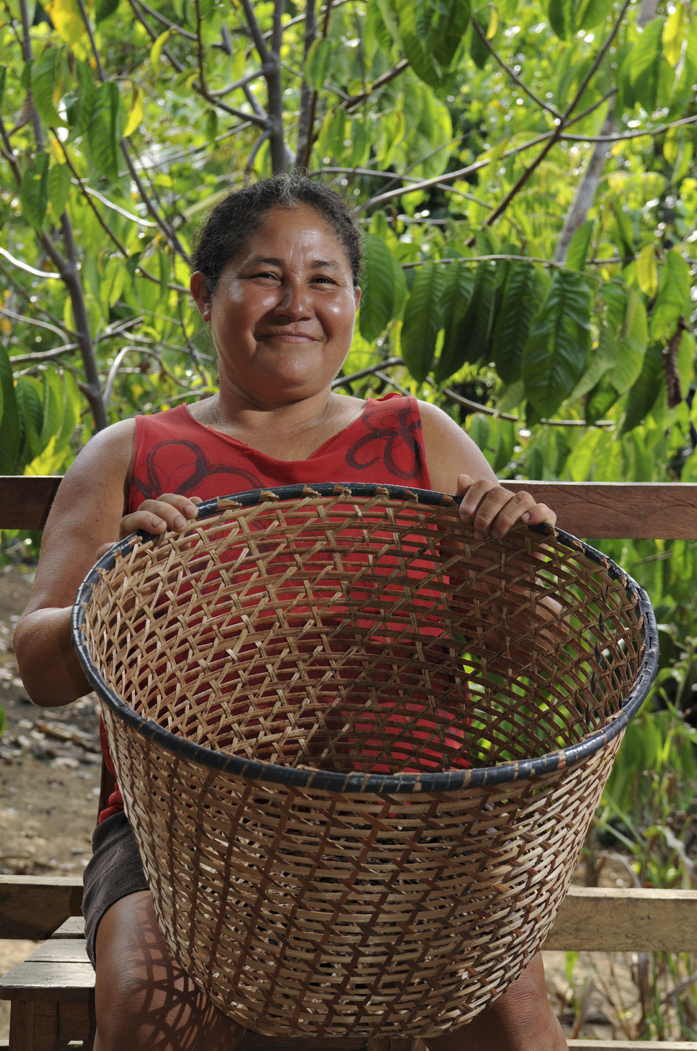
CSP’s solution:
CONSERVATION AGREEMENTS
a negotiated exchange of benefits in return for changes in resource use, depending on verified performance
Notes:
Definition of the model: CSP has developed a model for working with local communities we call Conservation Agreements. Emphasize that this is about incentives, an exchange of benefits for conservation performance; the terms of the exchange are determined through negotiation; the deal is meaningful only if performance is verified.

Slide 9
INTRODUCING CONSERVATION AGREEMENTS
WHY THIS APPROACH?
As shown at the beginning, biodiversity conservation is in hands of local people
Behavior change depends on incentives, and CAs are a powerful way to provide direct incentives
Using incentives, CAs also allow a fair distribution of burden and benefits of conservation
People have been making deals since the beginning of time: CAs make sense to communities, policy makers, and many funders
Notes:
Key points of rationale for the model: emphasize that conservation imposes a burden/cost on local people, so it is only just/fair/equitable to provide benefits/compensation – in addition to be necessary for effectiveness.

Slide 10
CONSERVATION AGREEMENT MODEL
Threats to biodiversity/ES
CONSERVATION AGREEMENT
Opportunity
cost
Conservation
Actions
Benefits
EXAMPLES
No poaching
No forest clearing
Patrolling
EXAMPLES
Social services
Livelihood support
Conservation wages
Notes:
Graphic of the CA model: actions are designed in response to threat to biodiversity (or ecosystem services); these actions impose a cost (we call this opportunity cost, more on this later in the workshop); the benefits have to be greater than the cost for conservation to be an attractive choice to local people.

Slide 11
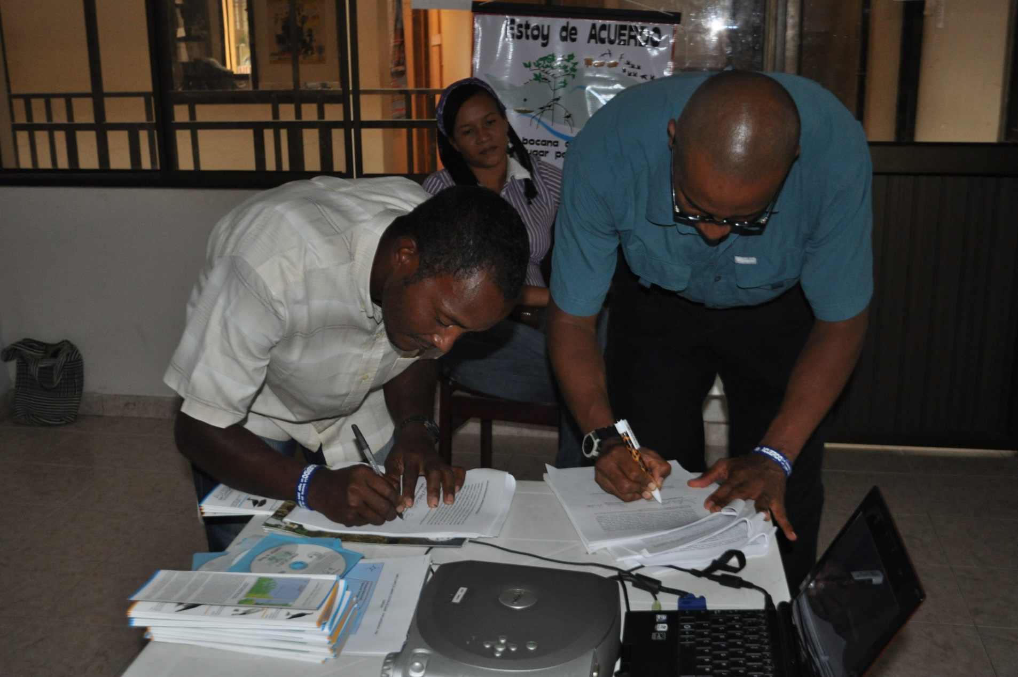
THE AGREEMENTS
Notes:
Title

Slide 12
BIODIVERSITY Colombian Amazon example
SET CLEAR, MEASURABLE GOALS AND TARGETS
Conserve 193,870 hectares of forest and freshwater ecosystems of the lower Caquetá and Apaporis rivers
Increase populations of Arowana (Osteoglossum bicirrhosum) and Pirarucú (Arapaima gigas)
Notes:
Biodiversity targets for Colombian Amazon CAs

Slide 13
STAKEHOLDERS Colombian Amazon example
IDENTIFY WHO CAN AFFECT ACHIEVEMENT
OF THE BIODIVERSITY GOALS
3 Indigenous Reserves
and 1 Vereda
Communities with about 400 households
Illegal fishermen from outside
Government authorities (police)
Notes:
Key stakeholders in Colombian Amazon CAs

Slide 14
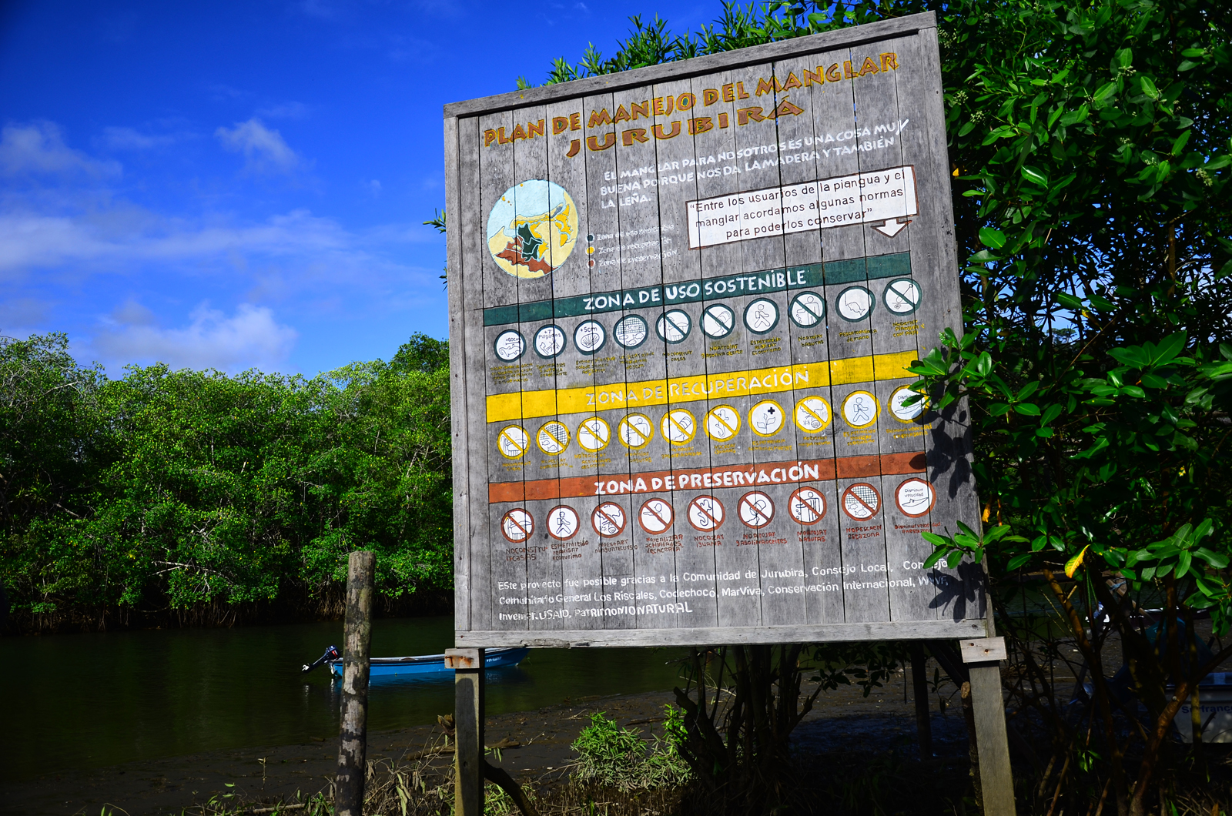
CONSERVATION AGREEMENT Colombian Amazon example
COMMITMENTS
BENEFITS
No fishing of Pirarucú or Arowana, quotas for other species
No fishing during spawning season
Fishing only with allowed methods
Participation in patrolling and monitoring
No deforestation along lakes and waterways
$8/day for patrolling and monitoring
Food and equipment for patrolling missions
$55/month for natural resource committee
Notes:
Commitments and benefits in Colombian Amazon CAs

Slide 15
CONSERVATION AGREEMENT Colombian Amazon example
INDIRECT BENEFITS
Strengthened leadership and governance
Strengthened territorial rights
Recovery of Pirarucú and Arowana populations
Notes:
Indirect benefits of Colombian Amazon CAs – note that there are benefits that the implementer/investor commit to providing as described in the previous slide, but the relationship in general also leads to various different kinds of benefits and advantages for communities.

Slide 16
Monitoring
Track verifiable and quantifiable results:
CA compliance
Biodiversity impact
Socio-economic impact
Notes:
Note three types of monitoring for the CA model

Slide 17
MONITORING: Biodiversity Impact Colombian Amazon example
Notes:
Colombian Amazon example – growing densities of Pirarucú in 4 lakes

Slide 18
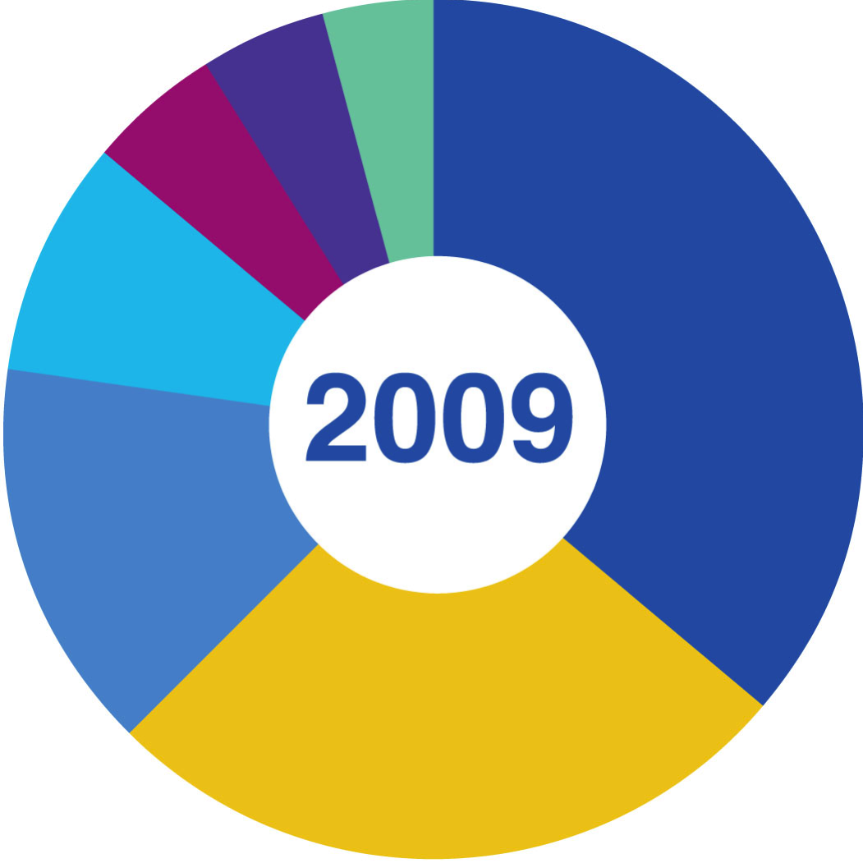
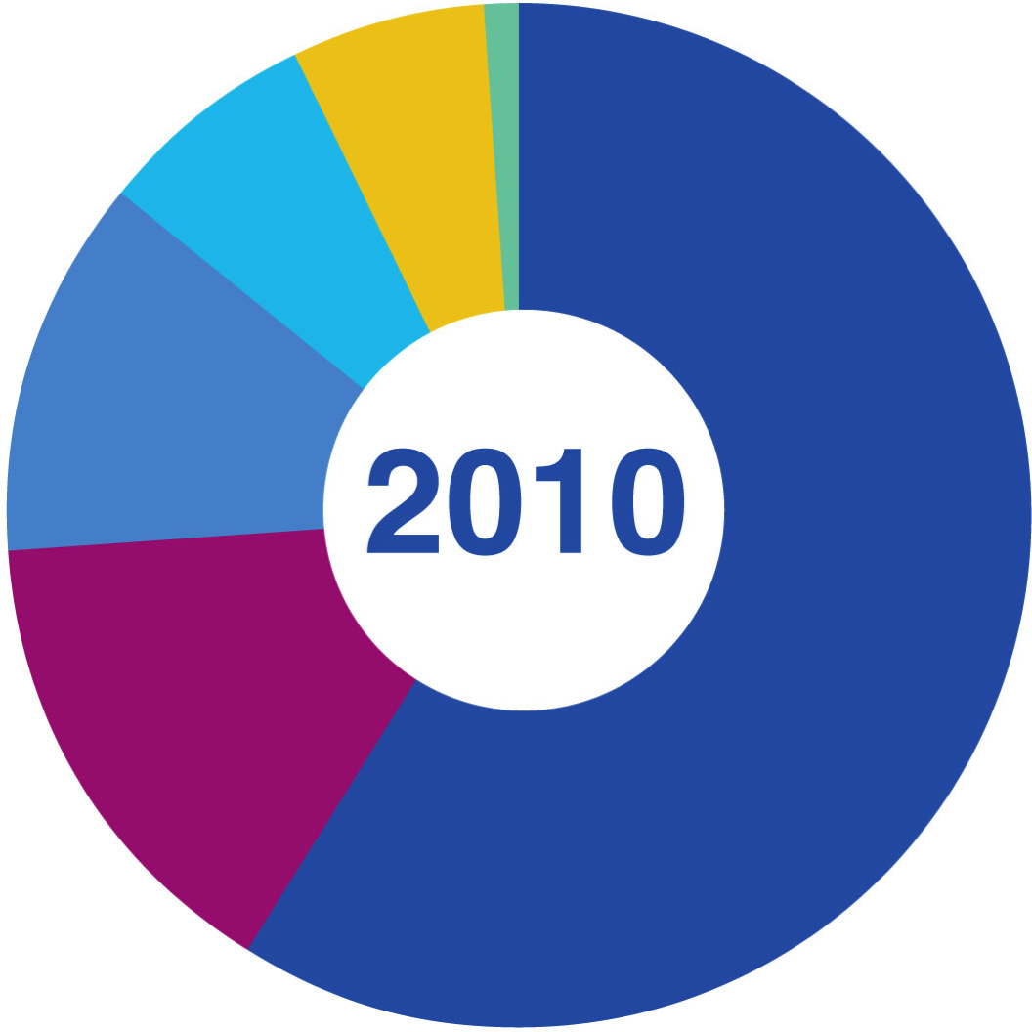
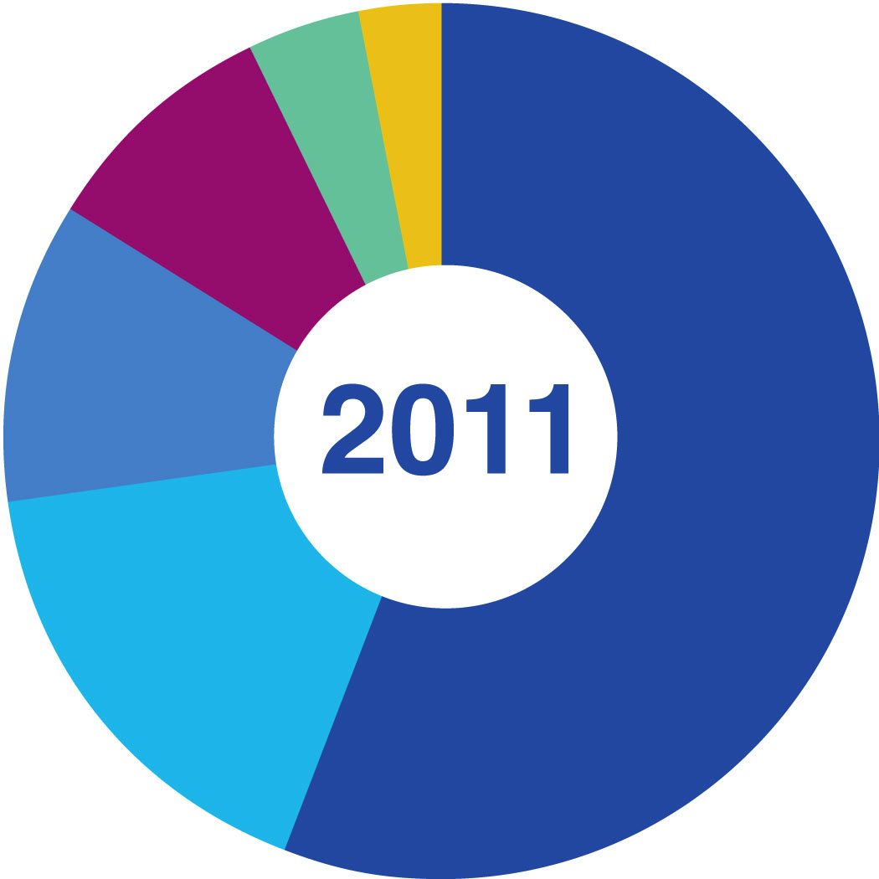
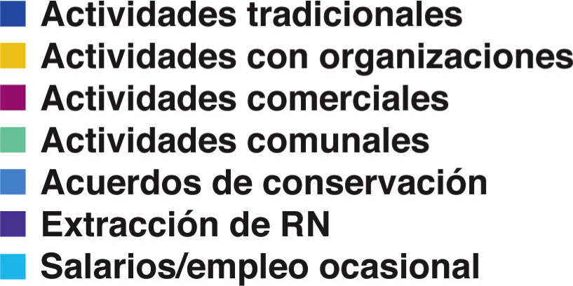
MONITORING: Socio- economic Impact Colombian Amazon example
Notes:
Colombian Amazon example – one thing to track in socioeconomic monitoring is the composition of household income.

Slide 19
Example - Rwanda Restoration of degraded coffee landscapes
Project Objectives;
Restore ecosystem value of degraded coffee landscape (water and coffee production)
Interventions:
SAN certification, conversion to shade grown coffee farms, waste water treatment plants, Credit access, premium market access
Environmental Results: 60,000 trees planted in 3000 hectares, waste water treatment, soil/water conservation, SAN audited production
Social Impact: increased coffee production, higher prices (45% more for one co-op)

Slide 20
Example - Liberia Keep the Forest – be food secure
Project Objectives;
Stop deforestation and poaching at Nimba Nature Reserve
Interventions:
Piggery and rice cultivation enterprise support, forest patrols
Environmental Results: deforestation rate decreased,Incidences of poaching reduced by 50%, slash & Burn cultivation stopped
Social Impact: rice & piggery enterprises for food security, employment creation through patrol wages

Slide 21
LONG-TERM SUSTAINABILITY Colombian Amazon example
Define how the CA will be managed and financed in the future
Strengthened community governance
National program of CAs
Regional Government
Sustainable harvesting
Sustainable markets
Notes:
Colombian Amazon example – for long-term CAs, need to identify solutions to who will manage them in the long-term (take care of the implementer role – a government agency? A local NGO? A community organization? …) and how the costs will be covered (government budgets, trust funds, community enterprises, …)

Slide 22
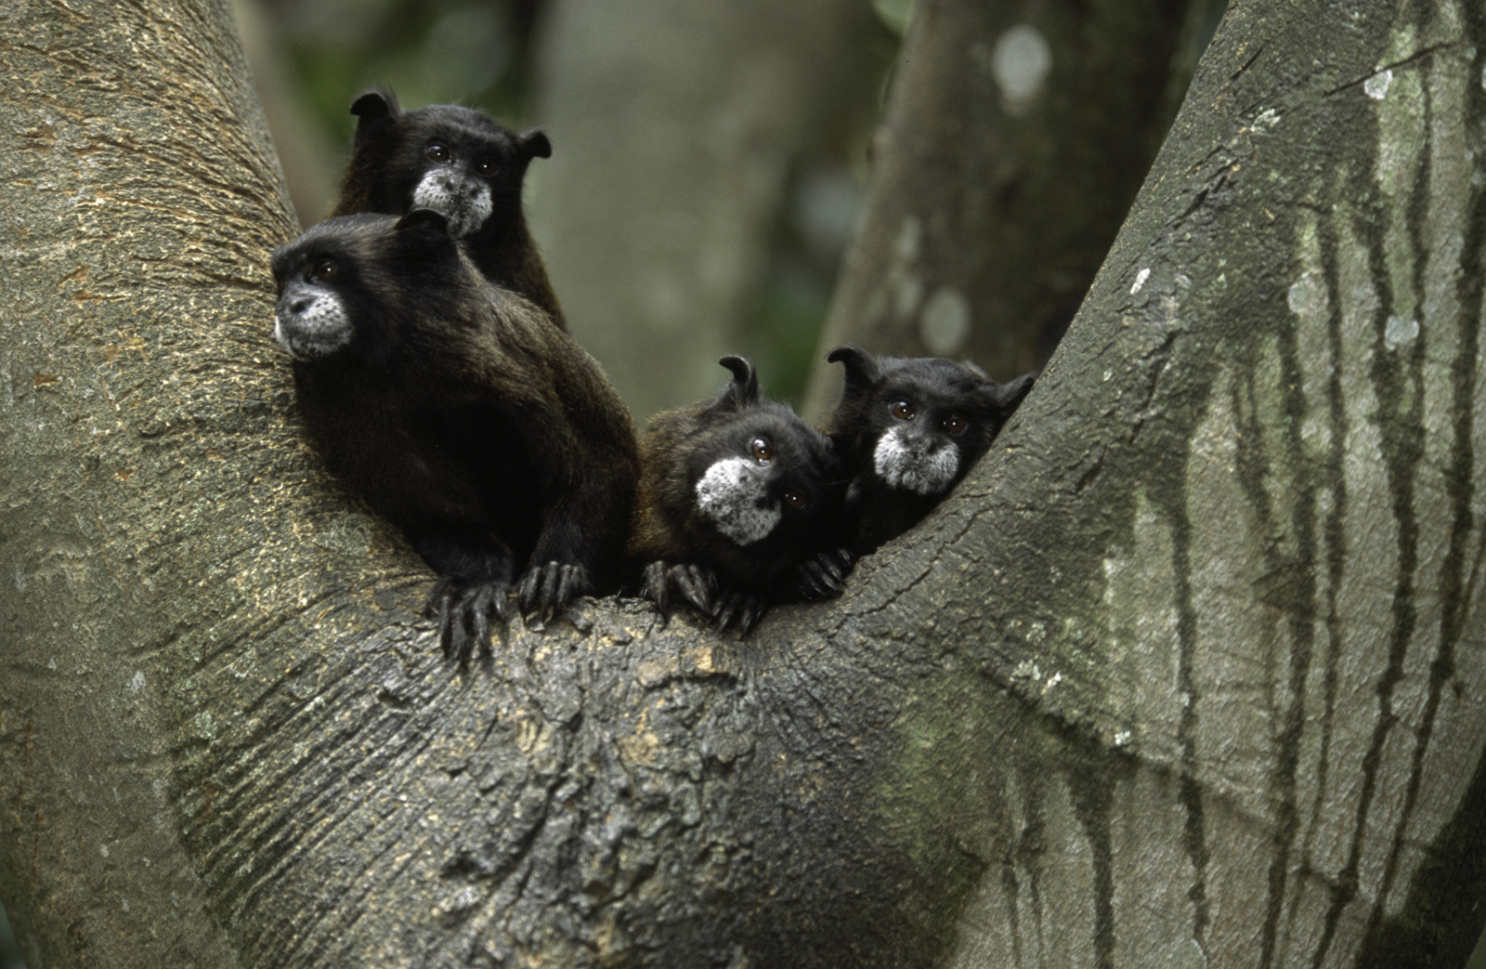
QUESTIONS?
Notes:
Pause for Q&A

Slide 23
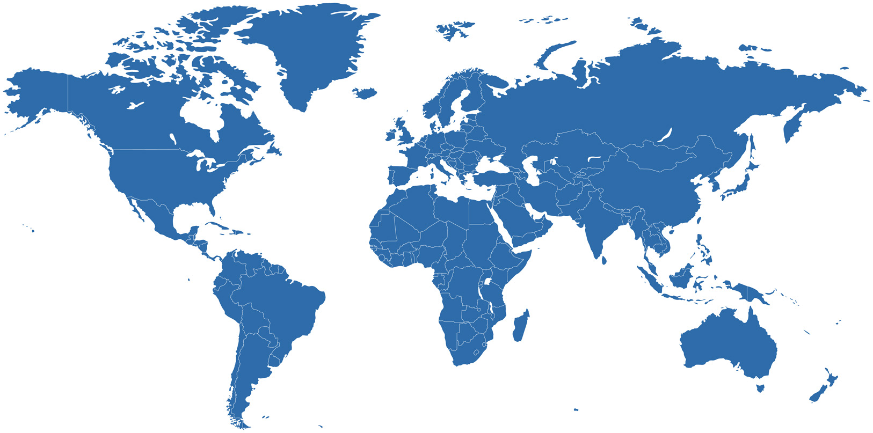
CSP INITIAL PORTFOLIO
Notes:
Map of CSP’s first generation of project sites – demonstration sites in 7 countries, mostly in Latin America

Slide 24
ACCELERATING ADOPTION
Notes:
Map showing new sites since then – some new CSP investments, but also use of the model by other CI programs, and other NGOs, in countries all over the world

Slide 25
IMPACT AT SCALE
Notes:
Map showing countries where large CA program initiatives are in progress
Guatemala – now throughout the MBR
Colombia – national program combining public, private and non-profit sectors exists: Programa Conservación para el Desarrollo
Ecuador – national government program exists: Programa Socio Bosque
Peru – from pilots to CAs with nearly 1,000 households in the Alto Mayo Protected Forest
Bolivia – national government program emerging: COMSERBO
Guyana – national government program under development: Sustainable Development Framework Agreements
Liberia – national government program under development
South Africa – national government program exists
China (Sichuan Province) – progressively higher level government adoption (district, protected area, county, prefecture …)

Slide 26
Applications of the approach CONSERVATION AGREEMENTS
Many scales single community site,
regional, national
Many resource rights settings communal, state,
private
Many ecosystems forests, grasslands, semi-arid, coastal, marine
Many strategic contexts protected areas, biodiversity offsets, REDD+, private sector partnerships
Notes:
Show many different uses of CAs

Slide 27
THE REST OF THE WORKSHOP CSP has developed a process for CA projects
We will go through this process step by step:
Feasibility Analysis
Stakeholder Engagement
Design & Negotiation
Implementation, Monitoring, Renegotiation
Secure Financing and Management
These steps follow the Project Cycle Toward Sustainability:
Notes:
Note the steps in applying the CA approach

Slide 28
PROJECT CYCLE TOWARD SUSTAINABILITY
STEP 1
STEP 4
Feasibility Analysis
Monitoring
Renegotiation
Implementation
STEP 2
Conservation Agreement
Engagement
STEP 5
STEP 3
Design & Negotiation
Secure Financing & Management
Notes:
Graphic of steps in applying the CA approach: note that we typically begin with a series of short-term agreements, while we figure out solutions for a long-term agreement. This also allows opportunities to refine the agreement, build trust, develop relationships, find more partners and, crucially, figure out long-term financing and CA management solutions

Slide 29
4 KEYS CONCEPT
TO CONSERVATION AGREEMENTS
Conservation
Actions
Benefit
Package
Monitoring
Penalties
Notes:
Re-emphasize critical components of a CA: conservation actions, benefits, monitoring, penalties: if there is anything people remember from the session, it should be this!

Slide 30
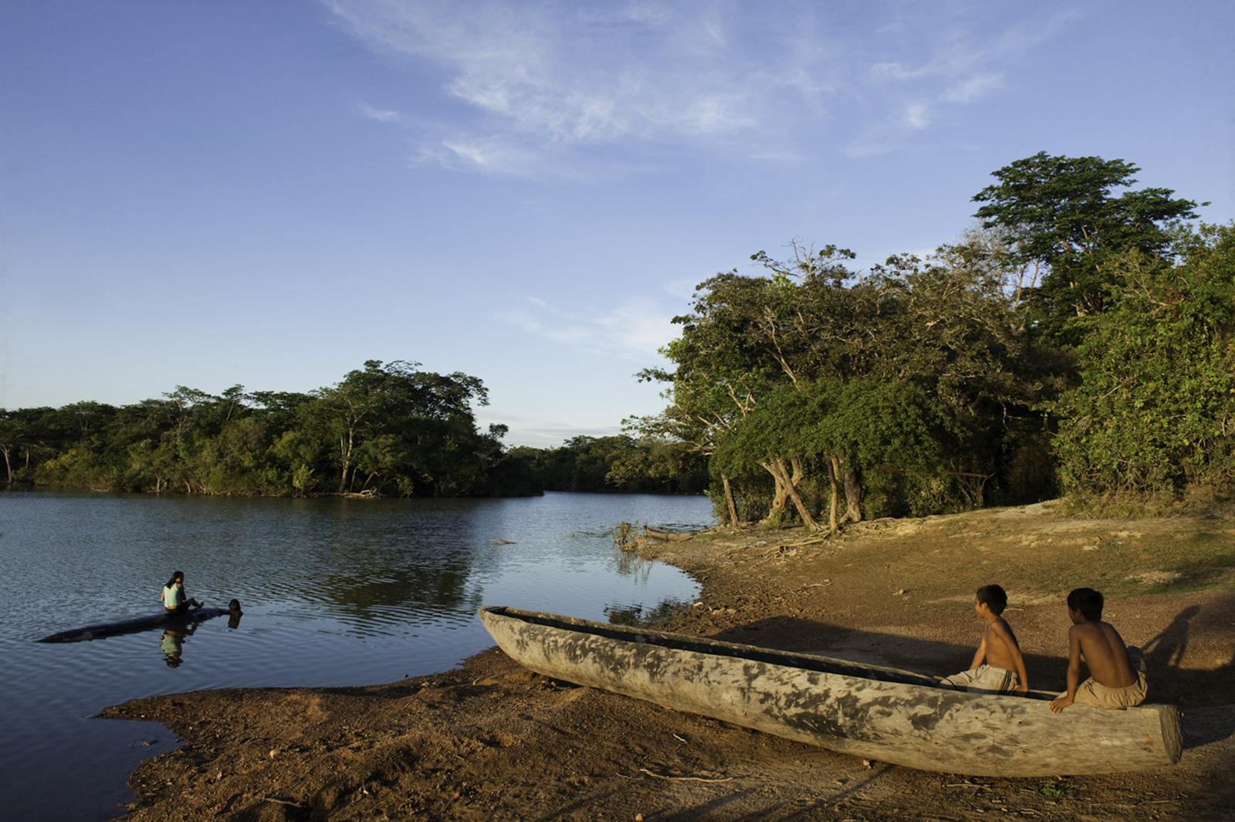
QUESTIONS?
Notes:
End session by opening to Q&A

Slide 31
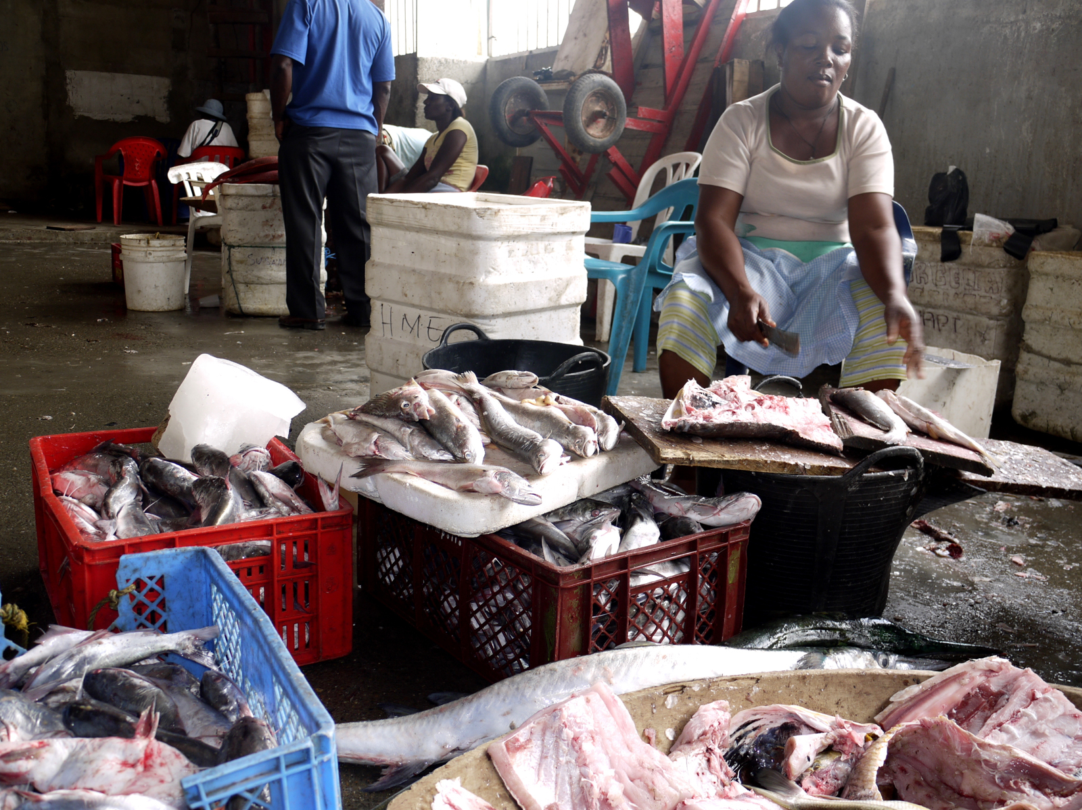
Extended Example
Colombian Amazon
Notes:
Extra Image

