Slide 1
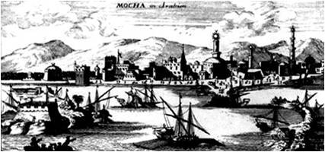
Coffee story
Plant native to Ethiopia /Abyssinia
Story of the goat keepers
Baba Boodan
Yemen port Mocha to Chandragiri hills KA in 16th century

Slide 2
Time lines of Coffee in India- Nilgiris
1795 first experiment done by colonel Read, collector in Tirupatur
Tallaichery
1828 in Malabar Wayanad-Kerala
1838 in Coonoor- Nilgiris
1839 in Kalhatti- Nilgiris
1847 in Ouchterlony ( O valley)Gudalur region

Slide 3
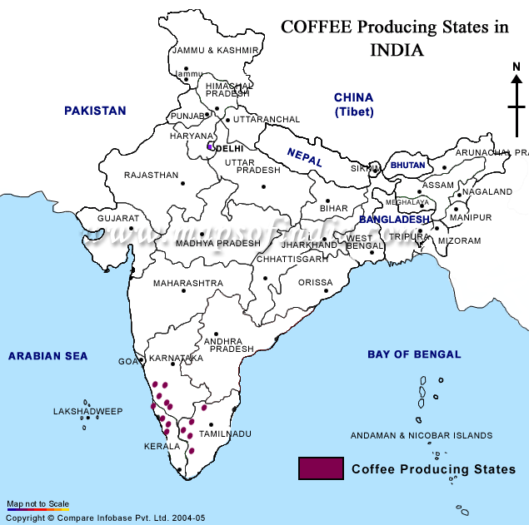

Slide 4
India; 6th largest producer in the world 4.5 %
Karnataka 53%
Kerala 28%
Tamilnadu 11%
17,34,995 acres(2010)
2.9 lakh tonnes (2010)
98 % small growers less than 10acres
Employment for 5,72,430
Local consumption is increasing from 50mt to 94.4mt. still it is 20% of our produce

Slide 6
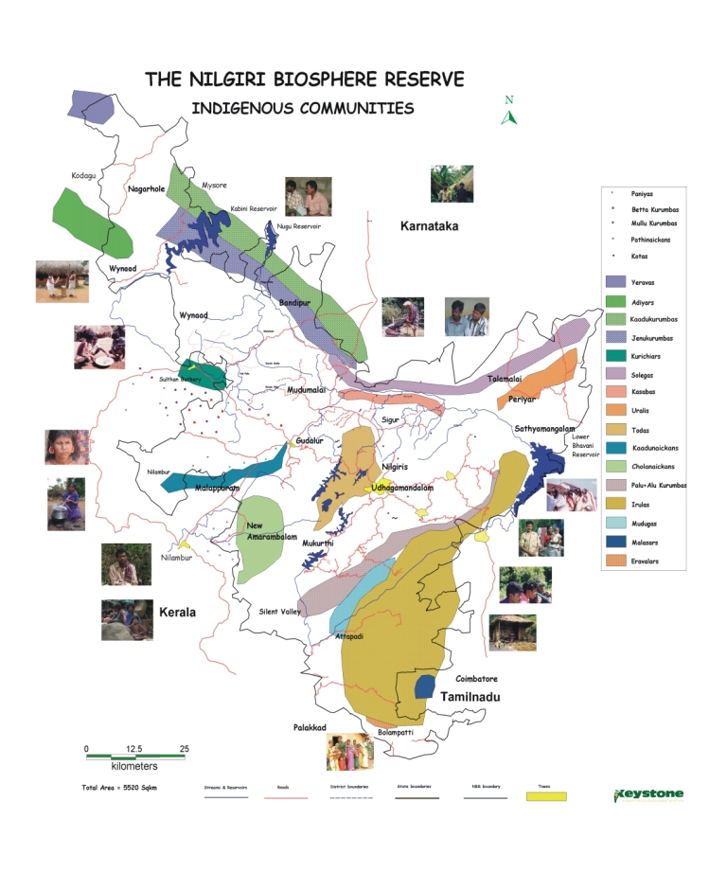

Slide 7
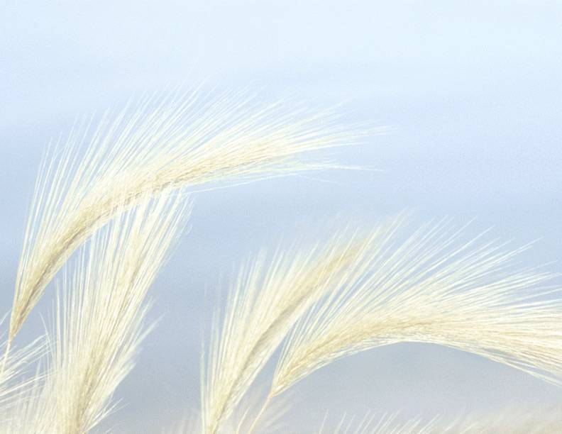
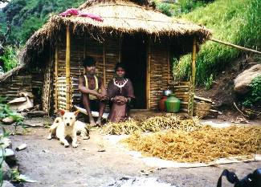
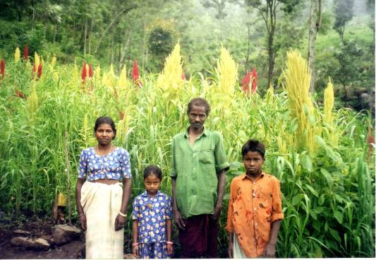
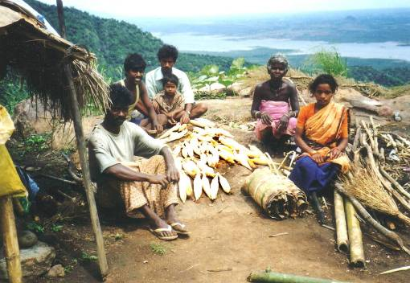
THE PEOPLE

Slide 9
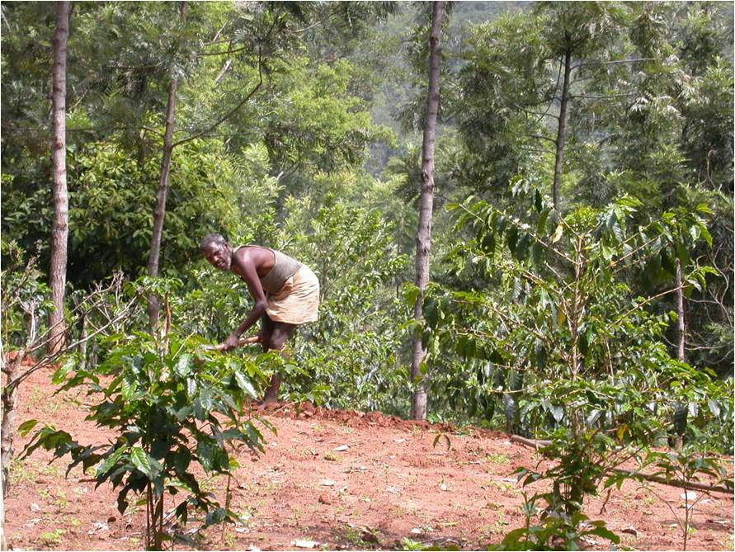
Coffee cultivation: in Kotagiri & Coonoor taluks
176 growers
2 Mts 2010-11
Traditional land
Organic practices
Fair pricing
Profit sharing
Extension

Slide 10
Coffee farming
Diverse Farming by indigenous groups
Rain fed crop
Conserve soil and water
High biological diversity
Crop against climate change
(Jack, nutmeg, clove, pepper, areca, lime, pomegranates, soap berries, silk cotton and wild trees)

Slide 11
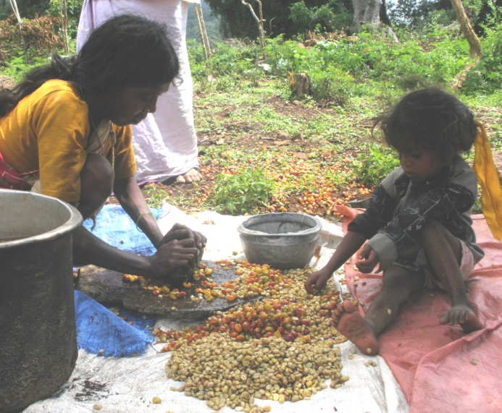
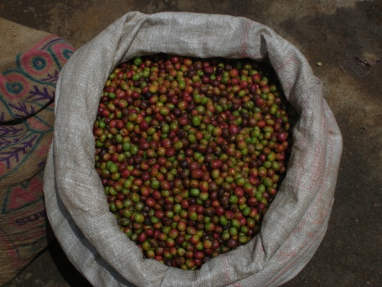
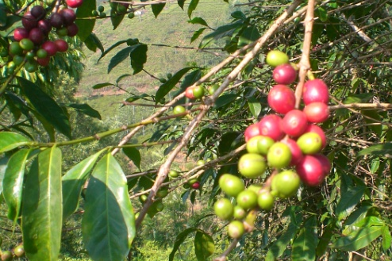
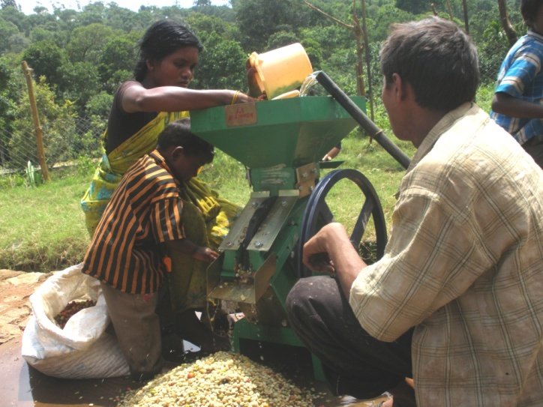
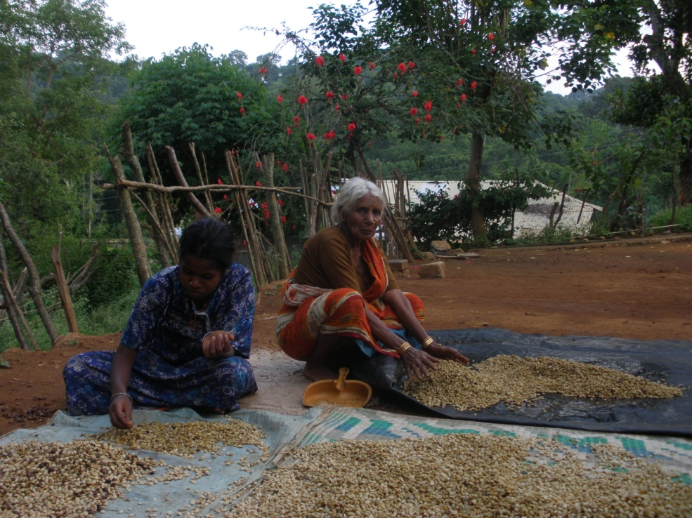
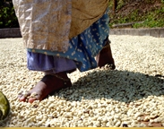
Steps in coffee processing; Processing at farm/village level

Slide 12
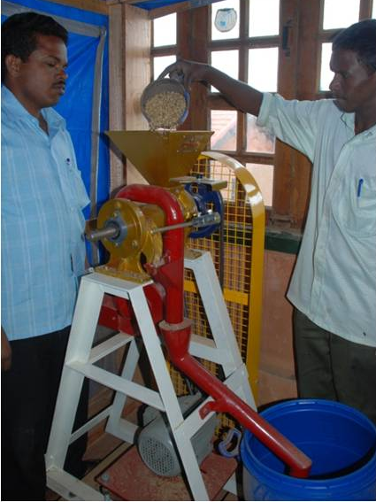
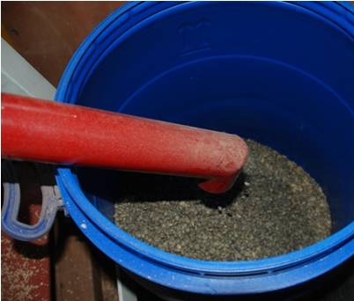
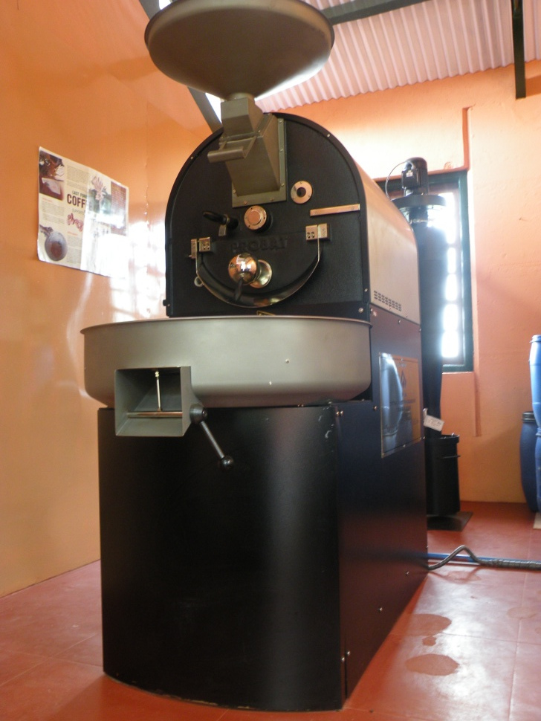
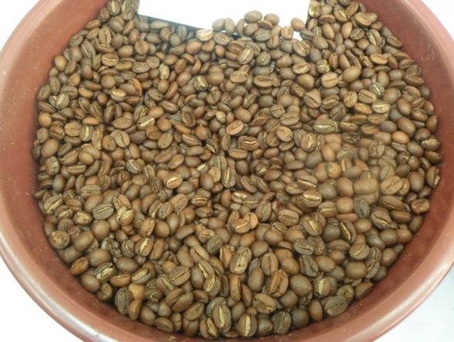
Processing at Kotagiri

Slide 13
Quality control in coffee production: training
cupping
Pure line
Blending
Consumer’s choice
To adjust with market
Fair price for the producer

Slide 14
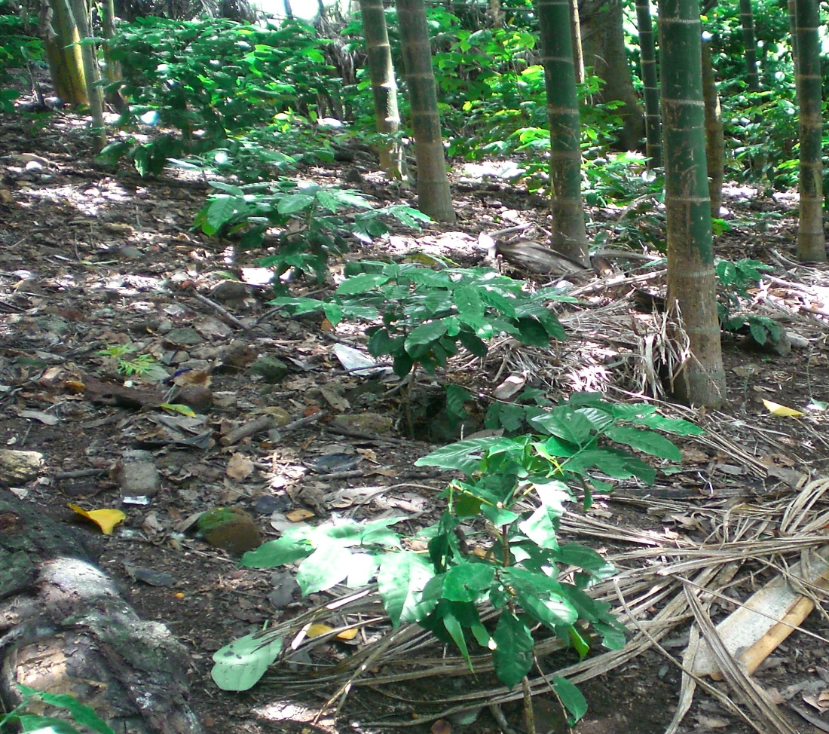
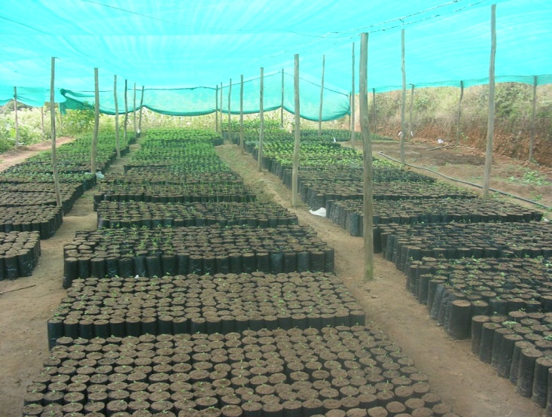
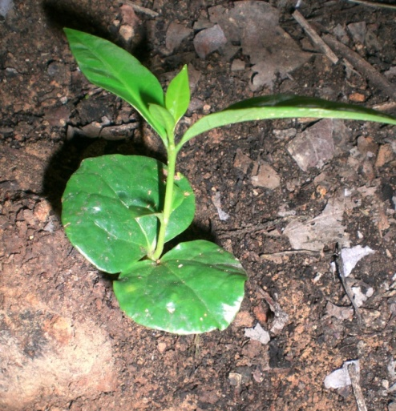
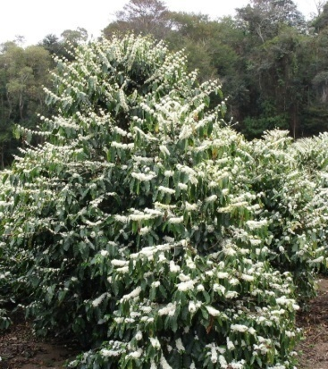
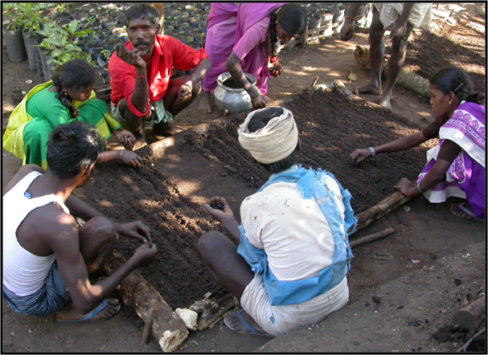
Coffee promotion work

Slide 15
Thank You
Lets us taste Nilgiri coffee now……

