Slide 1
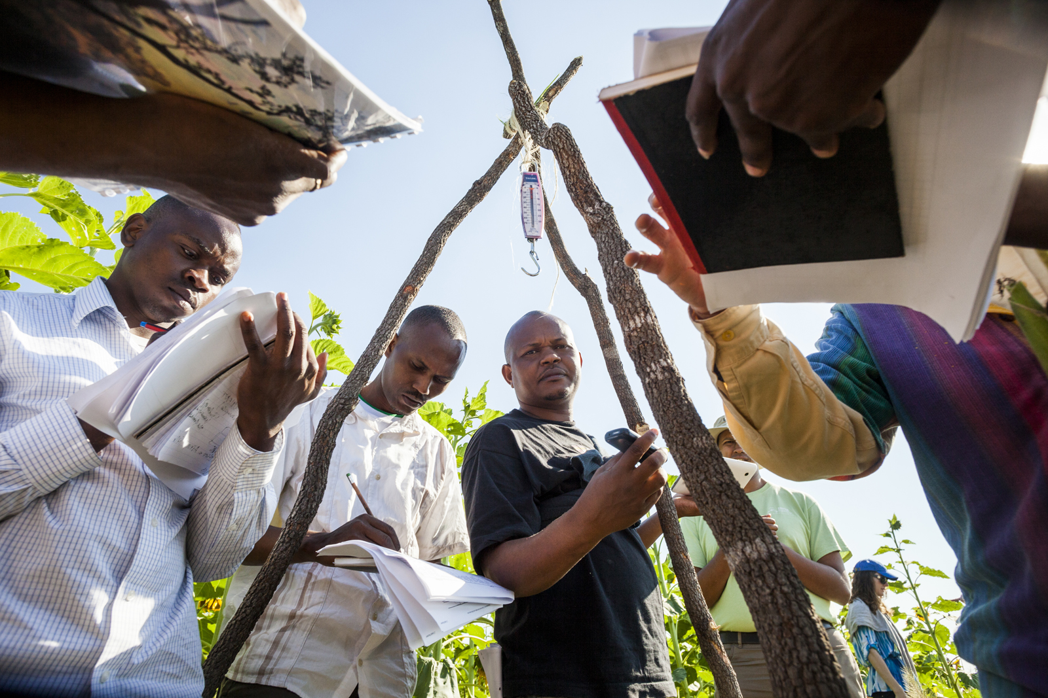
5: MONITORING
Conservation Stewards Program
Notes:
Session title

Slide 2
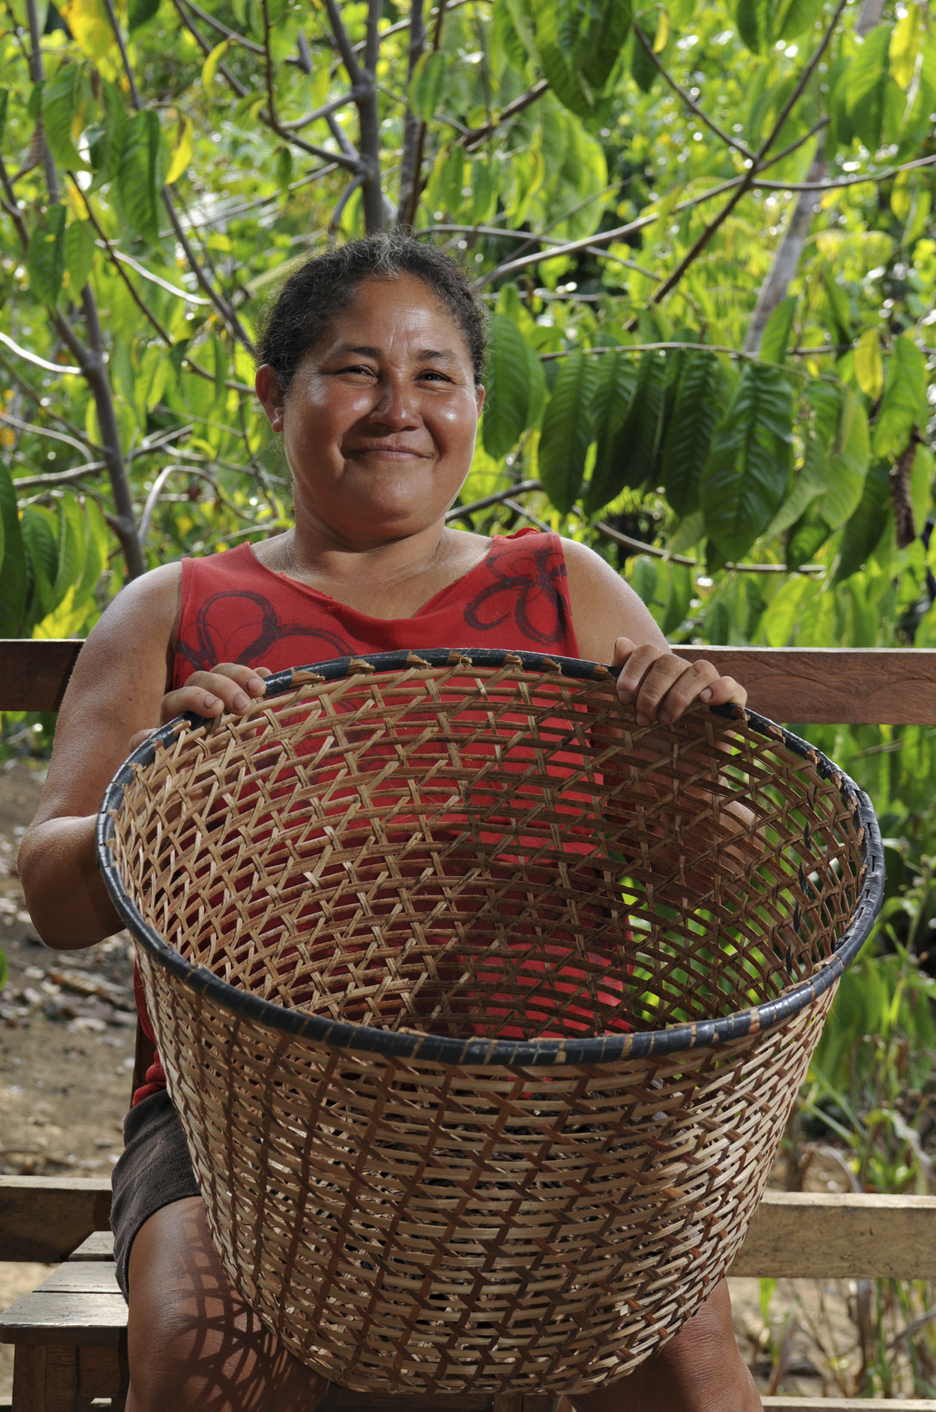
CONSERVATION AGREEMENT
MODEL
a negotiated exchange of benefits in return for changes in resource use, depending on verified performance
Notes:
Repeat basic definition of the CA model, to reinforce that verification of conservation performance is key, which requires monitoring.

Slide 3
PROJECT CYCLE TOWARD SUSTAINABILITY
STEP 1
STEP 4
Feasibility Analysis
Monitoring
Renegotiation
Implementation
STEP 2
Conservation Agreement
Engagement
STEP 5
STEP 3
Design & Negotiation
Secure Financing & Management
Notes:
Reminder of steps in application of the CA model, show that this session is about the monitoring component of the 4th step.

Slide 4
FUNCTIONS
OF
MONITORING
Track impact
Identify agreement weaknesses
Inform renegotiation
Build case for scaling up
Develop communications material
Fundraising
Policy engagement
Notes:
Monitoring has many purposes, some related to the working of the CA itself, some to justify the investment and support further fundraising, some will help with policy engagement, etc.

Slide 5
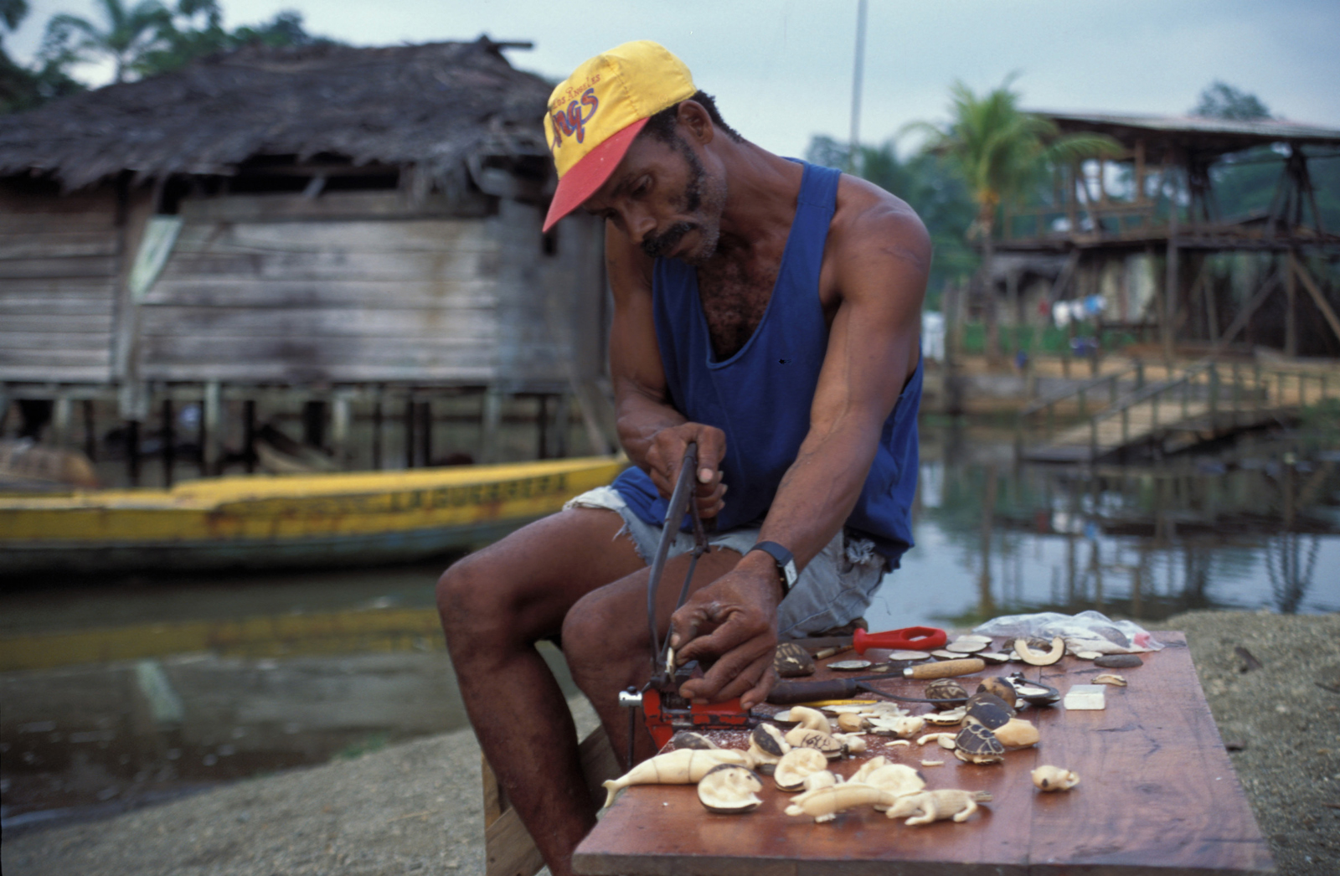
AREAS OF MONITORING
BIODIVERSITY
Is conservation being achieved?
COMPLIANCE
Are conservation commitments being met?
SOCIO-ECONOMIC
Are people better off?
Notes:
Reemphasize the three types of monitoring in the CA model.

Slide 6
MONITORING FRAMEWORK
Based on Theory of Change
Developed during design and negotiation
Baseline is essential
Third-party when possible
Notes:
Note that the Theory of Change developed earlier was important, because it provides the basis for the monitoring framework. Also, engagement, negotiation, and design efforts will have produced key inputs for the monitoring framework as well, for example negotiating conservation actions and how they will be verified. Monitoring requires a baseline, to identify changes and progress toward desired biological, social, and behavioral outcomes. Using objective 3rd party monitors is ideal, often requiring partnerships, possibly with a university or research center.

Slide 7
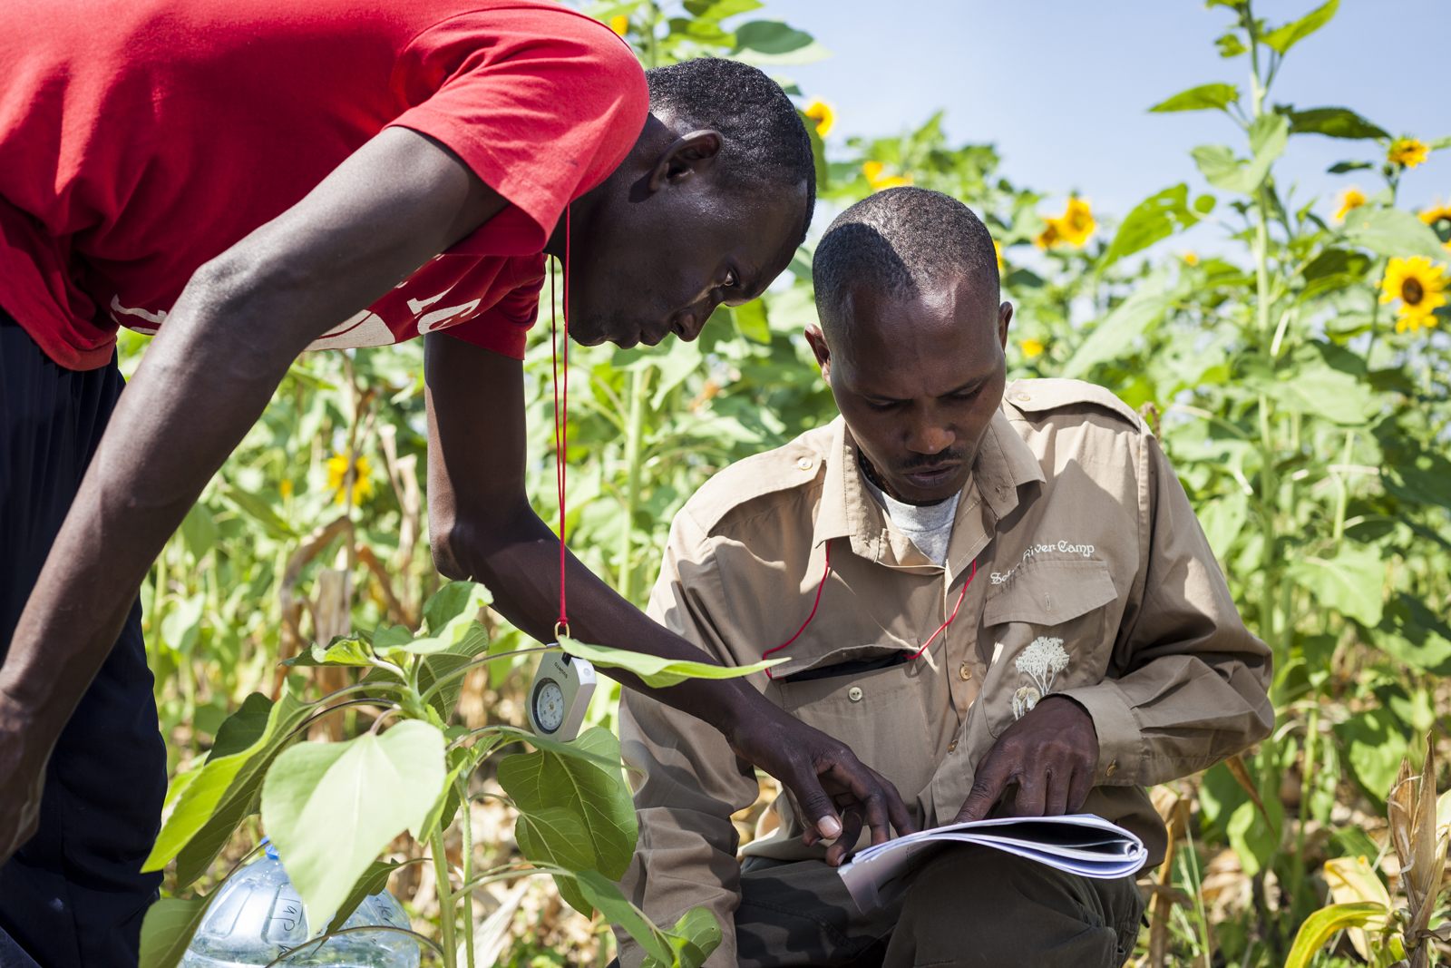
MONITORING FRAMEWORK
INDICATORS
MUST
BE:
relevant
readily measured
able to show progress in a short time
INVOLVE THE COMMUNITY IN MONITORING
conservation jobs
pride
knowledge & information
Notes:
A key point here is that involving the community in monitoring offers several advantages, and contributes to engagement/ownership of the community in the overall CA.

Slide 8
MONITORING FRAMEWORK
COMMUNICATING RESULTS
Monitoring report template
Summary statistics for key indicators
Report back to communities
Notes:
Implementer should prepare a well-organized system for collecting, analyzing, reporting, and communication monitoring results. It is important to prepare information in forms that are easy for communities to understand - oral presentation, calendar/poster, photo exhibit, etc. If external researchers are involved in monitoring, ensure that their TOR includes the obligation to prepare such materials and/or present to community.

Slide 9
BIODIVERSITY MONITORING
THREATS
DEGREE/SEVERITY
INCREASING/DECREASING
OUTCOMES
HABITAT AREA
HABITAT QUALITY
POPULATIONS OF KEY SPECIES
ECOSYSTEM SERVICES
Notes:
Biodiversity monitoring address the threats and outcomes defined in the Theory of Change. This will tell whether the CA is achieving the desired conservation outcomes.

Slide 10
THEORY OF CHANGE
Iscuandé (Colombia)
 | Action | Driver | Threat | Outcome
Elements | Establish local monitoring system (paid) Establish rotating zoning plans for mangrove management to recuperate areas Establish size restrictions (on clam) | No alternative fuelwood sources Demand (food) for local consumption Demand (food) for export | Overharvesting for fuelwood Overharvesting for food (too many, too small) | Stop degradation of mangroves Restore populations of piangua (black clam)
Notes:
Shows the theory of change for the Iscuande example in table format.

Slide 11
THEORY OF CHANGE
Iscuandé (Colombia)
 | Outcome
Elements | Stop degradation of mangroves Restore populations of piangua (black clam)
Targets (in 5 years) | Area of mangroves (ha) and quality of mangroves (diversity) stable or improving Increase in average size of piangua by 25% # of piangua harvested stable
Indicators | # of ha of mangroves Species diversity index in plots Average size (mm) of piangua # of piangua collected
Data collection (frequency) | Sampling plots Piangua collection station reports (monthly)
Notes:
Introduces the concepts of time-based targets, indicators, and data collection.

Slide 12
THEORY OF CHANGE
Iscuandé (Colombia)
 | Action | Driver | Threat | Outcome
Elements | Establish local monitoring system (paid) Establish rotating zoning plans for mangrove management to recuperate areas Establish size restrictions (on clam) | No alternative fuelwood sources Demand (food) for local consumption Demand (food) for export | Overharvesting for fuelwood Overharvesting for food (too many, too small) | Stop degradation of mangroves Restore populations of piangua (black clam)
Targets (in 5 years) | Fully staffed monitoring team Entire area zoned Size restrictions established and implemented | NA | <2 instances of harvesting mangrove outside of plans per month Less than 5% of piangua collected will be undersized | Area of mangroves (ha) and quality of mangroves (diversity) stable or improving Increase in average size of piangua by 25% # of piangua harvested stable
Indicators | # hours patrolling $ invested in wages Ha under zoning (mangrove) # families agreeing to size restrictions |  | # reported infractions in following mangrove zoning plans Average size (mm) of piangua | # of ha of mangroves Species diversity index in plots Average size (mm) of piangua # of piangua collected
Data collection (frequency) | Patrolling reports Payment records Zoning plans (monthly) |  | Vegetation cover analysis (years 1, 3 and 5) Analysis of piangua collection results (monthly) | Sampling plots Piangua collection station reports (monthly)
Notes:
Shows the entire suite of targets, indicators and data collection across actions, threats, and outcomes. The actions are aimed at the threats themselves so we aren’t anticipating changes in the drivers, therefore they are blank. If we were for example providing alternative fuelwood sources we would build out monitoring for that activity and how that driver would change and be monitored.

Slide 13
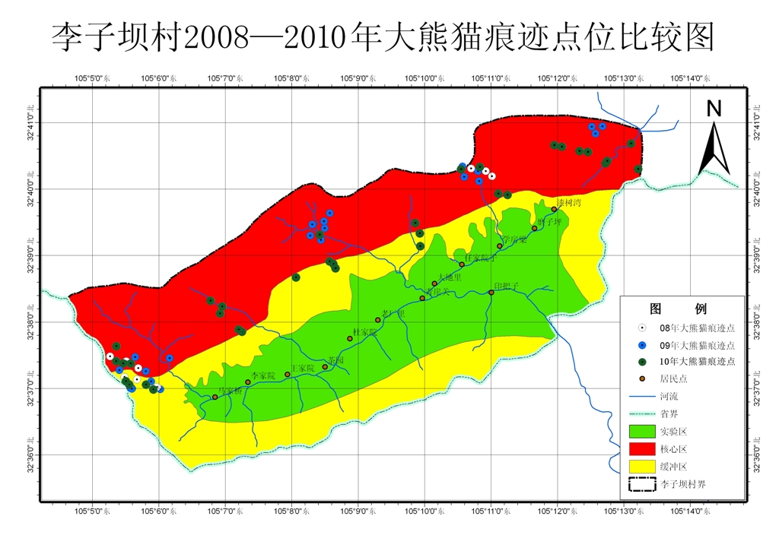
No illegal logging
No illegal hunting
Agriculture follows land-use plan
No burning or nets around nests
Community forest patrols
Notes:
This is a map of the Lizhiba community area in China’s Sichuan Province. The colored circles show where signs of Panda activity were observed each year; the dots show how Panda activity is spreading wider and wider, including down the valleys toward the villages, as increased protection efforts under the CA improve habitat and reduce disturbances.

Slide 14
SOCIO-ECONOMIC MONITORING
AWARENESS OF THE AGREEMENT
Conservation responsibilities
Benefits/how they are distributed
Penalties
Notes:
Overall, the main question for socioeconomic monitoring is whether people are better off under the CA. But this is also an important opportunity to check awareness of and satisfaction with the CA among people throughout the community. Therefore socioeconomic monitoring includes asking people about their knowledge of commitments, benefits and penalties under the CA. In some CAs, there is an incentive for the leadership or a natural resource committee to ensure wide community awareness; socioeconomic monitoring then determines whether that incentive is to be maintained or reduced (e.g. the committee gets $100 for its management expenses if at least 75% of surveyed community members correctly describe the basic CA).

Slide 15
SOCIO-ECONOMIC MONITORING
Perceptions of threats/conservation
Effectiveness of decision-making institutions
Impact of benefits on human wellbeing
Notes:
In addition to awareness of CA, an essential role of socioeconomic monitoring is to see if the CA is making people measurably better off (e.g. income, access to electricity, clean water), and if they perceive conditions as improving (such as threats, quality of governance, etc.). Importantly, monitoring should check whether people believe that any improvements are linked to the CA.

Slide 16
SOCIO-ECONOMIC RESULT
IMPROVED HUMAN WELLBEING THROUGH SOCIAL SERVICES
Areng Valley,Cambodia
Notes:
Given that there are so many different possible components of benefit packages in a CA, the things to measure and results to report vary widely. In Cambodia, one benefit was providing salary supplements for teachers; the implementer showed that this led to a significant increase in school attendance.

Slide 17
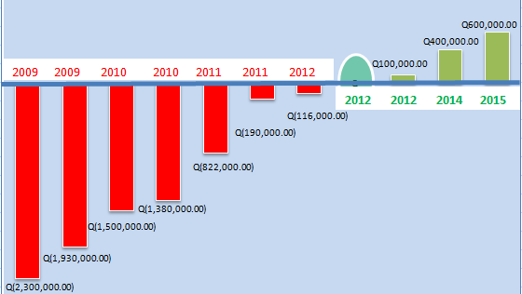
SOCIO-ECONOMIC RESULT
GREATER EFFECTIVENESS OF INSTITUTIONS
Uaxactún,
Guatemala
Debt reduction for community forest management body
Notes:
In Guatemala’s Maya Biosphere Reserve, a CA with the community of Uaxactún sought to improve the capacity and functioning of the community forest management body. Success in this regard was shown by steady decrease in the level of debt of the body, and eventually surpluses that contribute to community income.

Slide 18
RENEGOTIATION
Link to monitoring
Timing: monitoring, analysis, communication
Start with simple CA, expand over time
Update key Feasibility Analysis elements
Notes:
Remember, in all likelihood you will renew the agreement several times for the short term, before sealing a long term deal. This requires renegotiation. Renegotiation must be linked socioeconomic and biodiversity monitoring to refine conservation actions as well as benefits. However, some socioeconomic trends take longer to manifest, so they may not be worth checking annually (also because of cost); this needs to be thought about with respect to renegotiation. Also, careful planning is needed to ensure a smooth process with respect to ending one round of the CA and starting the next, with respect to timing of monitoring efforts, analysis of results, communicating results to stakeholders, and renegotiating the CA. You want to avoid long gaps between CA rounds. Finally, you should consider a strategy of starting with a simple CA, and using annual renegotiations to increase the strictness/magnitude or scope of commitments over time (which may require increasing incentives too, of course).

Slide 19
THANK YOU!
Notes:
Closing slide, opens Q&A session.

