Slide 1
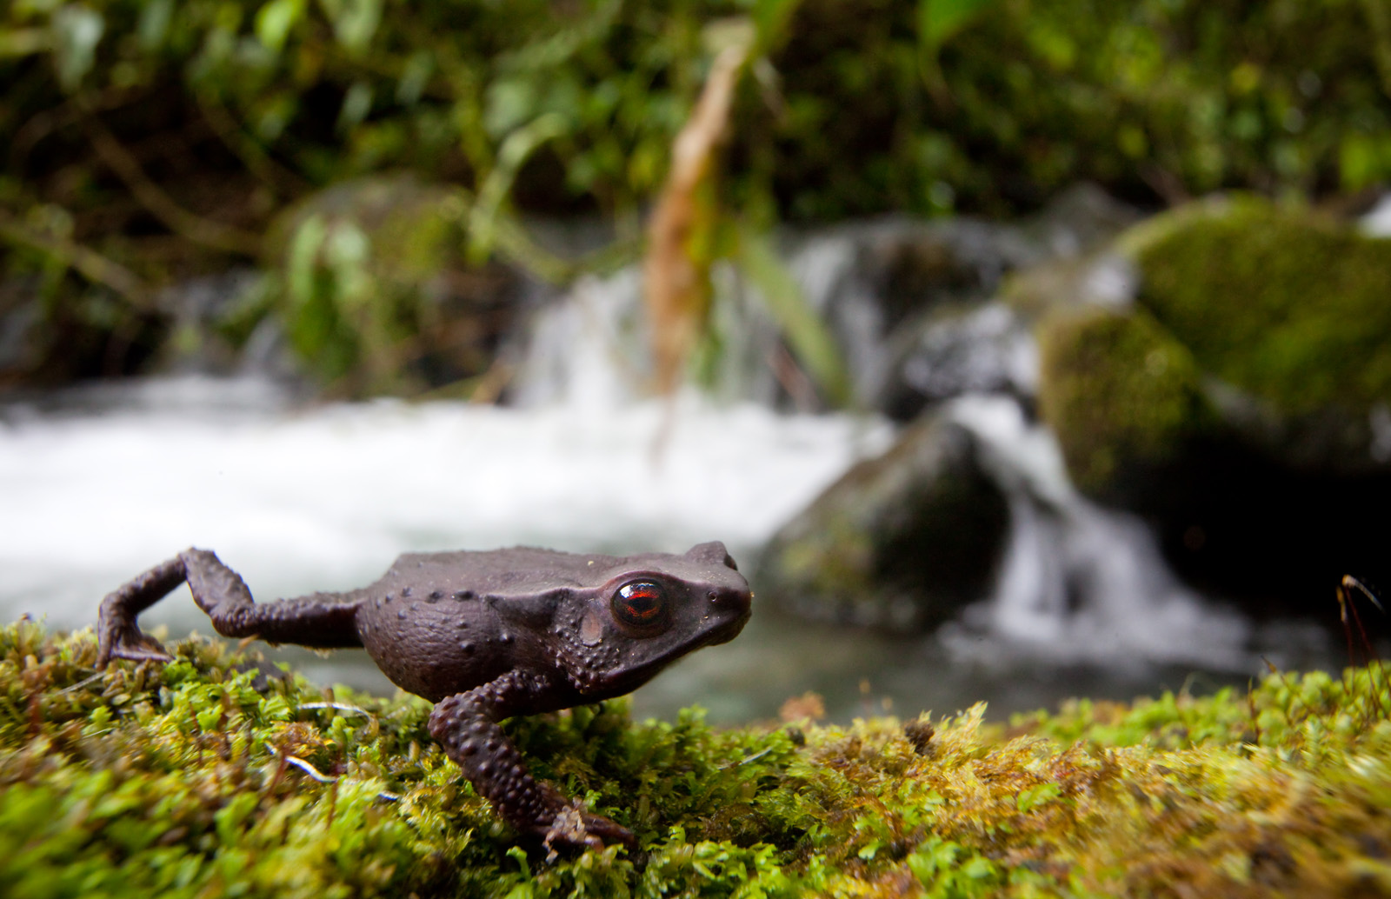
6: SUSTAINABILITY
Conservation Stewards Program
Notes:
Session title

Slide 2
PROJECT CYCLE TOWARD SUSTAINABILITY
STEP 1
STEP 4
Feasibility Analysis
Monitoring
Renegotiation
Implementation
STEP 2
Conservation Agreement
Engagement
STEP 5
STEP 3
Design & Negotiation
Secure Financing & Management
Notes:
Reminder of steps in application of the CA model, show that this session is about the monitoring component of the 5th step. A big picture question, related to the Theory of Change, is: what is the long-term strategy for the overall intervention? If it is a long-term CA, then you need to think about long-term sustainability with respect to financing and management.

Slide 3
LONG-TERM
CONSERVATION AGREEMENT
Development vision
Management plan
Monitoring indicators
Financing
Exit Strategy
Notes:
Note: “Long-term” means mid- or long-term throughout; the point is thinking beyond year to year renewal of CAs.
Questions for intervention strategy: what is the exit strategy for the implementer? What does sustainability look like (captured in Theory of Change)? How does this relate to replication/amplification?
If the plan is for a long-term CA, strategy should be integrated into wider long-term context – benefit package should be integrated into wider development vision; management plan needs to address long-term issues (especially about who will be responsible for what); the monitoring framework should address longer term questions about development, resilience, and sustainability; and financing strategy needs to take a long-term perspective.

Slide 4
FEASIBILITY CONSIDERATIONS
Biological Importance
Resource Rights
Expected costs
Threats
Stakeholders/ conflicts
Financing options
Capacity of stewards and Implementers
Political/legal context
Exit strategy
Notes:
At the beginning of the CA model project cycle, with feasibility analysis, you should already have looked ahead to the long-term.

Slide 5
FEASIBILITY CONSIDERATIONS
Financing options
Capacity of stewards and Implementers
Notes:
Recall that the feasibility analysis included initial thinking about financing options. To enter into a long-term CA, this needs to be fully developed. Also, the long-term vision hinges on capacity – what will be needed to enable Stewards (and implementers and other partners) to take on management responsibility in the long term?

Slide 6
LONG-TERM MANAGEMENT
CONSERVATION – BENEFITS – MONITORING
Community responsibilities
Implementer responsibilities
Capacity gaps
Timeline for transition
Notes:
You need to consider who will be responsible for organizing and verifying conservation actions in the long term, organizing provision of benefits in the long term, and monitoring compliance and socioeconomic and biological impacts in the long term. The vision for long-term management should consider both management of the CA itself, and management of natural resources/conservation in general.

Slide 7
LONG-TERM FINANCING
CONSERVATION – BENEFITS – MONITORING
Brief summary of CA
Annual budget
Funding history
Mid/long-term financing vision
Current and potential prospects
Workplan
Notes:
Long-term financing must cover the costs of conservation activities, benefits and monitoring. See the handout for a guide to developing a long-term financing plan.

Slide 8
Payments for Ecosystem Services (water, REDD+)
Community enterprise (ecotourism, NTFPs)
Government programs
SECURE FINANCING VISION
Ongoing fundraising (individuals, foundations, env/dev orgs)
Trust funds
Corporate partners (purchasing, offsets, CSR)
Notes:
Long-term financing solutions will vary greatly by site. In some sites, a community-based organization may be built to have the capacity for ongoing fundraising or enterprise management that sustains conservation activities. At others, financing will depend on external sources such as government programs, or national conservation trust funds. Sometimes the need for long-term financing is raised as a challenge for CAs; although it can be challenging, it is worth noting that this challenge is one faced by most conservation efforts.

Slide 9
Employment, income
Legal status
LONG-TERM
RESILIENCE
Awareness of benefits
Pride
Institutional strength
Notes:
Solutions for long-term management and financing are crucial. At the same time, one can invest in other factors to reinforce long-term resilience of the CA. These include ensuring that employment and income are linked to conservation, investing in community awareness of direct as well as indirect benefits of the CA (including the benefits of having a healthier/more biodiverse resource base), improved planning and decision-making through institutional strengthening at the community level, seeking opportunities to enhance the legal protection status of key conservation areas, and communication campaigns that build pride in the conservation accomplishments (videos, prizes, news coverage, government recognition, etc.).

Slide 10
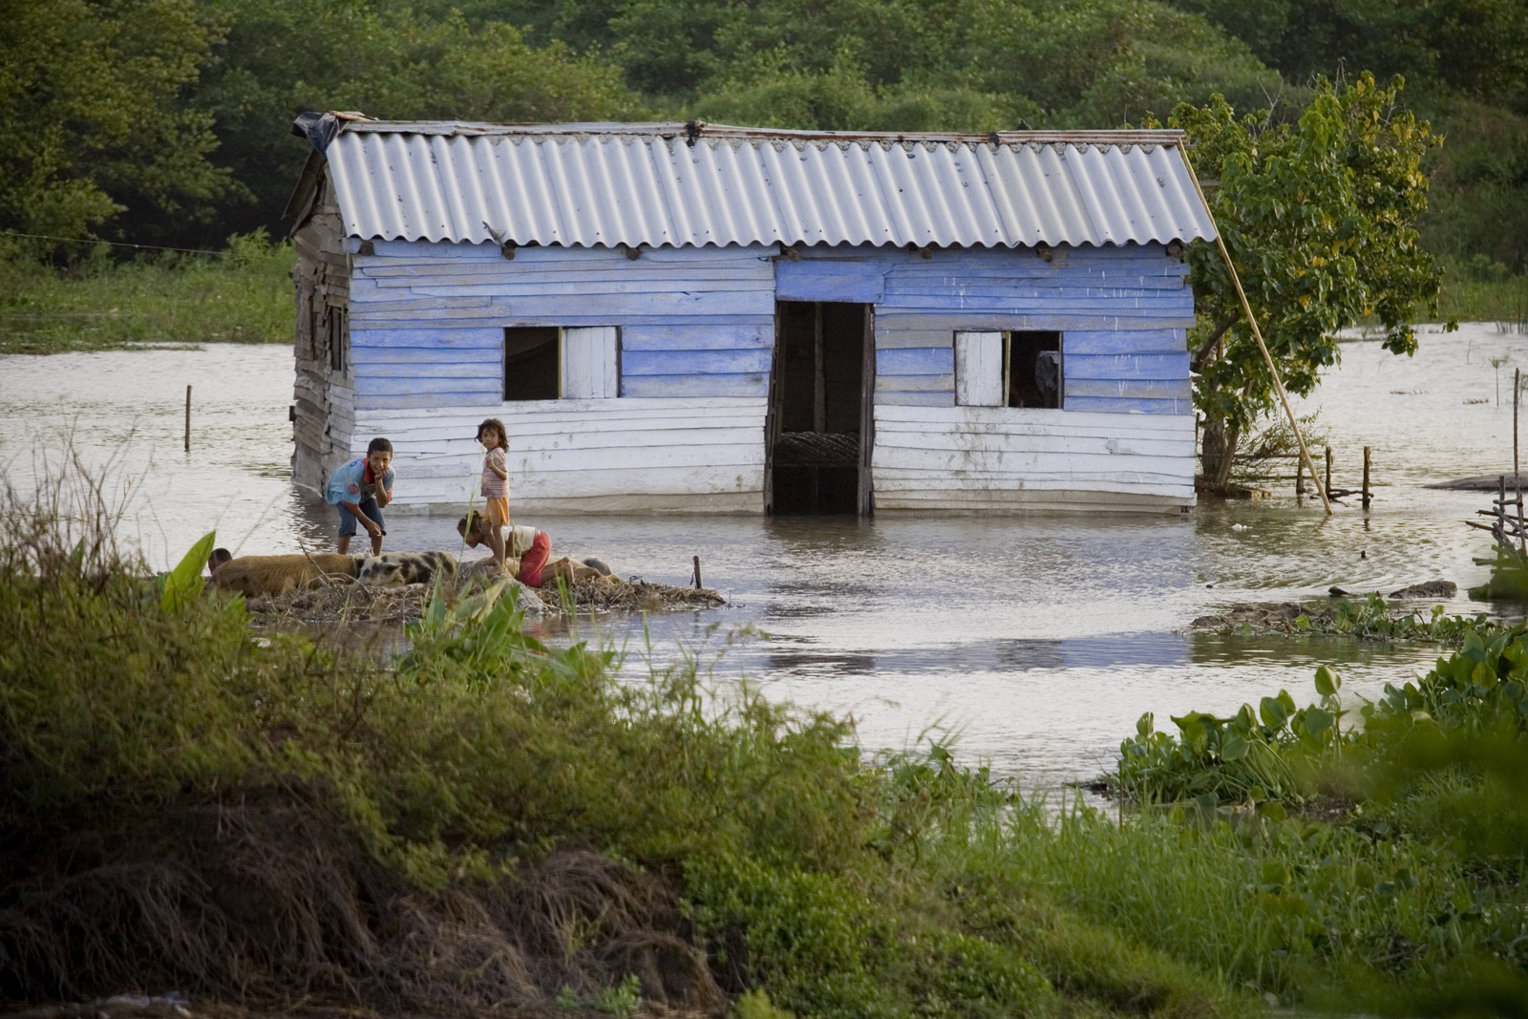
THANK YOU!
Notes:
Closing slide, opens Q&A session.

