Slide 1
Community Experiences on Indigenous Seed Sovereignty & Seed Savers Rights
A Project through Rosa Luxemburg Stiftung (2024)
Using Diversity Regional Meeting
Wayanad, 20th Sept 2024

Slide 2
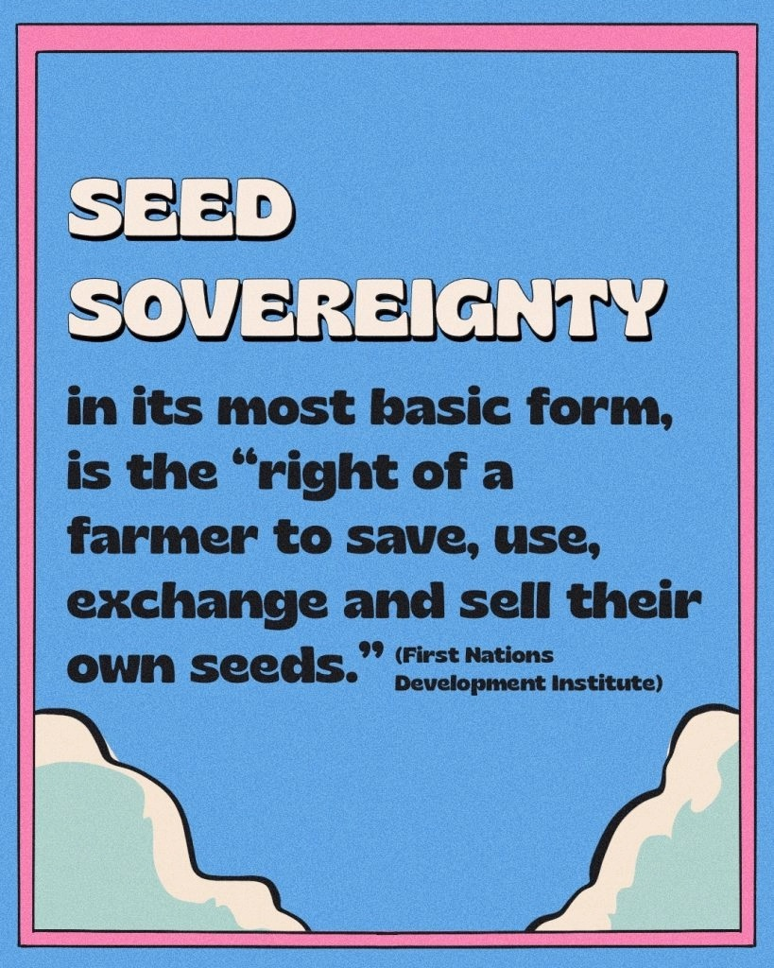
India’s ‘National Bureau of Plant Genetic Resources (NBPGR) has over 4,00,000 accessions of 1586 species.
ICRISAT holds 25,000 Indian varieties of dry-land crops.
Many thousands of our crop seeds have ended up in distant gene banks: IRRI in Philippines, CIMMYT in Mexico, or Fort Collins in USA.
All such varieties from India, rightly belong to our farming and indigenous communities!

Slide 3
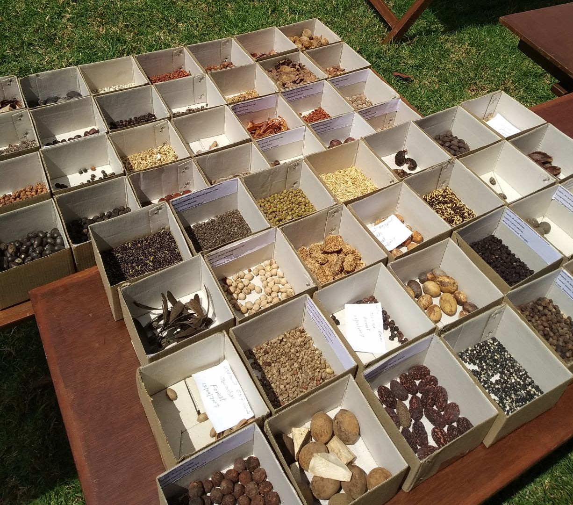
Policies, Laws & Government Actions
International agreements like the International Treaty on Plant Genetic Resources for Food and Agriculture (ITPGRFA)
United Nations Declaration on Rights of Peasants (UNDROP), 2018.
Trade Related Intellectual Property Rights (TRIPS) on seeds and genetic resources.
The Seeds Act, 1966
Protection of Plant Varieties and Farmers' Rights Act (PPVFR Act)
  Rights of farmers to save, use, and exchange seeds
  Plant variety protection and intellectual property rights
Biological Diversity Act, 2002
National Seed Policy, 2011
  Promotion of hybrid and GMO seeds
  Impact on traditional seed systems and farmer rights
Seed Bill, 2019 (Proposed)
HOW DO ANY OF THESE LAWS AND POLICIES IT IMPACT OUR COMMUNITIES?

Slide 4
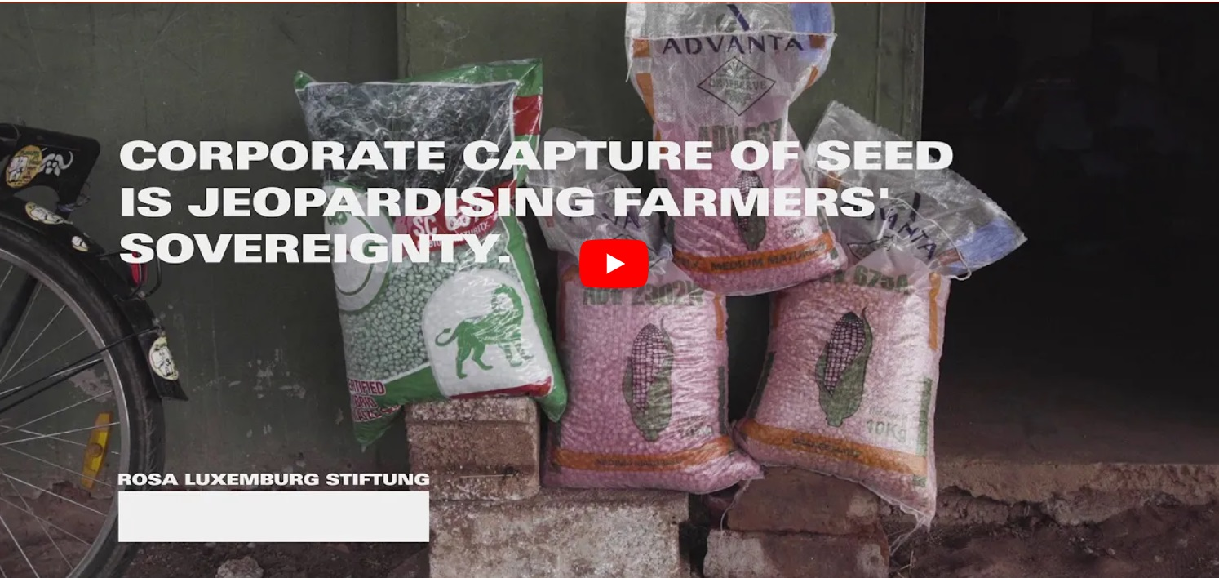
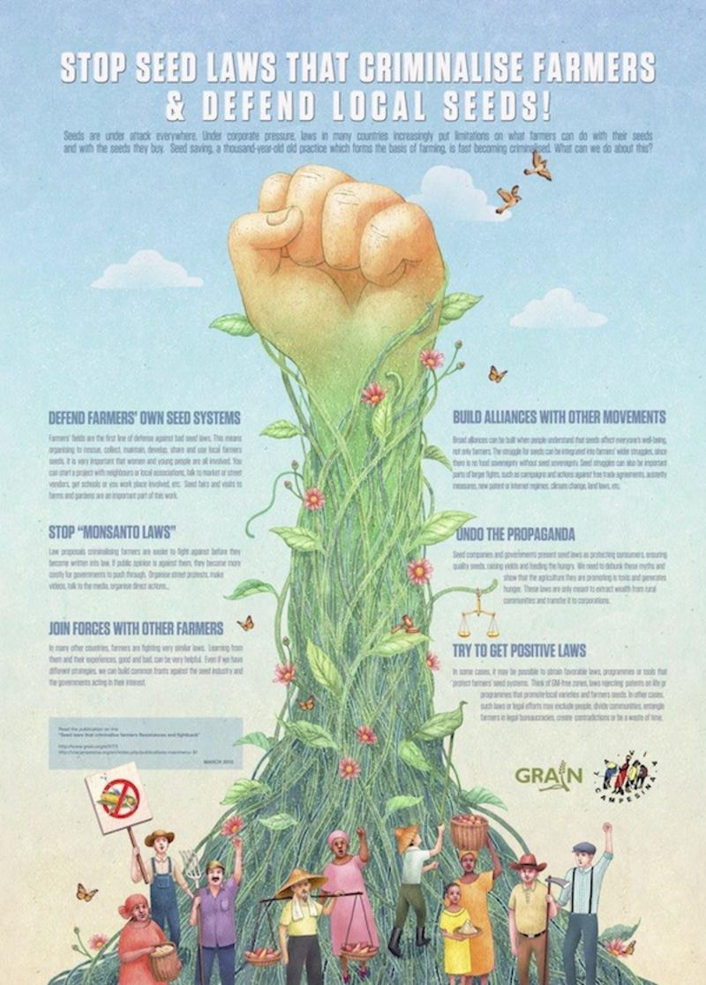
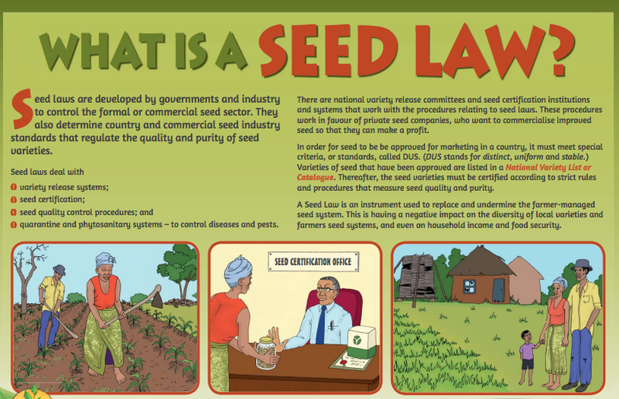

Slide 5
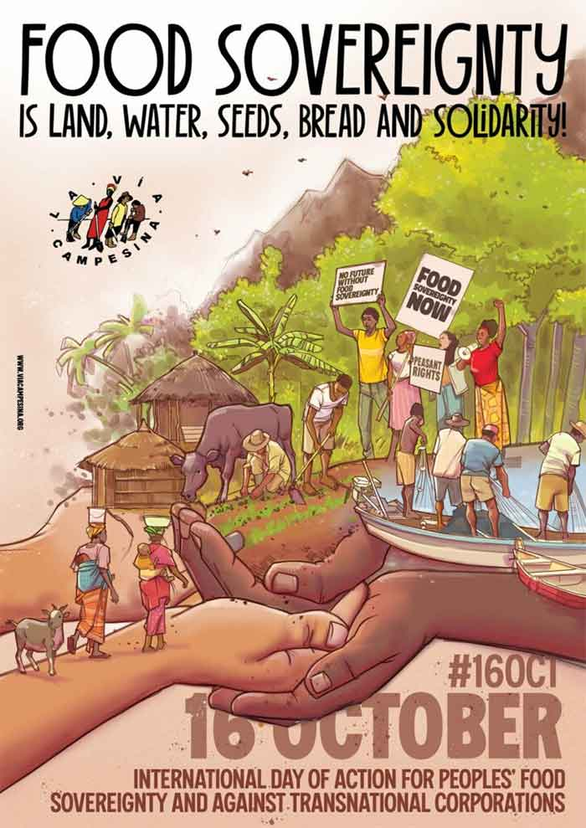
Issues / Concerns regarding Indigenous Seeds & Seed Savers
Conservation of Heirloom Seeds by Communities. Conservation of Traditional Seed varieties being up by research institutes
Big Private Players and Global Policy
Role of Civil Society Organisations to strengthen farmers’ networks
Markets demands and pressures
GMO debates : Involves the digitizing of the genetic sequence information of seed/plant varieties. This Digital Sequence Information (DSI) is being used by corporations for selective manipulation to claim patents/Intellectual Property Rights (IPR).
WHY IS A WIDER NETWORK NEEDED? WHAT ROLE CAN IT PLAY?

Slide 6
Declaration on Seeds and Farmers’ Rights, 2023
by Bharat Beej Swaraj Manch | Sep 9, 2023
Seeds and plant propagation materials, is our collective heritage. It is our duty to preserve them for future generations.
International treaties and national laws have failed to effectively safeguard our rich heritage of plant varieties; and the registration of heritage crop varieties in private names under ‘Protection of Plant Varieties and Farmers’ Rights Act’(PPVFRA), violates our traditional collective rights.
We assert our sovereign rights to freely plant, use, reproduce, select, adapt, save, share, exchange or sell our seeds, without restriction, and we resolve to work for the decentralized conservation, regeneration and sharing of our biodiversity by farmers, gardeners and indigenous communities.
WHAT ARE THE EXPERIENCES FROM YOUR AREAS?
WHAT ARE THE THREATS TO SEED DIVERSITY?

Slide 7
Declaration on Seeds and Farmers’ Rights, 2023
by Bharat Beej Swaraj Manch | Sep 9, 2023
We reject attempts to privatize/usurp India’s genetic commons and bio-cultural heritage, and create Intellectual Property rights over life forms.
We believe the state must safeguard natural farming rights, prevent any theft or bio-piracy of our genetic wealth.
A National Bio-safety law and mechanism for its effective implementation is essential to comprehensively guard against the threat of GMOs, GEOs, and technologies like CRISPR.
ARE OUR COMMUNITIES MOVING AWAY FROM NATURAL FARMING AND INTO MORE CHEMICAL FARMING?
WHAT ARE THE MARKET PRESSURES IN YOUR AREA?
ARE THERE BIG PLAYERS WHO ARE INFLUENCING FARMERS & BREEDERS BEHAVIOUR?

Slide 8
Declaration on Seeds and Farmers’ Rights, 2023
by Bharat Beej Swaraj Manch | Sep 9, 2023
We call upon the Indian government to create an open-source National Biodiversity Heritage Registry, protected from any private/corporate Intellectual Property Rights (IPRs); and to aid collaborative documentation and sharing of our biodiversity and related knowledge.
Indigenous/local communities stand for continued community access and community benefit.
We call upon all concerned citizens to join in a people’s movement to document, publish, propagate and share our collective wealth of biodiversity, knowledge and bio-culture wherever possible!
WHAT ARE THE ACCESS AND BENEFIT SHARING MECHANISMS IN YOUR COMMUNITIES CURRENTLY?
WHAT KIND OF DOCUMENTATION MEASURES WILL BE USEFUL IN YOUR AREAS?

Slide 9
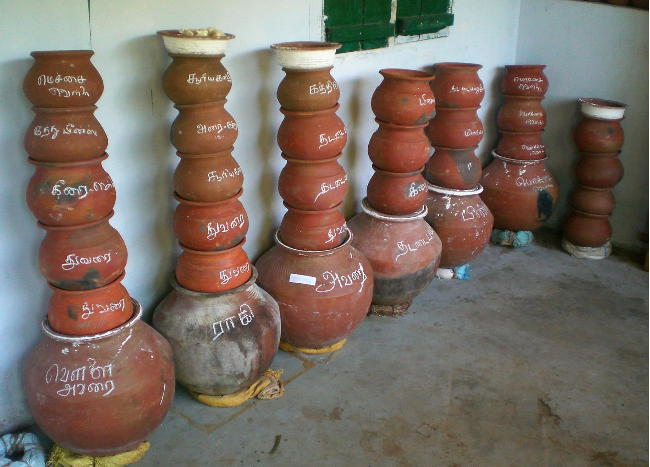
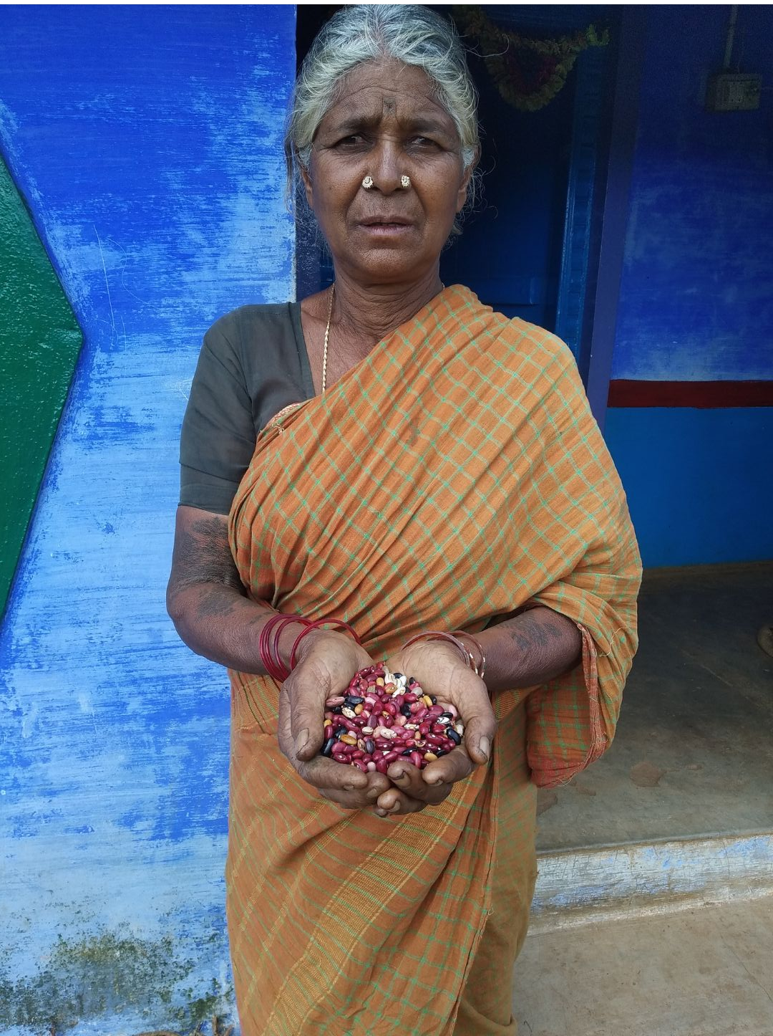
Community Conservation Measures
HAVE LOCAL DIETS CHANGED DRASTICALLY? ARE TRADITIONAL SEEDS EASILY ACCESSIBLE?
WHAT KIND OF SEEDS’ CONSERVATION INITIATIVES ARE BEING TAKEN UP IN YOUR AREAS?
CAN NETWORKS EXIST AND CAN WE STRENGTHEN THEM?

